Slide 1
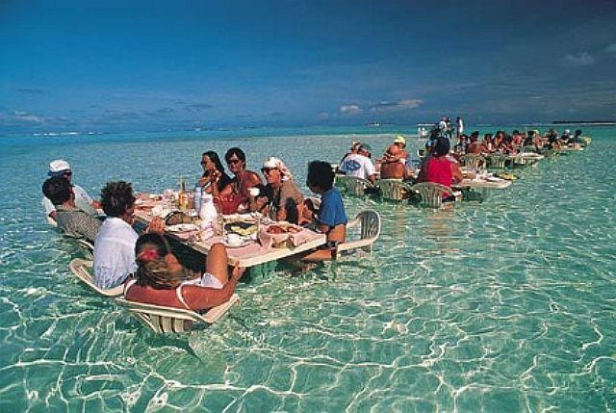
Was Man more aquatic in the past?
Mario Vaneechoutte
Mario.Vaneechoutte@ugent.be
Marc Verhaegen
October 26th 2012
MidPacific Conference on Primal Birth Health
Honolulu, Hawai

Slide 2
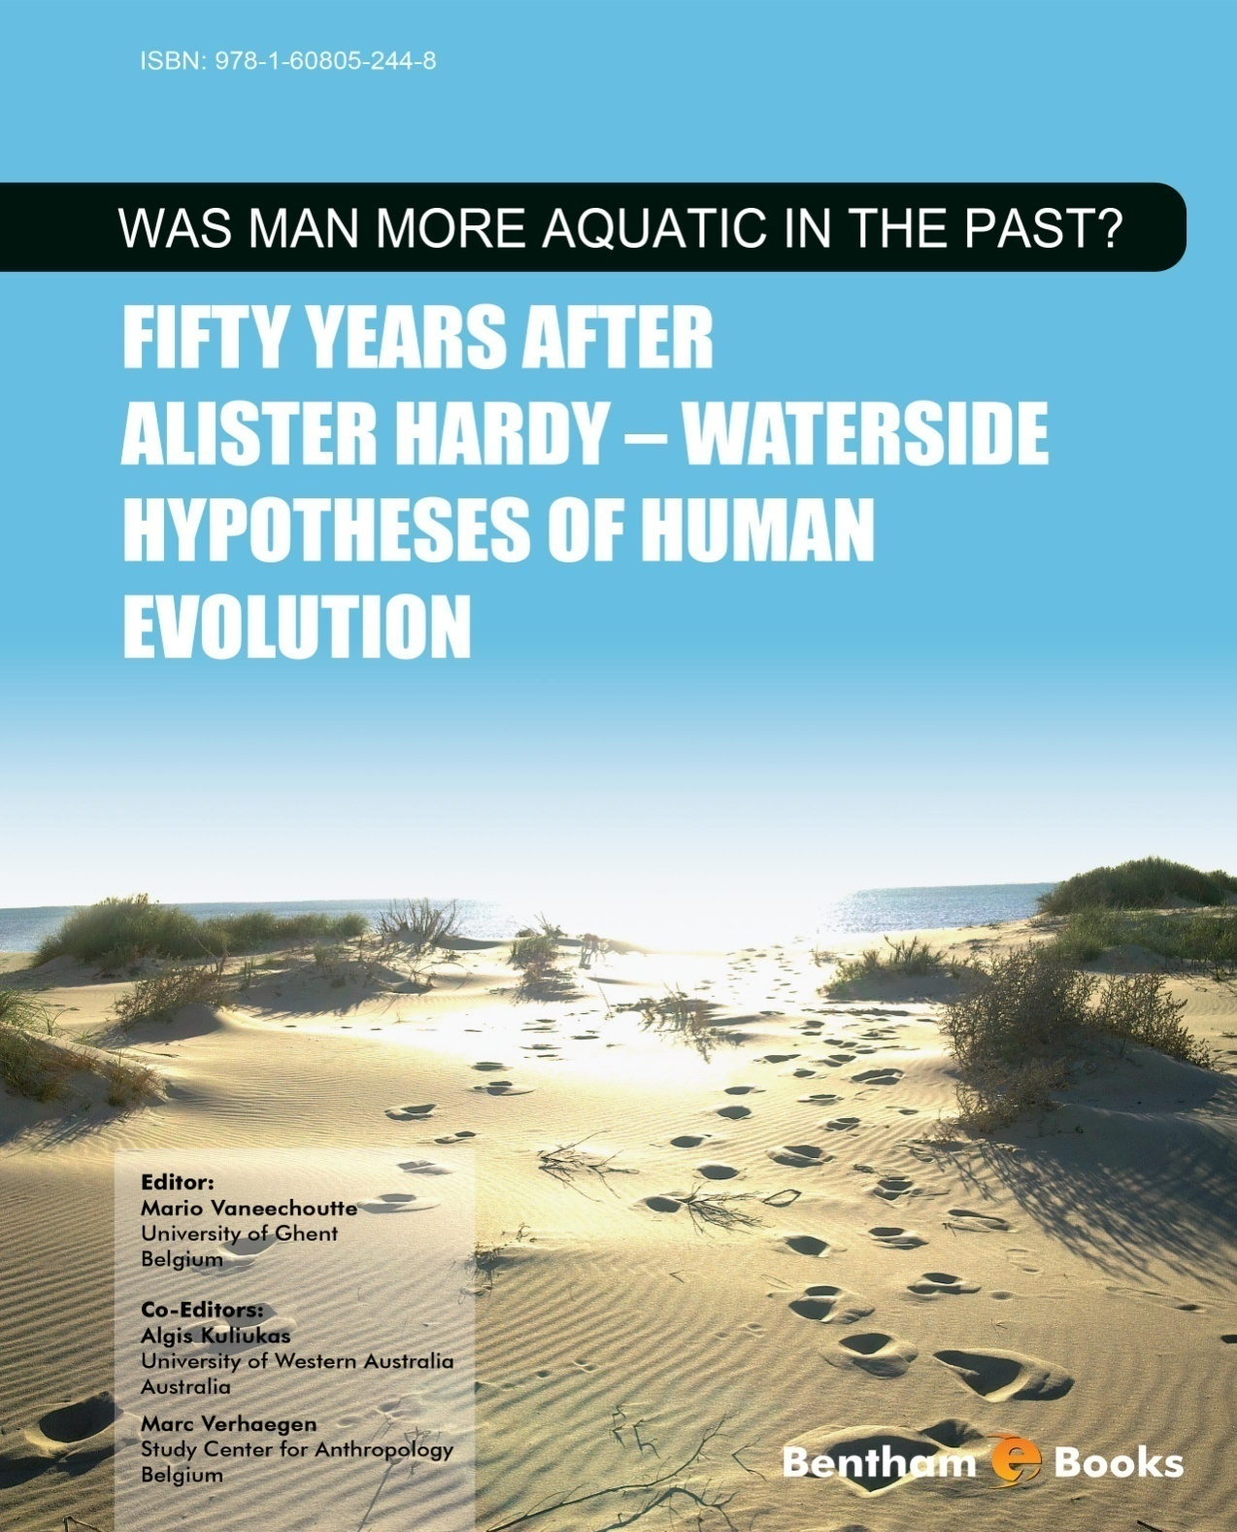

Slide 3
Homo sapiens is a very special species
Walking fully upright: orthograde (<> simply bipedal)
Large brain (3 times larger than chimp and gorilla)
Speech ¹
→ Thinking 'about': Reflexive awareness (Consciousness) ^{2, 3}
→ Thinking about the future
→ Religiosity ⁴
→ Science, technology
1. Vaneechoutte, M. & J.R. Skoyles. 1998. The memetic origin of language: humans as musical primates.
J. Memetics - Evolutionary Models of Information Transmission 2
2. Vaneechoutte, M. 2014. The origin of articulate language revisited. J. Hum. Evol. 29: 1-33.
3. Vaneechoutte, M. 2000. Experience, awareness and consciousness:
suggestions for definitions as offered by an evolutionary approach. Foundations of Science 5: 429-456.
4. Vaneechoutte, M. 1993. The memetic basis for religion. (Correspondence Letter). Nature 365: 290.

Slide 4
Homo sapiens is an extremely special primate/animal
1. Only fully upright vertebrate animal (except penguins?)
2. Furless: naked
3. Streamlined
4. Subcutaneous fat/ Extremely fat (and helpless?) neonates
5. Our bodies are wasteful with water and salt
Sweat glands all over the body
Multipyramidal kidneys
6. External nose - everted lips - philtrum - mouth breathing
7. Voluntary breath control/Strong diving reflex
8. Reduced colour vision
9. Reduced olfactory capacity (smell)
10. Increased manual dexterity and tactility
11. Sexuality: Face-to-face mating - Hymen - Menstrual cycle – Low vaginal pH
12. Large brains/Need for ω3 fatty acids and iodine
13. Song and Speech
The Aquatic Hypothesis (AH) claims that many/most/all of these characteristics
are most straightforwardly explained
by assuming that they evolved as adaptations to a wading/swimming/diving lifestyle
of our direct hominin ancestors, between 5 million and 200 000 years ago.

Slide 5
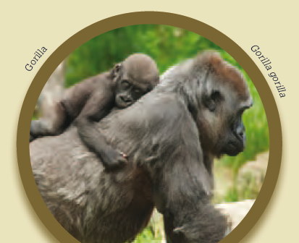
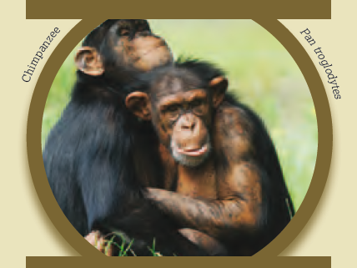
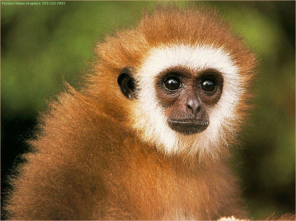
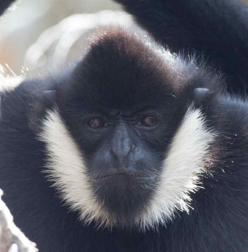
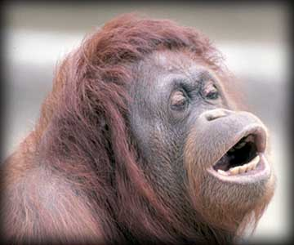
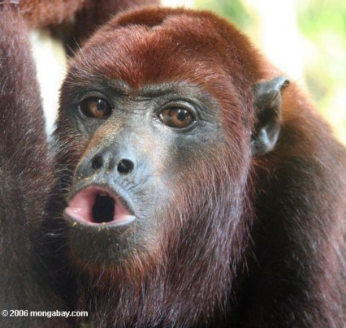
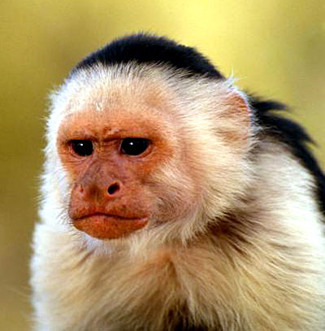
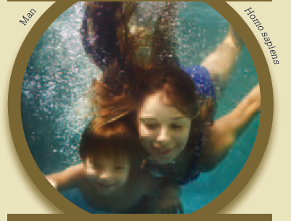
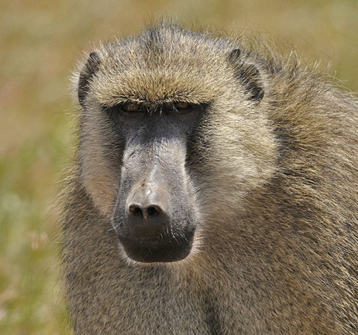
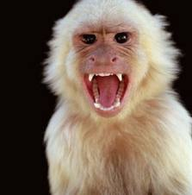
Homo sapiens is an extremely special primate/animal

Slide 6
Introduction:
Reactions to the notion that our ancestors may have been more aquatic
Reaction 1.
"Of course. I knew that already: All animals originated from the water."
But: the AAH is not about the transition from fish to amphibian,
which took place 400 million years ago (mya),
but about the transition from ape to human, from only 7 mya onwards.
Fish: fully aquatic (except for example lung fish)
→ Amphibians: amphibious = semi-aquatic: 400 mya (Devonian)
→ Reptiles: ancestor is fully terrestrial: 320 mya (Carboniferous)
→ Birds: ancestor is fully terrestrial 150 mya (late Jura)
→ Mammals: ancestor is fully terrestrial 220 mya (Trias)
Hominoids (Apes): ancestor is (aqu?)arboreal 27 mya (Oligocene)
Latest ancestor gorilla - chimp - humans: 7-10 mya
Semi-aquatic phase of direct human ancestors: 7-10 mya: Morgan
< 2-0.2 mya ago: Verhaegen

Slide 7
Introduction:
Reactions to the notion that our ancestors may have been more aquatic
Reaction 2:
"Going back to the water: what a crazy idea!"
In fact, transitions between different habitats happen all of the time during evolution.
Moreover: it is a driving force for innovation in evolution
When not specialized too strongly, animal groups may switch
water, land, tree, air habitats, when environmental conditions are changing
Reptiles
land to land-water: Ichtyosaurus (†), Mosasaurus (†),
tortoises, crocodiles, sea leguans, water snakes
land to land-air: Pterosaurus (†), Archaeopteryx (†), birds
Birds (bipedal)
land-air to land: ostriches, kiwi, dodo (†)
land-air to land-water: penguins
Mammals
land to air: bats
land to water: deep water: Cetacea: dolphins, whales
shallow water: Sirenia [sea cows]: dugongs and manatees
land to land-water: seals, sea lions, walruses, hippopotamus, ancestors (†) of elephants & pigs
Homo erectus? (†) (2 million – 50 000 years ago)
land-water to land: elephants, pigs
Homo sapiens? (200 000 years ago – present)

Slide 8
Introduction:
Reactions to the notion that our ancestors may have been more aquatic
Reaction 3:
"What an odd proposition!:
The AH states that a) we first were arboreal quadrupedal apes,
thereafter b) we went to the sea and turned into dolphins,
and c) then came back on land to look like chimps again.
In fact,
a) We started from aquarboreal (bipedal) apes, not arboreal (quadrupedal) apes
b) That we were once fully aquatic is not a claim of the AH.
Indeed, Hardy only asked: "Was Man more aquatic?"
c) We don’t look very much like chimps
Notes:
AD. 2007. page 176: De oceanograaf Alister Hardy. Hardy was a marine biologist.

Slide 9
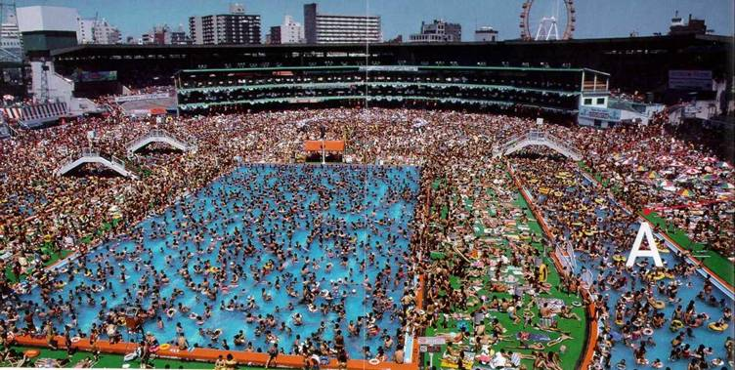
Introduction:
Reactions to the notion that our ancestors may have been more aquatic
Reaction 4:
"Quite unlikely!
Apes, and many humans are afraid of water and are poor swimmers."
Elaine Morgan: 'Hotel rooms with a sea-view are the most expensive ...'
Our fondness of water may be noticed from the illustration below:

Slide 10
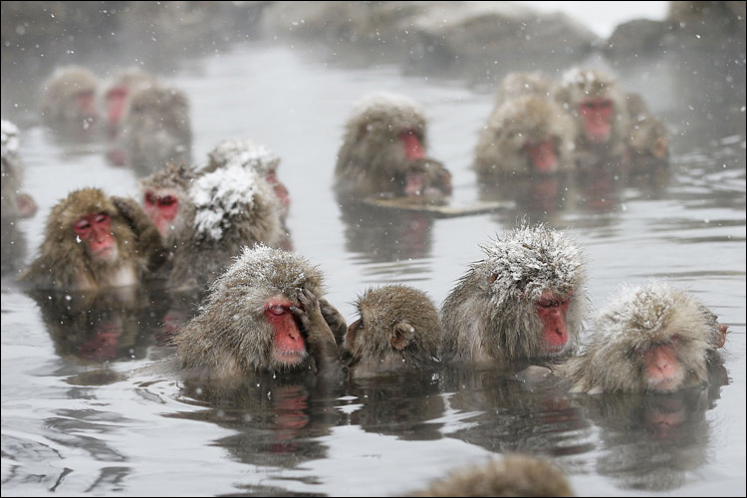
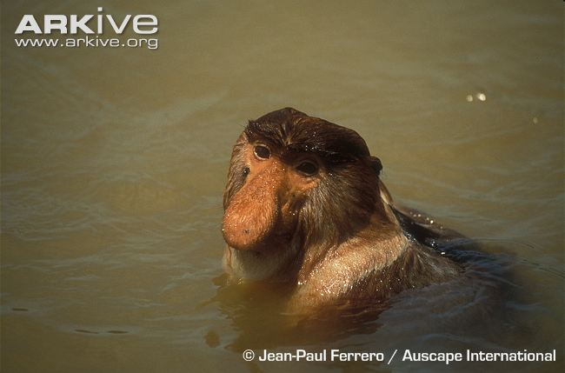
Introduction:
Reactions to the notion that our ancestors may have been more aquatic
Reaction 4:
"Quite unlikely!
Apes, and many humans are afraid of water and are poor swimmers."
Some examples of swimming/bathing monkeys
Japanese macaques bathing in hot spring
Swimming proboscis monkey

Slide 11
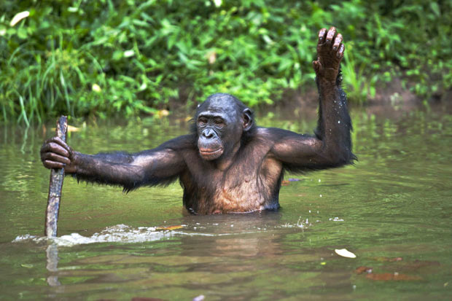
Introduction:
Reactions to the notion that our ancestors may have been more aquatic
Reaction 4:
"Quite unlikely!
Apes, and many humans are afraid of water and are poor swimmers."
Some examples of wading apes (hominids)
Wading bonobo with stick
Wading lowland gorilla

Slide 12
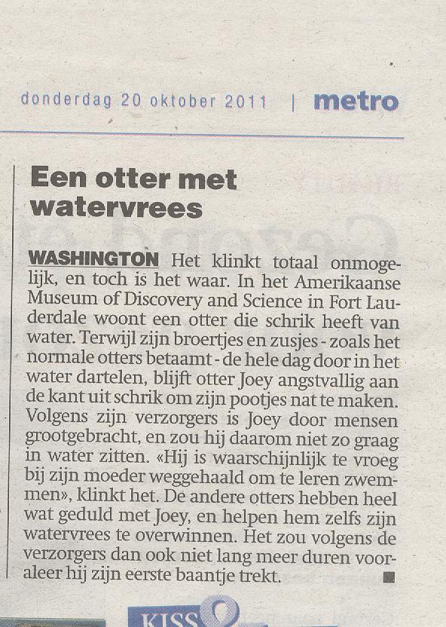
Introduction:
Reactions to the notion that our ancestors may have been more aquatic
Reaction 4: "Quite unlikely!
Apes, and many humans are afraid of water and are poor swimmers.
We have to learn to swim."
But Hardy remarked:
Hardy A. 1960. Was Man more aquatic in the past? New Scientist 7: 642-645.

Slide 13
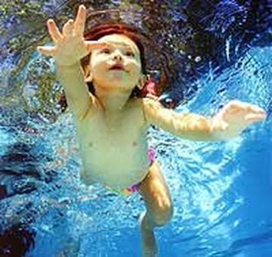
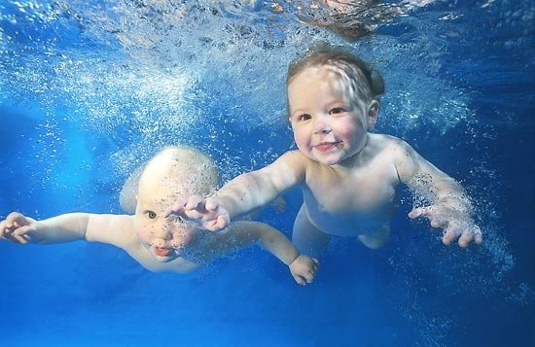
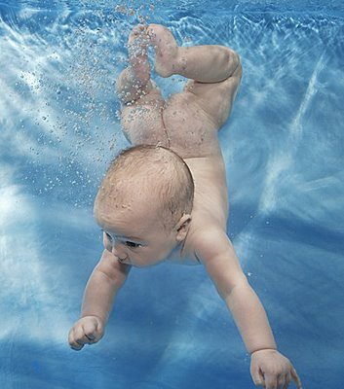
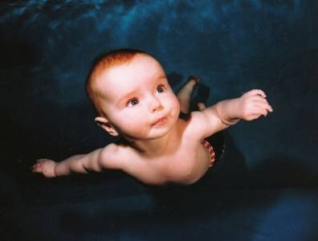
Reaction 4: "Quite unlikely!
Apes, and many humans are afraid of water and are poor swimmers.
We have to learn to swim...."
Hardy A. 1960. Was Man more aquatic in the past? New Scientist 7: 642-645.
For the sake of animal wellfare:
Don't try this with chimp babies!

Slide 14
Reaction 4: "Quite unlikely!
Apes, and many humans are afraid of water and we are poor swimmers."
In fact: we are excellent divers and swimmers and can support apnea during long periods
Current world records
Discipline | Aim | Method | Male record | Female record
Static apnea (STA) | duration | apnea at rest floating in a pool | 11’ 35” | 8‘ 23’’
Dynamic apnea with fins (DYN) | distance | horizontal swimming in a pool with fins | 265 m | 225 m
Dynamic apnea without fins (DNF | distance | horizontal swimming in a pool without fins | 218 m | 160 m
Constant weight with fins (CWT) | depth | vertical swimming down and up with fins | 124 m | 101 m
Constant weight without fins (CNF) | depth | vertical swimming down and up without fins | 95 m | 62 m
Free immersion (FIM) | depth | pulling down and up on a rope | 120 m | 85 m
Schagatay E. 2011. Chapter 7. In: WMMA?

Slide 15
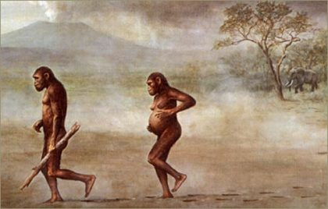
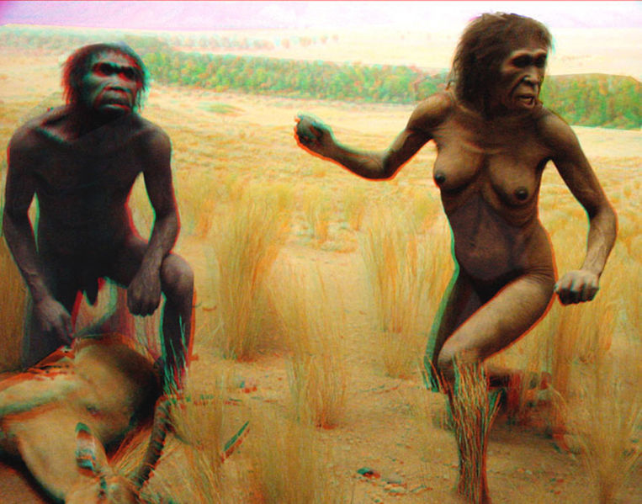
Introduction:
Reactions to the notion that our ancestors may have been more aquatic
Reaction 5:
"No way! Everyone knows that our ancestors were
savannah hunters and long distance runners"

Slide 16
Introduction:
Reactions to the notion that our ancestors may have been more aquatic
Reaction 5:
"No way! Everyone knows that our ancestors were savannah hunters.
long distance runners"
In fact, the 'savannah hypothesis' (open plains) has been long abandoned
(only: few people seem to realize that!?)
Quotes from Morgan. 1997. The aquatic ape hypothesis. p. 17:
Leakey R, Lewontin R. 1992. Origins reconsidered, p. 85. Little Brown, London.
"In fact, the immense plains and the immense herds on them
are relatively recent aspects of the African environment,
much more recent than the origin of the human family."
Wood B. 1996. Nature 379: 687
"The savannah 'hypothesis' of human origins, in which the cooling climate begat
the savannah and the savannah begat humanity, is now discredited."
Hunt KD. 1994. J Human Evol 26: 191.
"Recent evidence suggests that the common supposition that australopithecines
were grassland adapted is incorrect."
Tobias PV. 1995. Daryll Forde Memorial Lecture. Univ College London.
"All the former savannah supporters (including myself) must now swallow our earlier
words in the light of the new results from the early hominid deposits.
Of course, if savannah is eliminated
as a primary cause or selective advantage of bipedalism,
then we are back to square one
and have to try to find consensus on some other primary cause."

Slide 17
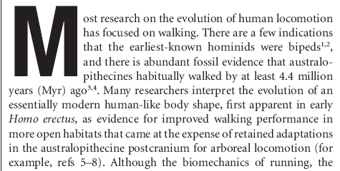
Introduction:
Reactions to the notion that our ancestors may have been more aquatic
Reaction 5:
"No way! Everyone knows that our ancestors were savannah hunters."
In fact, the savannah hypothesis has been long abandoned
(only: few people seem to realize that!?)
Bender R, Tobias PV, Bender N. 2012.
The savannah hypotheses: Origin, reception and impact on paleoanthropology.
Hist Phil Life Sci 34: 147-184.

Slide 18
Introduction:
Reactions to the notion that our ancestors may have been more aquatic
Reaction 6:
"Going from trees to land, over water, is not parsimonious"
Law of parsimony (Occam's razor)
is a principle that generally recommends selecting the one competing hypothesis
that makes the fewest new assumptions, when more hypotheses are equal in other respects.
1. It is a useful principle to approach evolutioniary dynamics.
But it is not a dogma!
2. Indeed, some monkeys went directly from tree to savannah:
baboon, vervet monkey, marmoset monkey:
→ they are quadrupedal, fully haired, large snouts, ...
3. Did we go from tree to water to land?
Or rather?: from tree-water (LCA) to water-land (H. erectus) to land-water (H. sapiens)

Slide 19
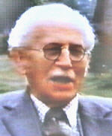
Introduction:
Brief history of the idea
Sir Alister Hardy
(1896-1985)
Sir Alister Hardy. A marine biologist.
He based his ideas on those of Wood Jones (1929),
who specifically focused on our skin:
naked, thick and with subcutaneous fat.
After he noticed the subcutaneous blubber of marine animals.
1960. (And … after having kept these ideas 30 years for himself ...):
"I have been toying with this concept of Man's evolution for many years,
but until this moment, which suddenly appeared to be an appropriate one,
I had hesitated because it had seemed perhaps too fantastic;
yet the more I reflected upon it,
the more I came to believe it to be possible, or even likely."
Picked up by Desmond Morris in some of his documentaries.
This inspired Elaine Morgan (1972), feminist journalist.
Her books have inspired several others.
Wood Jones F. 1929. Man's place among the mammals. Edward Arnold, London.
Hardy A. 1960. Was Man more aquatic in the past? New Scientist 7: 642-645.
Morgan E. 1972. The descent of woman. Stein and Day, New York.

Slide 20
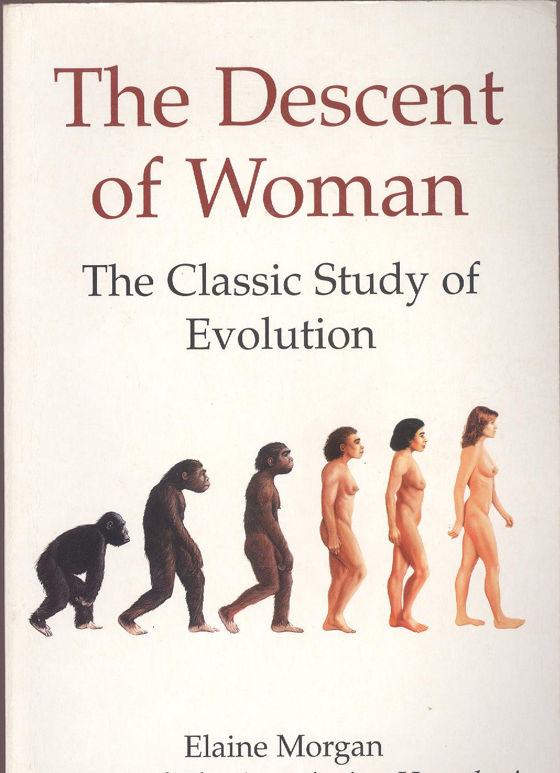
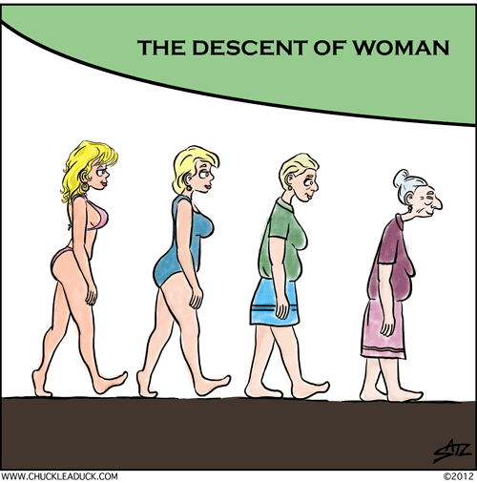
Introduction:
Brief history of the idea
Morgan E. 1972. The descent of woman. Stein and Day, New York.

Slide 21
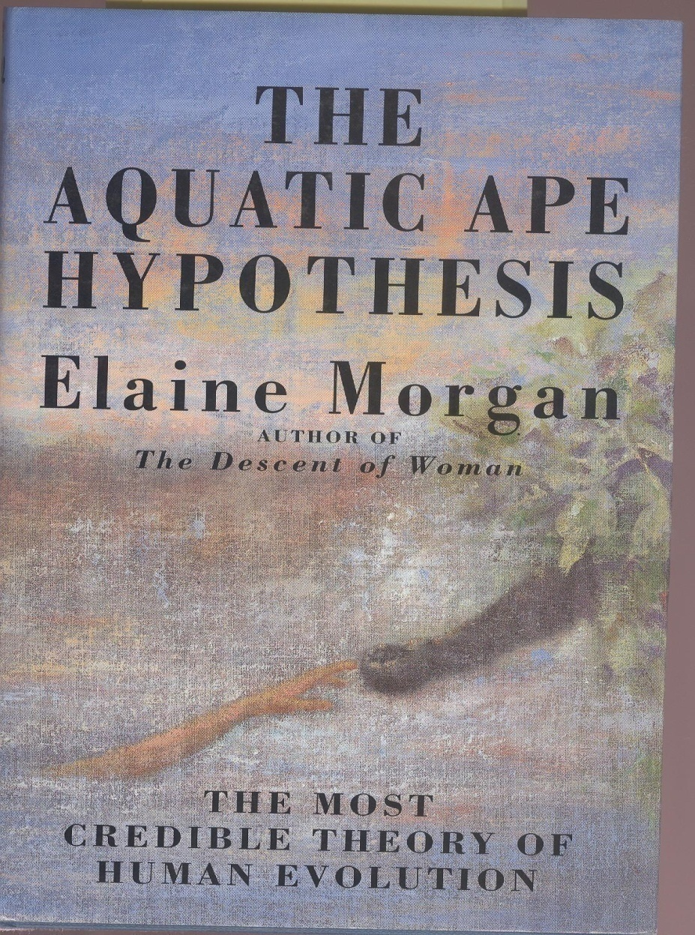
Introduction:
Brief history of the idea
Morgan E. 1997. The aquatic ape hypothesis. Souvenir Press, London.

Slide 22
Introduction:
Brief history of the idea
Verhaegen, M. 1997. In den beginne was het water. Hadewijch, Antwerpen

Slide 23
Introduction: extant primates
'Half apes': galago, indri, maki, lemur
Monkeys:
New World: S. American primates: capucine, tamarin
Old World: vervet monkey, marmoset,
proboscis monkey, baboon, macaque
Monkeys
Apes (Hominoids):
Hominids:
(great apes)
orangutan (Asia)
Gorilla
chimp (Pan)
man (Homo)
Hylobatidae
(lesser apes)
gibbon (Asia)
siamang (Asia)
Hominoids
Notes:
Hominins: lineage of hominids leading to our species. Because this term already makes assumptions, some of which we doubt, we will avoid the use of this term. For example, according to current standard theory, australopithecines are our ancestors and therefore hominins, but Marc Verhaegen disputes this assumption.

Slide 24
Homo sapiens is an extremely special primate/animal
1. Only fully upright animal (except penguins?)
2. Furless: naked
3. Streamlined
4. Subcutaneous fat/ Extremely fat (and helpless?) neonates
5. Our bodies are wasteful with water and salt
Sweat glands all over the body
Multipyramidal reins
6. External nose - everted lips - philtrum -mouth breathing
7. Voluntary breath control/Diving reflex
8. Reduced colour vision
9. Reduced olfactory capacity (smell)
10. Increased manual dexterity and tactility
11. Sexuality: Face-to-face mating - Hymen - Menstrual cycle
12. Large brains
13. Sea food, Song and Speech

Slide 25
Humans are extremely special primates/animals
1. The only fully upright terrestrial bipedals
bipedality is not synonymous to fully upright ( = orthograde) posture
bipedals not fully upright: dinosaurs → birds
kangooroo, jumping mice
occasionally upright bipedal mammals: bears, bush antilopes, mangust, otter
occasionally upright bipedal primates: gibbon, long-nosed monkey, gorilla, bonobo
! Wading is not a sufficient
explanation for
full uprightness ...
Notes:
Adriaens. 2007. Page 176: 'De semi-aquatische levenswijze werd ook in verband gebracht met de evolutie naar bipedale locomotie, aangezien de mensachtigen het lichaam rechtop dienden te houden in het water om te kunnen ademen'
This does not explain fully upright posture. Diving and swimming do.

Slide 26
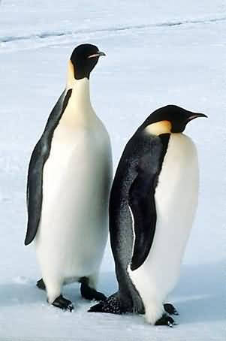
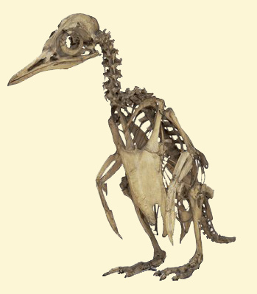
Humans are extremely special primates/animals
1. Humans are the only fully upright terrestrial bipedal animals
One exception: penguin → semi-aquatic well-adapted diver
→ started from a bipedal ancestor (bird)

Slide 27
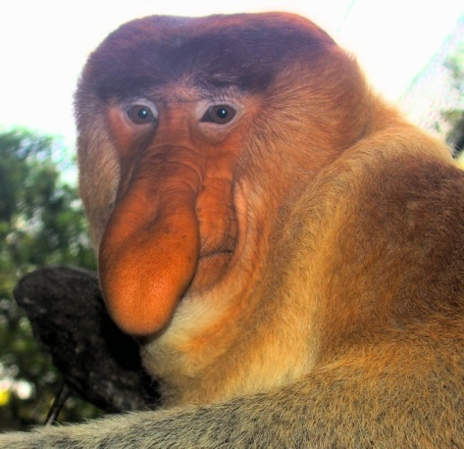
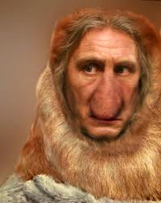
Humans are extremely special primates/animals
1. The only fully upright terrestrial bipedals
Exception? One monkey walks frequently upright
The proboscis monkey (Nasalis larvatus) or long-nosed monkey
a reddish-brown aquarboreal monkey, endemic to Borneo.
The Proboscis monkey's lifestyle is both arboreal and amphibious,
with its mangrove swamp and riverine environment containing
forest
dry land
shallow water allowing wading
deep water requiring swimming.
Like other monkeys, the Proboscis monkey climbs well.
Proficient swimmer, often swimming from island to island.
Has been picked up by fishing boats in open ocean a mile from shore.
While wading, the monkey uses an upright posture,
with the females carrying infants on their hip.
Troops have been filmed continuing to walk upright, in single file
The only non-human mammal, with the exception of gibbons and giant pangolins
known to use this form of locomotion on land for any length of time.
http://en.wikipedia.org/wiki/File:Portrait_of_a_Proboscis_Monkey.jpg
Notes:
Adriaens. 2007. Carrying hypothesis to explain bipedality.

Slide 28
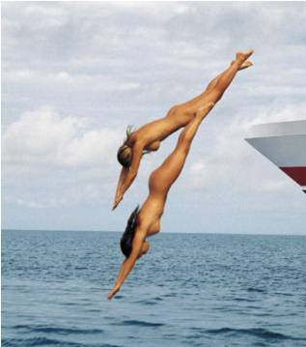
Humans are extremely special primates/animals
2. Furless: naked

Slide 29
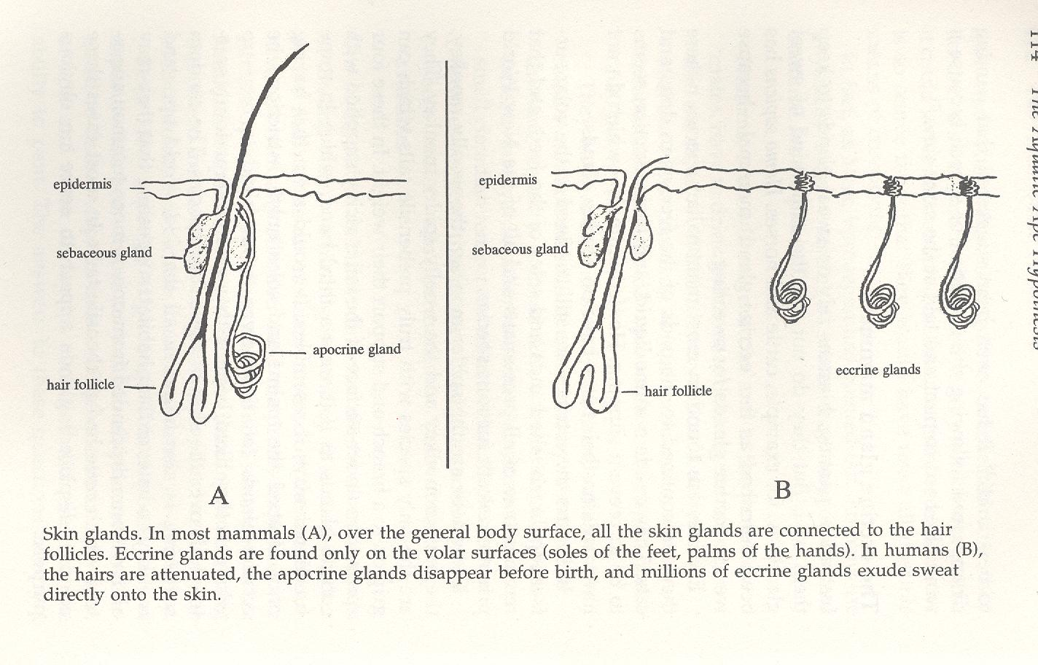
Humans are extremely special primates/animals
2. Furless: naked
Very special skin, compared to terrestrial mammals and primates:
hairs: strongly reduced
sebaceous glands: numerous, very active: for waxening the naked skin
apocrine glands: disappear before birth
eccrine glands: all over, instead of only at pads of hands and feet
Land mammals, apes Humans
Sebaceous
glands
Sebaceous
glands
Apocrine
glands
Eccrine glands
Morgan E. 1997. AAH

Slide 30
Humans are extremely special primates/animals
3. Streamlined
Morgan E. 1997. AAH

Slide 31
Humans are extremely special primates/animals
3. Streamlined
The hairs that we have left, grow in an orientation, unseen in other primates
Hardy suggested that this might have evolved for reduced drag while swimming in water:
"particularly to be noted are the hairs on the back, which are all pointing in lines to meet diagonally towards the mid-line, exactly as the streams of water would pass round the body and meet, when it is swimming forward like a frog.
Such an arrangement of hair, offering less resistance,
may have been a first step in aquatic adaptation before its loss."
Chimp Human
Human
Morgan E. 1997. AAH

Slide 32
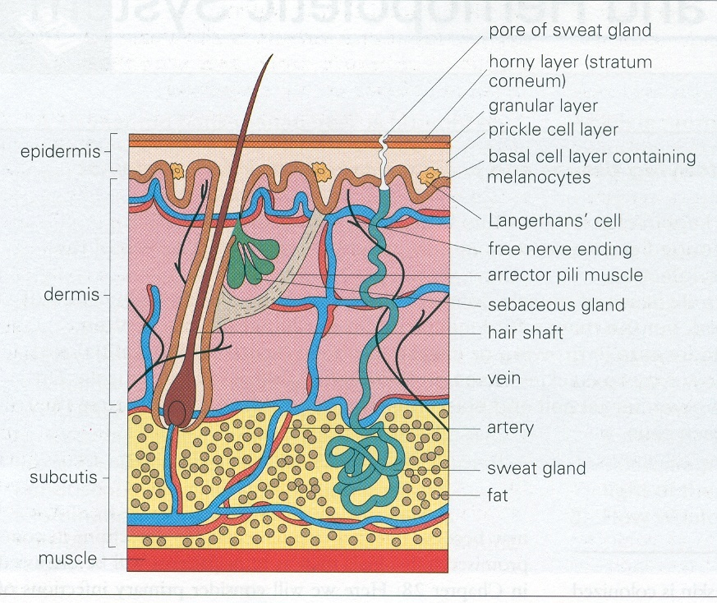
Structure of human dermis
Humans are extremely special primates/animals
4. Fat
(hypodermis)
Eccrine glands

Slide 33
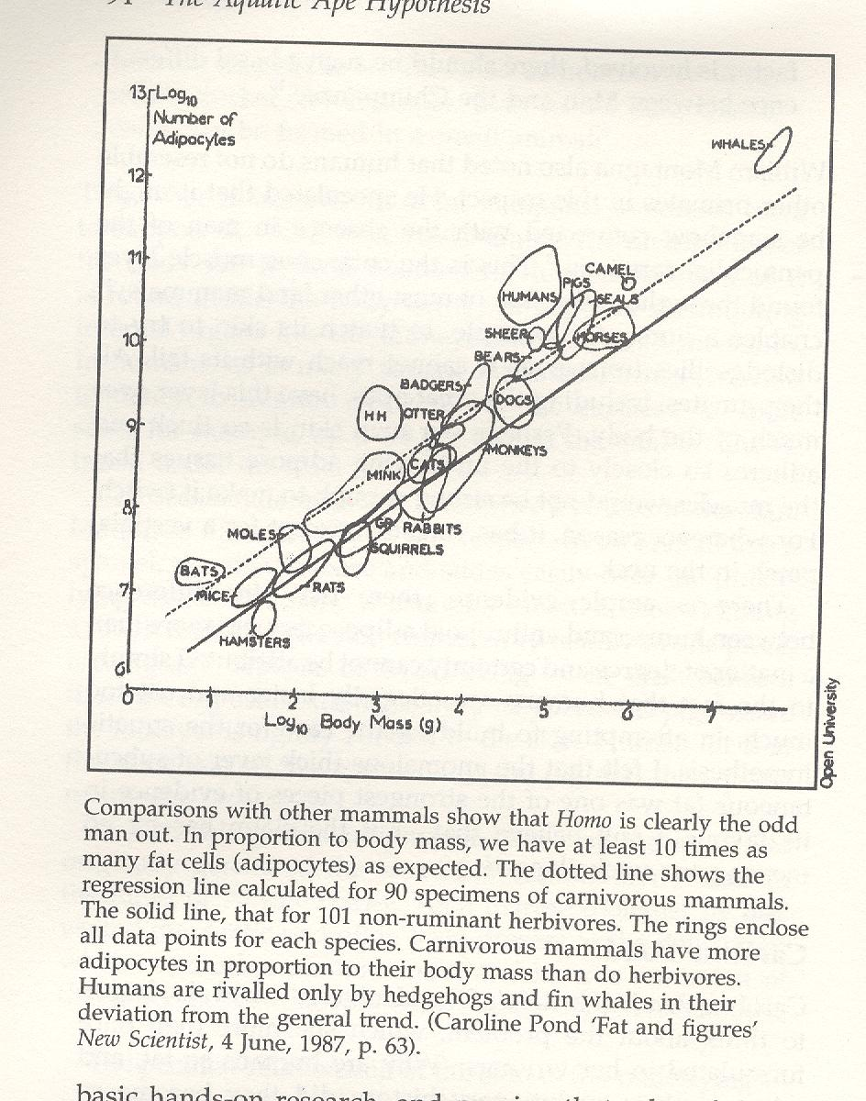
Humans are extremely special primates/animals
4. Fat
Number of adipocytes (fat cells)/log body mass (g)
Whales
Humans
Hedgehog
Monkeys
Strong difference between humans and 'monkeys'
Much fat in hibernators: hedgehog, badger, bear, bat
Most fat in whales, seals, pigs and humans. (Also camels ...)
Morgan E. 1997. AAH

Slide 34
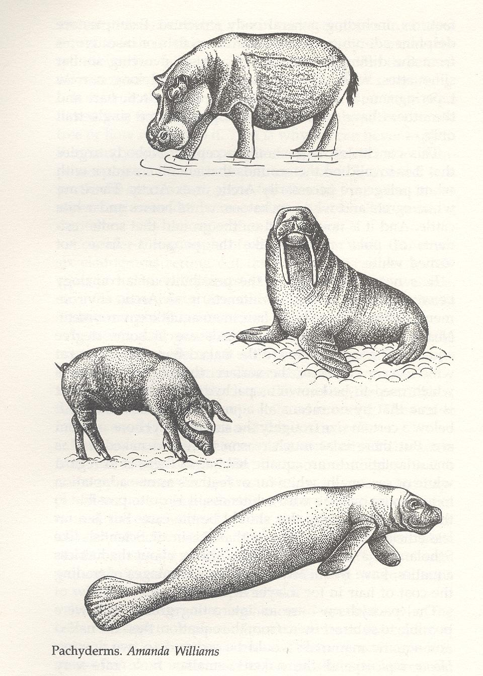
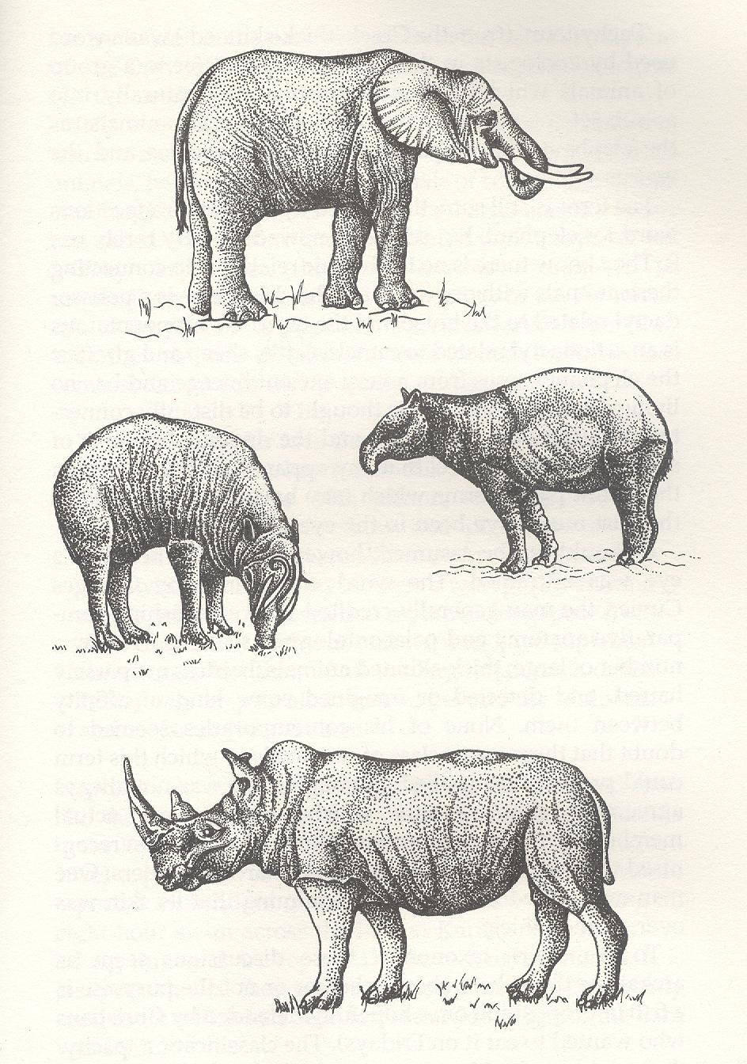
Humans are extremely special primates/animals
4. Fat
Naked, fat, big: who else?
'Pachyderms' (Cuvier)
And of course: whales and dolphins: + streamlined
Fully aquatic
Semi-aquatic
Aquatic
relatives/
ancestors
Terrestrial
Manatee
+ streamlined
Morgan E. 1997. AAH

Slide 35
Humans are extremely special primates/animals
4. Fat
Is an aquatic explanation plausible for all this fatness and nakedness?
Fatness: Fat insulates best in water
Fat provides buoyancy (floating)
Furlessness: Fur insulates by trapping air
→ Wet fur looses its insulation capacities
Nakedness increases streamline in water
An aquatic explanation for the food source that can provide
all this [special] fat (8% of brain: omega 3): see Nutrition 12. Large brains
Several sea mammals still have fur:
contradicts nakedness for swimming?
possible explanation:
mostly arctic species with ancestors from Artiodactyla/Carnivora,
whereas we stem from tropical ancestors
belonging to another order (Primates)

Slide 36
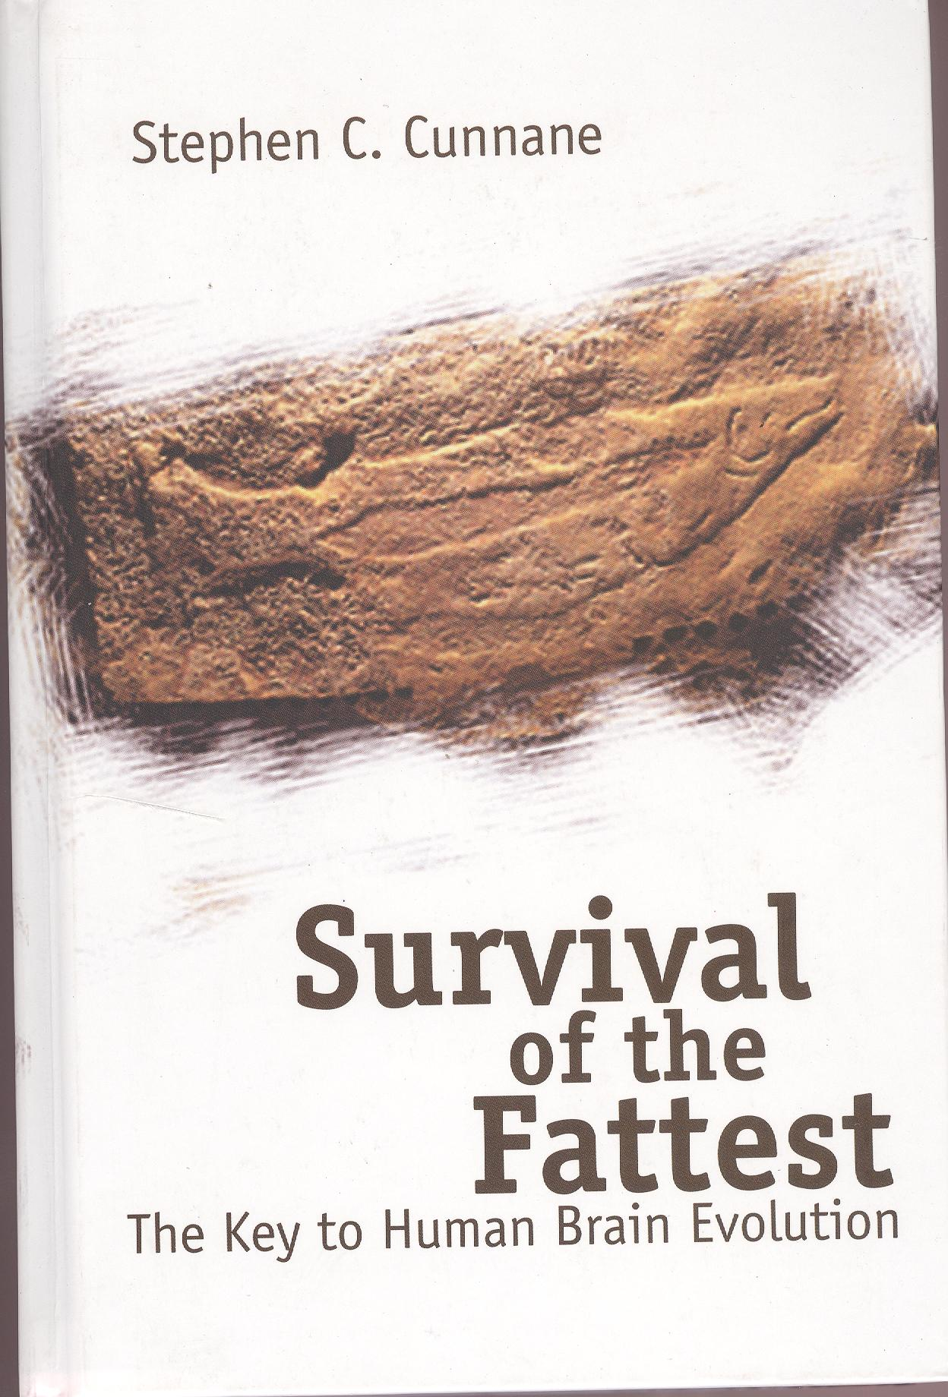
Humans are extremely special primates/animals
4. Fat
Cunnane: Our neonates are extremely fat: essential for brain development
Cunnane SC. 2005. Survival of the fattest. World Scientific, New Jersey

Slide 37
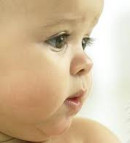
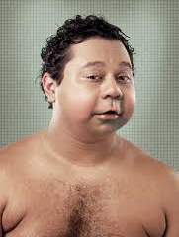
Humans are extremely special primates/animals
4. Fat
Cunnane: Our neonates are extremely fat: essential for brain development
Compare to skinny chimp neonates

Slide 38
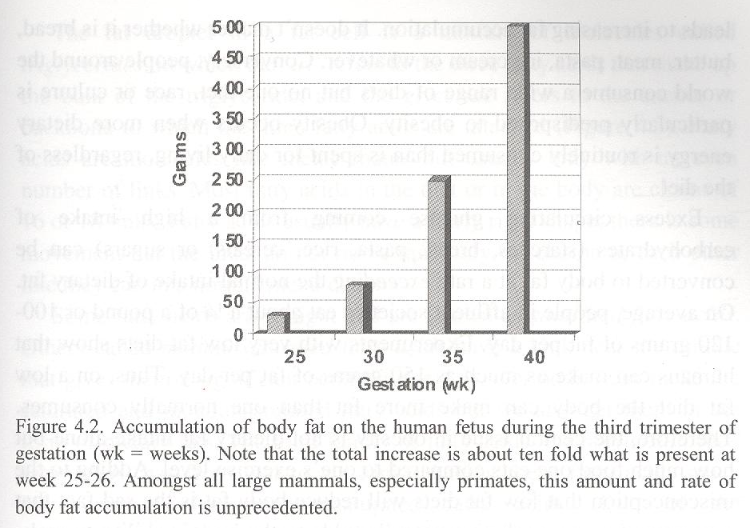
Humans are extremely special primates/animals
4. Fat
Cunnane: Our neonates are extremely fat: essential for brain development
Cunnane SC. 2005. Survival of the fattest. World Scientific, New Jersey

Slide 39
Humans are extremely special primates/animals
5. Our bodies are wasteful with water
and are not adapted for large water intake at once:
1. Land animals concentrate the urine to save water
Our urine is not concentrated:
Species | millosmol/l | Niche
Beaver | 550 | Sweet water
Pig | 1100 | Marshes
Human | 1400 | ?
Dolphin | 1700 | Sea water
Cat | 3200 | Land
Cangooroo Rat | 4600 | Desert
2. We sweat twice as much as camels, 5 times as much as horses (per surface of skin)
Most land mammals do not sweat at all.
3. Heavy illness of humans at 3% water depletion
Donkey, camel: only at 20% water depletion
4. Land animals drink large amounts of water
Humans need to drink often, but can take in only small amounts at the time

Slide 40
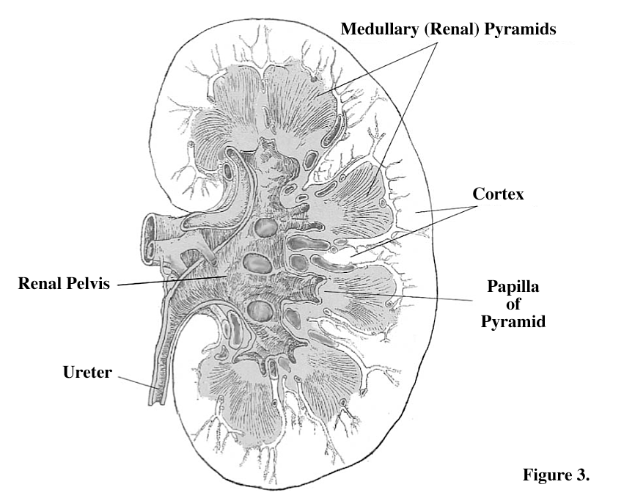
Humans are extremely special primates/animals
5. Our bodies are wasteful with water
We have multipyramidal kidneys, more like manatees than like apes
Marcel Williams. 2011. Chapter 8. In: WMMA?
"In this chapter, I argue that evolution of renal medullary pyramids in mammals
is an adaptive response to diets with exceptionally high salt contents and
that the existence of multiple renal medullary pyramids in humans was the result of
specialized coastal marine adaptations in the human evolutionary past."
apes: unipyramidal kidneys
humans: 8-18 medullary pyramids
camels/manatees: 6-11 medullary pyramids
whales, dolphins: hundreds of pyramids
Apes
Camel/Manatee
Human

Slide 41
Humans are extremely special primates/animals
5. Our bodies are wasteful with water
Sweating, crying and spitting
Sweating:
Our sweat may initially have served for removal of salt:
Salt content of sweat increases when eating more salt.
Secondary function (at land - after returning to land): cooling
Land mammals cool by panting,
which we can no longer do: as most aquatic mammals cannot.
Crying:
We are the only species with emotional tears: no explanation thus far.
Spitting:
We are the only species (except camelidae: stomach fluid) that spit.
We spit especially during exercise, and when salty sensation in mouth.
[Camels: drink brink water, eat halophytes: spitting is removal of salt?]
[Spitting towards opponent = aggressive, both in camelidae and humans]
Whatever the explanation for crying and spitting:
unconcentrated urination + sweating all over + spitting + crying = wasting water.
Unlike desert or land animals.
Notes:
Spitting is aggressive: idea came up in Honolulu at 01:27, October 26th 2012.
Adriaens. 2007.De uitgesproken aanwezigheid van zweetklieren zou dan het insulatieprobleem (ten gevolge van hypodermis (onderhuidse vetlaag) voor insulatie in water) kunnen opvangen als deze mensachtigen zich uit het water bevonden (en dus via zweten het lichaam koel konden houden).
Salt is recuperated in external channels of our eccrine glands, by inverted! CFTR channels. CFTR mutations, rendering the CFTR channel inactive, are frequent: homozygotes have cystic fibrosis or mucoviscidosis, with very salty sweat. Adaptation after returining to land?

Slide 42
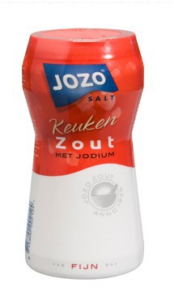
Humans are extremely special primates/animals
5. Our bodies are wasteful with water
Our bodies are wasteful with salt as well:
sweat, salty tears.
Advantageous when you are living in/at the sea
But problematic when you return to land: we crave for salt:
Salzburg: prehistoric salt mines
salary: salt = money ('salarius')
salt caravans
Vlaanderen 18°-19° Eeuw: zoutsmokkel!
!! modern humans: inverted CFTR channels in canals of the eccrine glands:
?? recent terrestrial evolution to regain excess of excreted NaCl?
Moreover: Sea salt is iodine rich. We add iodine to salt

Slide 43
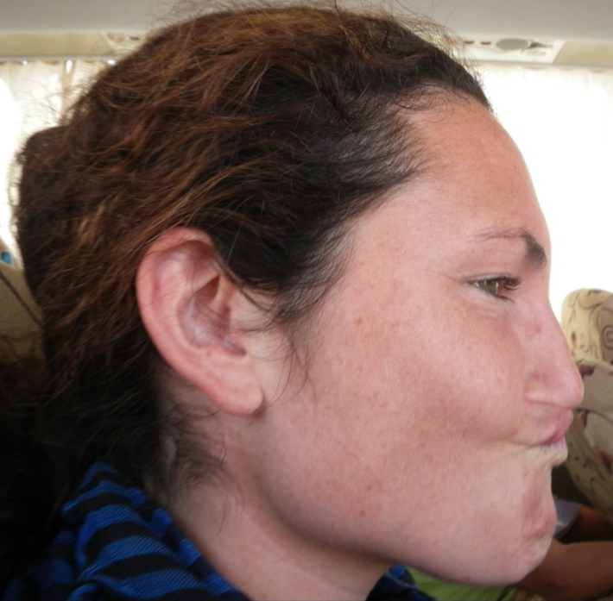
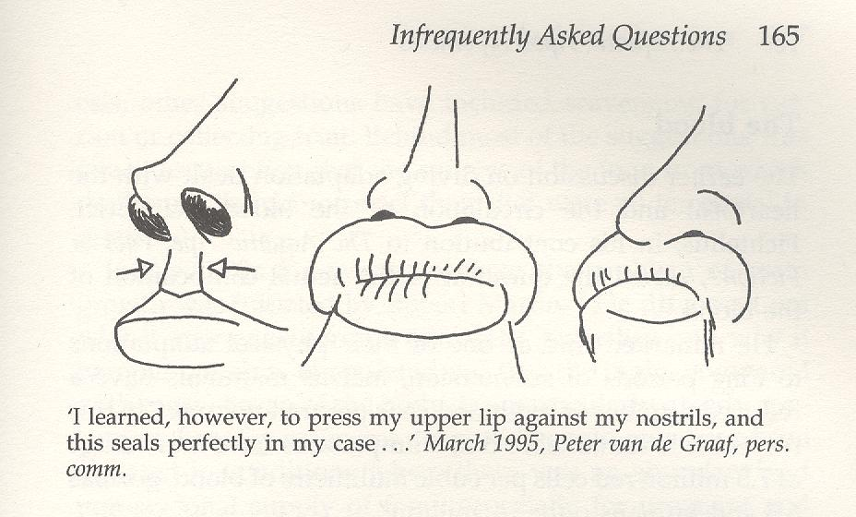
Humans are extremely special primates/animals
6. External nose and everted lips with a philtrum/mouth breathing
External nose
Seems maladaptive: the current of air has to describe a U-turn before reaching the lungs.
But: In case you dive, head first, or swim beneath the water:
The nose acts like a prow, forcing the water to deflect on either side of it.
If not, the water would be forced up into the nostrils, as would happen with chimp or gorilla.
Some people can close the nose by raising the upper lip:
+ philtrum (absent in apes) fits the nose septum!
Morgan E. 1997. AAH
Schagatay. 2011. Chapter 7. WMMA?
Some people (like myself ☺) can close the nostrils and lower the nose tip (nose musculature)

Slide 44
Humans are extremely special primates/animals
6. External nose
everted lips with a philtrum
mouth breathing
Most land mammals (including chimp & gorilla) are exclusively nose breathing:
Nose filters/sterilizes air
Nose warms air
Nose moistens air
Before air is reaching the lungs
We are mouth breathers when excercising, speaking
Reason for frequent airway infections?

Slide 45
Humans are extremely special primates/animals
7. Voluntary breath control/Diving reflex
Hominids (chimp, gorilla), terrestrial: only autonomous breathing
Dolphins, whales, aquatic: only voluntary breathing
Seals, semi-aquatic: both autonomous and voluntary breathing
Humans: both autonomous and voluntary breathing
Aquatic explanation for voluntary breathing?
holding breath under water (see also: closing nostrils
lips can close mouth)
breathing extra deep before diving
breathing faster after dive
Verhaegen M. 1997. In den beginne was het water.
Schagatay E. 2011. Chapter 7. WMMA?

Slide 46
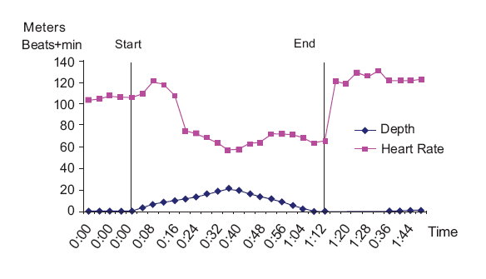
Humans are extremely special primates/animals
7. Voluntary breath control/Diving reflex
Diving reflex
When our forehead touches water
+ sufficient temperature difference (= not necessarily cold water)
→ heartbeat rate reduction.
Of course, when we swim or dive as well.
/
(min:sec)
Schagatay E. 2011. Chapter 7. WMMA?

Slide 47
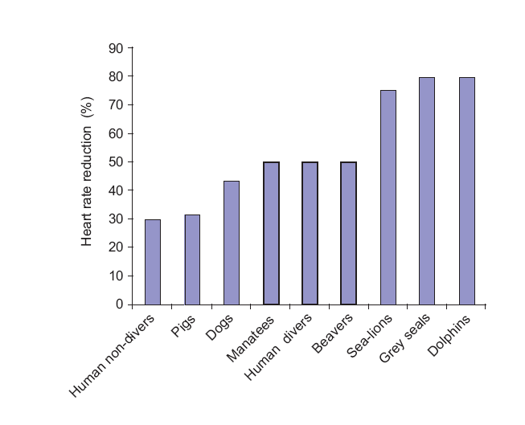
Humans are extremely special primates/animals
7. Voluntary breath control/Diving reflex
Diving reflex: heartbate rate reduction
Schagatay E. 2011. Chapter 7. WMMA?

Slide 48
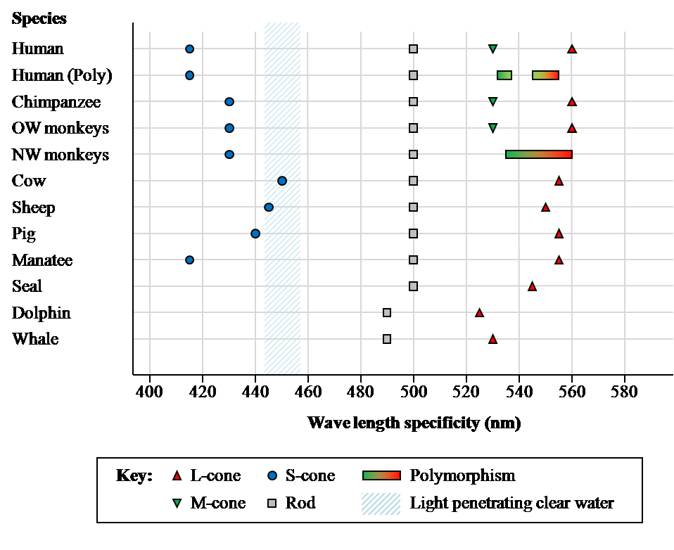
Humans are extremely special primates/animals
8. Reduced colour vision
Species S Rod M L
(Di)

Slide 49
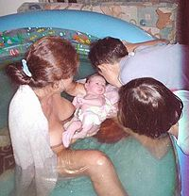
Humans are extremely special primates/animals
11. Sexuality: Face-to-face mating - Hymen - Menstrual cycle
Vaginal hymen: Not in chimps (although present in foetus)
Present in some aquatic mammals
Lunar rythms of menses:
Lunar cycles also in some fish, frogs, toads, crabs, seahorses ...
Face-to-face mating: Also in aquatic mammals (and bonobo)
Streamline for diving → vagina ventral → Face-to-face mating?
Underwaterbirth: proceeds smoother, with less distress
Was discovered by accident (Odent M. 2011)
Some examples:
Only (?) human females have acidic
vaginal milieu: pH < 4.5 !!! ???
Odent M. 2011. Chapter 9. Obstetrical implications of the Aquatic Ape Hypothesis. WMMA?

Slide 50
Humans are extremely special primates/animals
12. Seafood & Large brains
Brain size vs body weight in hominids
Species | Brain size (g) | Body weight male (kg)
Australopithecines (†) | 400-500 | 30-50
Chimp | 400 | 45
Gorilla | 500 | 170
Homo erectus (†) | 860-1000 | 60
Homo neanderthalensis (†) | 1420 | 76
H. sapiens, early (Cro Magnon)((†)) | 1500 | 63
H. sapiens, present | 1350 | 60
H. sapiens, inuit | 1500 | 60
H. sapiens, aboriginals | 1250 | 60
H. sapiens, pygmee | 1100 | 40
Compiled from Verhaegen M. 1997, Cunnane SC. 2005
Notes:
MV (120108) If H. sapiens is less aquatic than H. erectus and returned to land, how could it get larger brains?

Slide 51
Humans are extremely special primates/animals
12. Seafood & Large brains
Source of special omega 3 fatty acids
Food source | Fat percentage | Arachidonic acid (AA) Omega 6 | Docosohexaonic acid (DHA) Omega 3
Game lean, < 4% fat
Wart hog |  | 8.5 | 0.6
African buffalo |  | 7 | 0.4
Zebra |  | 3.0 | 0.23
Antelope |  | 8 | 0.4
Kangaroo |  | 7.7 | 0.9
Kangaroo liver, 4% fat | 4 | 6.9 | 1.3
Sea birds
Penguin liver |  | 8.6 | 11.2
Emperor penguin egg yolk, 30-40% fat |  | 1.7 | 5.5
Emperor penguin, maternal blubber |  | 0.4 | 8.0
Temperate shell fish
Mussel (Mytilus spp.) | 1-3 | 2-4 | 6-14
Surf clam (Spisula spp.) | 1-3 | 4 | 11-12
Quahog clam^{d}, -1°C | 3 | 1.6 | 13.1
Fish
Sand smelt | 3.8 | 4.3 | 24.8
Whiting | 2.7 | 3.5 | 40.8
Australian barramundi | 0.3 | 14.5 | 16.2
Indian halibut | 1.7 | 6.3 | 10.4
Broadhurst CL, Crawford M. 2011. Chapter 2. WMMA? Compiled from Tables 1 and 2

Slide 52
Humans are extremely special primates/animals
12. Seafood & Large brains

Slide 53
Humans are extremely special primates/animals
12. Seafood & Large brains
"Iodine deficiency:
world's most serious nutritional deficiency,
adversely affecting nearly a billion people"
Cunnane CS. 2005. Survival of the fattest.
Loss of iodine from soils through erosion.
Most deficiency in mountain and inland regions.
Leading to hypothyroidism and cretinism.
In France, children born with cretinism were considered
to be so mentally retarded that they were even incapable of committing sin.
Thus the name cretinism, meaning 'Christ-like'.

Slide 54
Humans are extremely special primates/animals
12. Seafood & Large brains
Are we now typically terrestrial?
Cunnane S.:
we are still very dependent on iodine and omega3 for normal brain development
Lack of iodine: cretinism. This is unexpected for a terrestrial species!
What are the sources of iodine?
Weight of food (grams) needed to meet daily iodine requirement
+ sea salt!: iodine rich

Slide 55
Humans are extremely special primates/animals
12. Seafood & Large brains
Beach combing/diving for shellfish:
we don't realize what an easy and wealthy source of food this was
until human overpopulation?
New Zealanders may take it for granted sometimes,
but one of the reasons New Zealand is a foodie's paradise is that in many parts of the country anyone can still
go down to the beach and collect fresh seafood.
Paua (the Maori word for abalone) is a popular delicacy, especially because the sale of wild Paua is prohibited and recreational free divers are limited to collecting 10 per day, strictly without the use of scuba equipment (that’s cheating).
Nothing like working up an appetite by free-diving!
Sadly, undersized Pauas are often poached and smuggled out to be sold on the lucrative international black market. Its colourful iridescent shells can often be found polished up in gift shops or made into jewellery.
New Zealand Food

Slide 57
2002

Slide 58
13. Sea food, song and speech
A possible aquatic explanation of why we can speak?
Why is it only humans can speak? Current explanations:
Steven Pinker: speech was advantageous. That is why it was selected
Steve Bickerton: a macromutation took place
Noam Chomsky: we have a language acquiring device: innate grammar
Vaneechoutte & Skoyles 1998: we have a music acquiring device
→ pre-adaptive for language (cfr. Charles Darwin)
1. Increased song capacities
Primate ancestors already musical (cfr. gibbon)
Aquatic life: Communicaton by sound, rather than by smell and vision
(cfr. whales, dugongs = Sirenes)
2. Aquatic life style → Increased control of oral apparatus and breath control
Sea food: Suction feeding
Diving for sea food: Voluntary breath control
1 + 2 → Humans are extremely good singers
→ Further development of vocal cords and breath control
+ sexual selection for male singers?
3. Increased brain capacity
Sea food: Omega3, brain minerals (iodine)
extreme song capacities + large brain → SYMBOLIC LANGUAGE
Vaneechoutte M, Skoyles J. 1998. The memetic origin of language: humans as musical primates.
J. Memetics - Evolutionary Models of Information Transmission 2.

Slide 59
Suction feeding of aquatic foods might explain our
flat faces
vaulted soft palate
closed globular tooth row (with small canines)
mouth that can be closed by muscled, fleshy, everted lips
round tongue that can close the airways while feeding
All of this + voluntary breath control + descended larynx (see Figure below)
predisposes to making a large variety of sounds and tones

Slide 60
Is knowing about our exact past history a purely academic matter?
Or may it have consequences for our health?
Some possible examples of diseases that can be better understood:
Fully upright posture → Back ache (hernia)
Varices → We have special external venes. With age - standing upright too long: defects
Acne: sebaceous glands produce oily substance, for waterproofing hair and skin
become large and very active during puberty (<-> apes)
Lack of seafood → mental retardation, cretinism, ADHD
→ pre-eclampsia?: due to conflict between mother and foetus
because pregnant women do not get the right food?: sea food
Descended larynx → free uvula → Sudden Infant Death Syndrome (SIDS)
→ Sleep apnoea → Chronic fatigue
→ Depression
Ear exostoses: overall: 2%, swimmers: 43%. Also observed in H. erectus!
Mouth breathing → Throat infections, chronic bronchial disorders
Sinuses. Ethmoid sinus typically human → sinusitis
Verhaegen M. 1987. The aquatic ape theory and some common diseases. Med Hypotheses 24: 293-299.
Morgan E. 1990. The scars of evolution. Souvenir, London.
Morgan E. 1997. The aquatic ape hypothesis. Souvenir, London.

Slide 61
Are AH adepts fanatics?
My thesis is, of course, only a speculation
- a hypothesis to be discussed and tested against further lines of evidence.
Such ideas are useful only if they stimulate fresh inquiries
which may bring us nearer the truth.
Alister Hardy. 1960. New Scientist 7: 642-645
There may be sound reasons why the aquatic model, like the savannah one,
will in the end, after careful scrutiny, have to be abandoned.
But there is no case for rejecting it out of hand.
Over the past ten years it has been adjusted and modified
to meet valid objections and to accomodate new data.
For those who have assumed that there is something inherently untenable about it,
it is time to think again.
Elaine Morgan. 1997. The aquatic ape hypothesis. Page 20.
59

Slide 62
Was Man more aquatic in the past?
Slides available (from 5 november onwards) at:
http://users.ugent.be/~mvaneech/Index.html
Mario Vaneechoutte
Marc Verhaegen
The people along the sand
All turn and look one way
They turn their back to the land
They look at the sea all day
Robert Frost
Quoted by Elaine Morgan. 1997. AAH

