Slide 1

Leveraging the VSC infrastructure for AI workloads
HPC4AI session at Acumen 2021 (Oct 20th 2021) https://www.agoria.be/acumen
Kenneth Hoste (VSC, HPC-UGent)

Slide 2






WHO AM I?
Kenneth Hoste
Masters (2005) + PhD (2010) in Computer Science from Ghent University
Dissertation topic: “Analysis, Estimation and Optimization of Computer System Performance Using Machine Learning”
HPC system administrator at Ghent University + VSC since 2010
Main tasks: user support, software installations, training
Lead developer of EasyBuild (tool to install scientific software on HPC systems)
Big fan of open source software
@kehoste
@boegel
https://easybuild.io

Slide 3

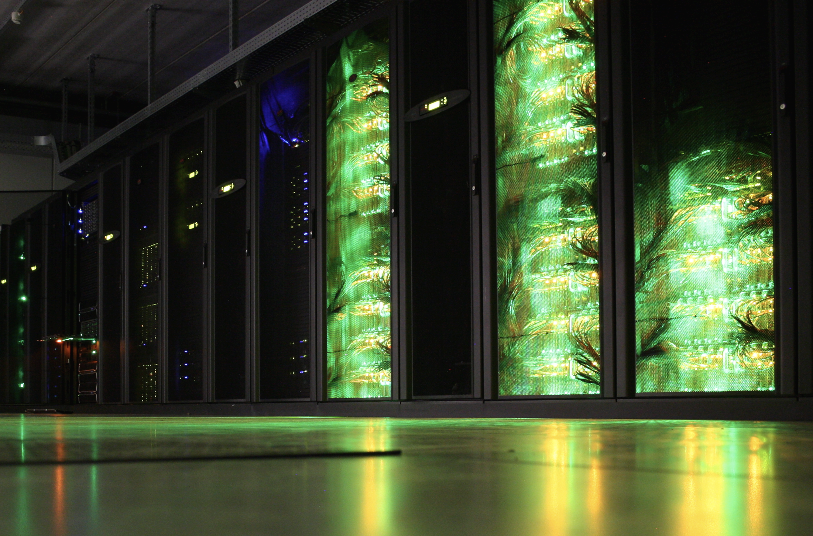
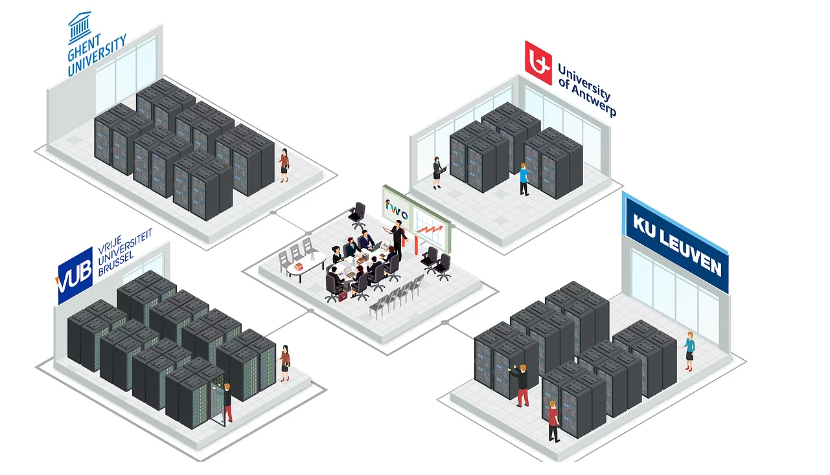
WHAT IS VSC?
Vlaams Supercomputer Centrum (VSC)
https://www.vscentrum.be - https://docs.vscentrum.be
Partnership between 5 Flemish university associations, managed & co-funded by FWO
Virtual center - infrastructure in 4 hubs (KU Leuven, UAntwerpen, UGent, VUB)
Provides infrastructure, support, training for scientific and technical computing
Tier-2 + Tier-1 compute clusters, VSC cloud, VSC data component
One VSC account to access all VSC infrastructure
Access for both academic researchers (free of charge), research institutes and industry (pay what you use, free exploratory)

Slide 4
INTRODUCTION: Supercomputing, HPC
What is a supercomputer?
FIXME
HPC

Slide 5
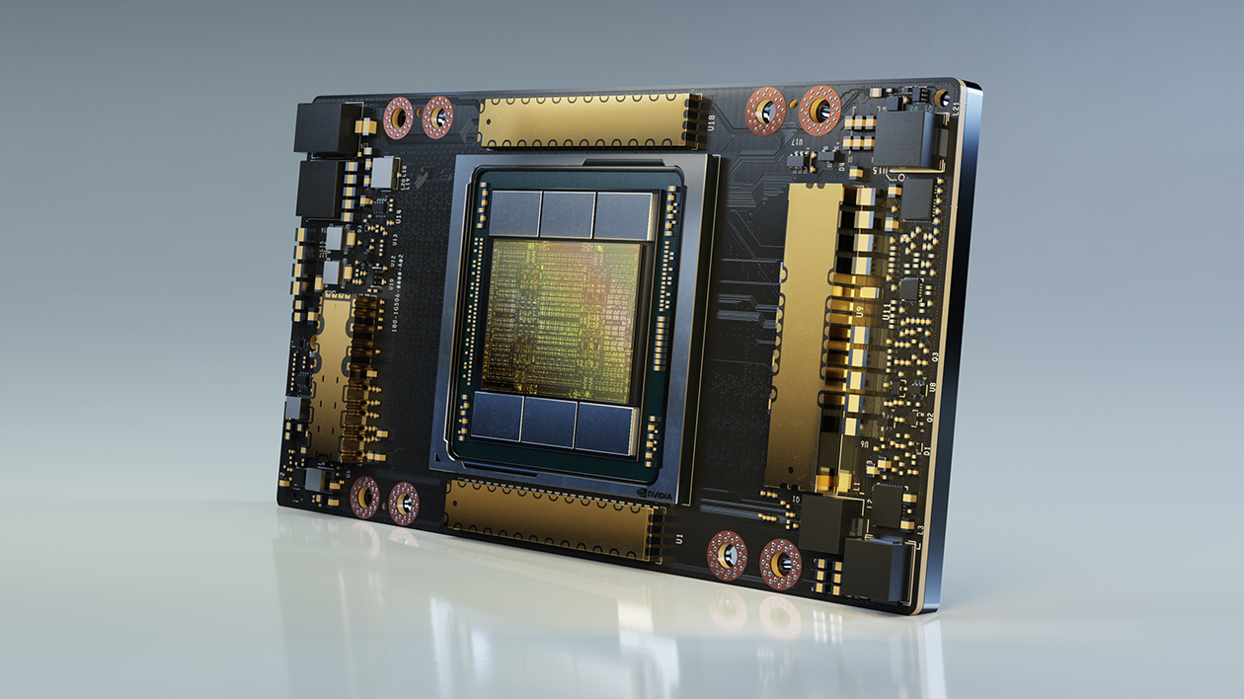


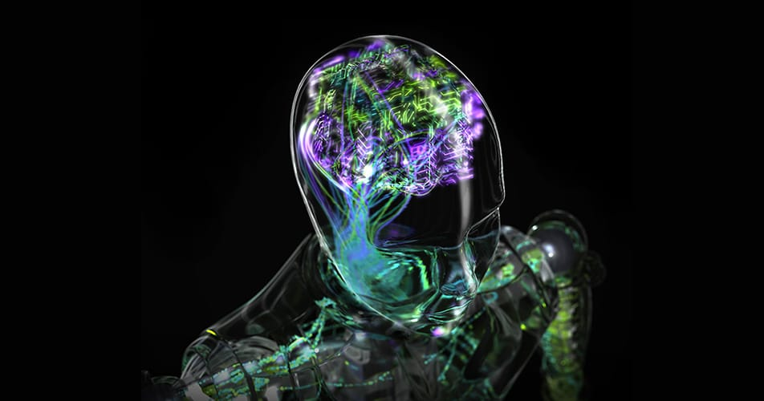
INTRODUCTION: GPUs
What is a GPU?
Graphical Processing Unit, “video card” that can be used as a co-processor
Originally created for Computer Graphics and Video Processing
Huge market thanks to movie and video gaming industry
Well suited for processing large blocks of data in parallel
Also used as accelerator for (some) scientific computations (incl. AI)
GPGPU: General Purpose Computing on GPU
Order(s) of magnitude speedup (10x - 100x, or more) is possible
Recent top-of-the-line GPUs support massively parallel computations

Slide 6
INTRODUCTION: Supercomputing, HPC
VSC infrastructure: Tier-2
FIXME
HPC

Slide 7
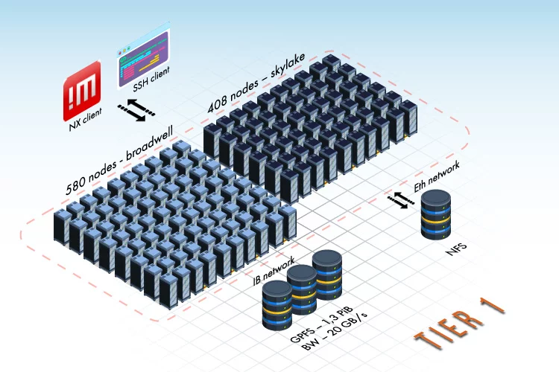
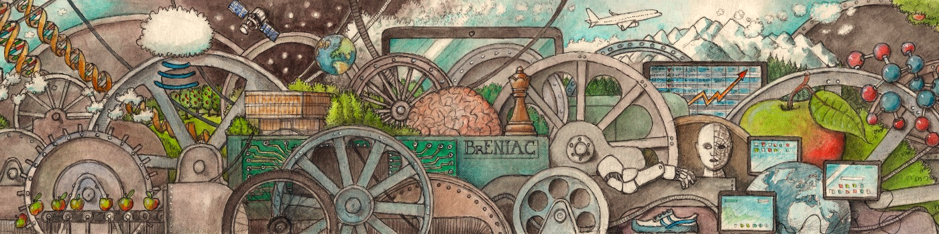
VSC infrastructure
VSC infrastructure: Tier-1 (BrENIAC @ KUL)
FIXME
HPC

Slide 8
VSC infrastructure
VSC infrastructure: Tier-1 (Hortense @ UGent)
FIXME
HPC

Slide 9
VSC infrastructure
VSC infrastructure: Tier-1 Cloud
FIXME
HPC

Slide 10
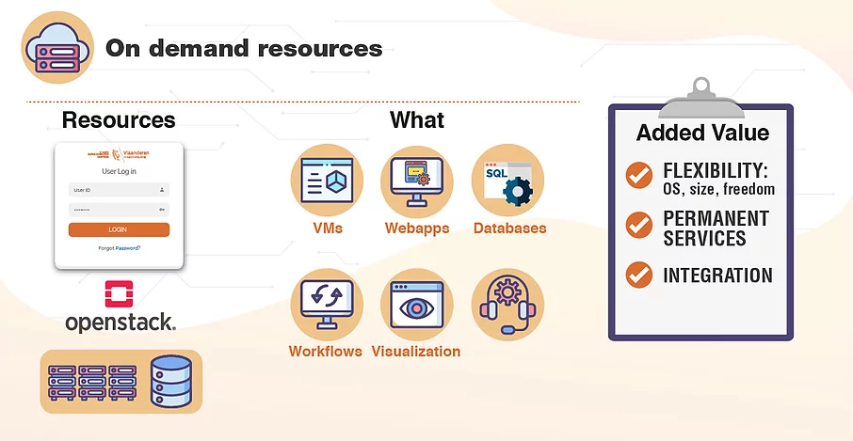
GPU resources
VSC Tier-1 Cloud (incl. limited GPU resources)
Self-managed virtual machines (VMs): you install the software you need!
Golden VM images available, can be modified, or use your own images
Project based access (project proposal due by specific cut-off date)
Several GPU instance types, each with 1 virtual GPU (vGPU)
1 vGPU = 1/4th of an NVIDIA T4 GPU => 4GB GPU memory
GPU driver + CUDA already installed in available GPU images
Can be used for small GPGPU compute workloads (like AI inference) or visualization (with some limitations)
Tweaked instance types can be considered (on request)
VSC network access can be made available (on request)
Documentation: https://www.vscentrum.be/cloud
For more information: cloud@vscentrum.be

Slide 11
VSC for industry
VSC infrastructure: access for industry
Well suited for R&D workloads
Contract with one of VSC partners
Prices?
Free exploratory use to get started
Pay-what-you-use (compute + storage)
Support via experienced helpdesk team
Contact: industry@vscentrum.be ???

Slide 12


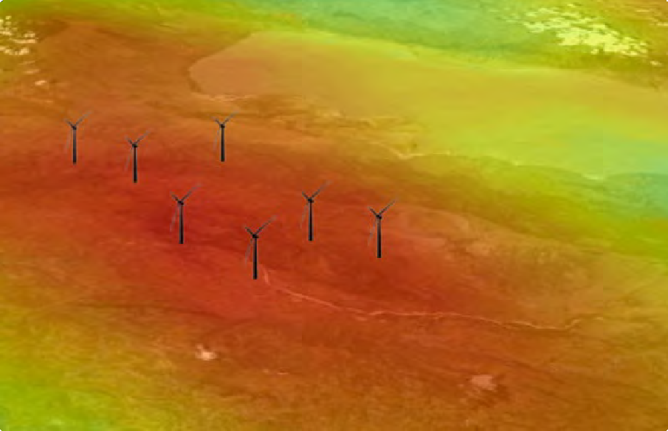
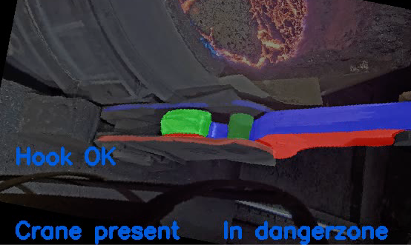
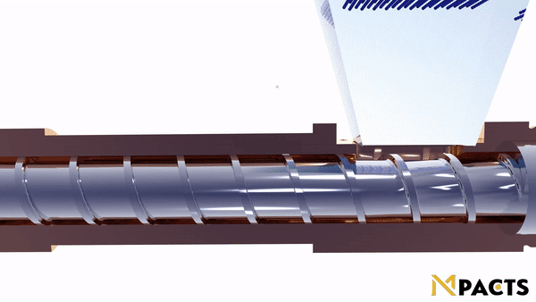




VSC for industry
AM-Team?
ePotentia (Michael)
VSC for industry: examples

Slide 13
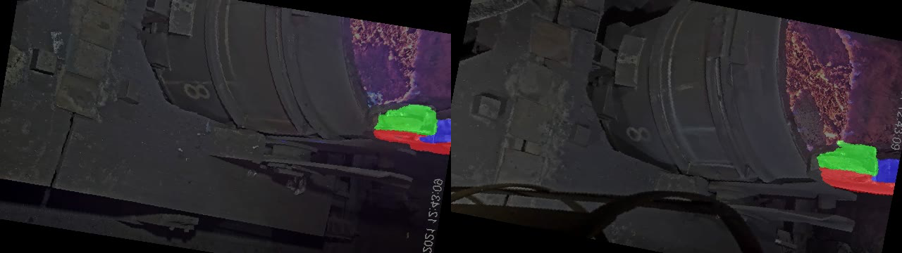
VSC for industry
VSC for industry: object tracking at
source: Michael Coene (Arcelor Mittal)
Object tracking with pre-trained TensorFlow model
Goal: make sure that hooks are in correct position to lift bucket of pig iron
Developed with the help of available GPU resources at VSC!

Slide 14

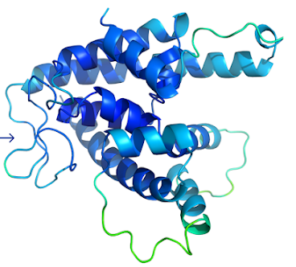
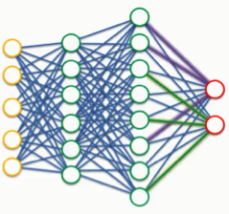

Deep Learning in a nutshell
INTRODUCTION: Deep Learning & AI
Type of machine learning algorithm
Multi-layer neural network (DNN)
Inspired by biological systems
Wide variety of Artificial Intelligence (AI) applications: game playing, natural language processing, bioinformatics, …
The Deep Learning Revolution
“Big Bang” of Deep Learning: orders of magnitude speedup for training deep neural networks on GPUs
Release of TensorFlow v1.0.0 by Google Brain team, with support for running on (multiple) GPUs
Deepfake technology goes mainstream: used by online communities and companies to replace faces in video content, later also applied to voices
More accurate rain prediction using DeepMind’s DGMR tool (link)
2009
2017
2021
Release of PyTorch v1.0.0
TensorFlow is among most popular projects on GitHub, and is the most popular machine learning project
2011
2012
2015
2018
2019
2020
AlphaFold 2 blows away competition in CASP14 competition by achieving high accuracy in protein structure prediction (link)
Multi-task deep neural networks used to win “Merck Molecular Activity Challenge” to predict the biomolecular target of one drug
Turing Award (“Nobel Prize” in Computer Science) for conceptual and engineering breakthroughs that have made deep neural networks a critical component of computing
Superhuman performance in visual pattern recognition contest using Convolutional Neural Networks (CNNs)
AlphaGo beats professional human player at board game Go (link)

Slide 15
INTRODUCTION: Deep Learning
What Enabled the Deep Learning Revolution?
Big Data + Data Science
GPUs
Key to success for Deep Learning: lots of “examples”
More (good) data Better trained models
Desire to extract information from tsunami of data (sensors, …)
More data is sometimes easy to generate (AlphaGo)
Wealth of data can enable scientific breakthroughs (AlphaFold)
GPUs are well suited for Deep Learning algorithms
Large performance speedup compared to only using CPUs
Rise of GPGPU computing fueled Deep Learning hype
Deep Learning applications fueled GPGPU hype
Also: algorithms, open source software (TensorFlow, PyTorch), …

Slide 16
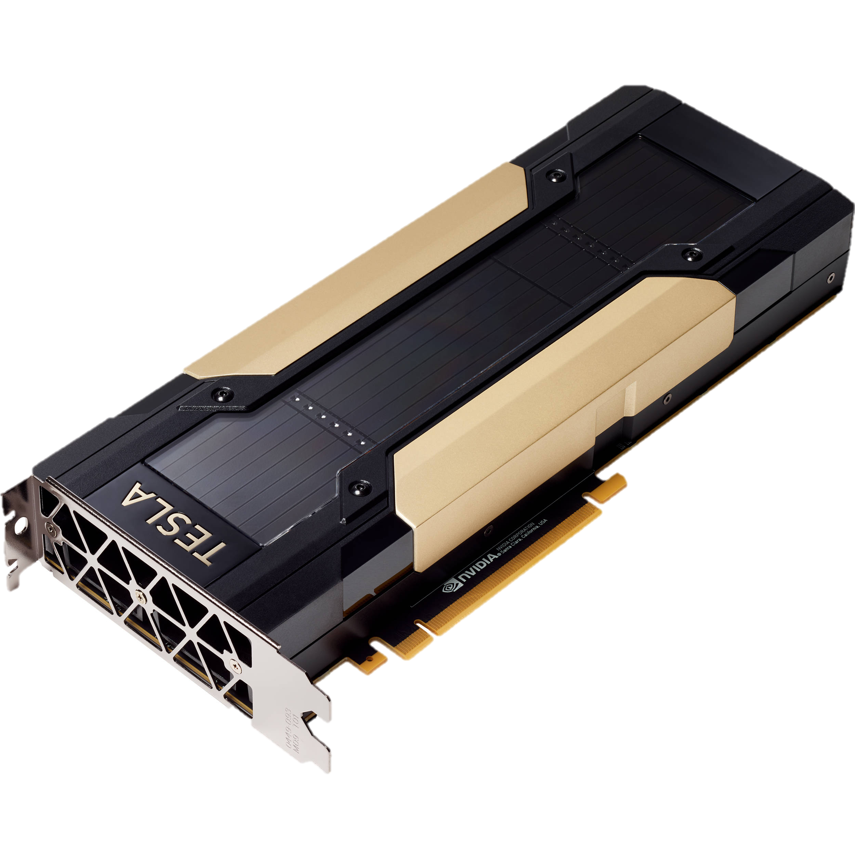

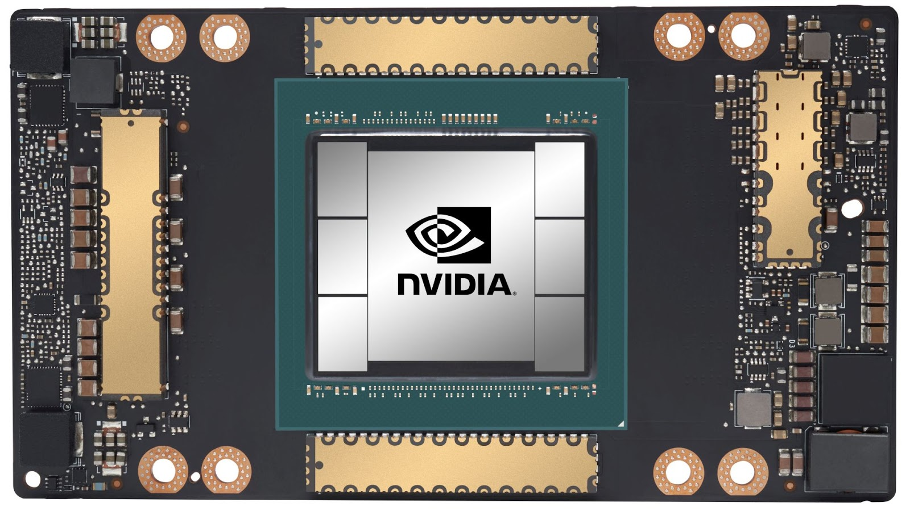
GPUs for Science
GPUs for computational science
In 2008 Nvidia started selling GPUs that were well suited for scientific computations
Double-precision floating-point support (FP64)
More and faster GPU memory
Fast interconnect between GPUs (NVLink)
Most recently: Nvidia Ampere series, incl. A100 with up to 80GB GPU memory (HBM2)
Sparked the Deep Learning revolution
Order-of-magnitude speedup is possible for specific types of computations (incl. deep learning & AI)
Big impact on HPC systems infrastructure
Porting traditional scientific software applications to leverage GPU resources took some time…

Slide 17
GPU resources
Currently available GPGPU resources at VSC
https://docs.vscentrum.be/en/latest/hardware.html
Hydra Tier-2 cluster at VUB https://hpc.vub.be/docs/faq/basic/#how-can-i-use-gpus-in-my-jobs
6 nodes with 2x NVIDIA K20Xm GPUs (2x 10-core Intel Ivy Bridge, 128GB RAM, 6GB GPU mem.), QDR IB – since 2013
4 nodes with 2x NVIDIA P100 GPUs (2x 12-core Intel Broadwell, 256GB RAM, 16GB GPU mem.), 10Gbps – since 2017
Genius Tier-2 cluster at KUL https://docs.vscentrum.be/en/latest/leuven/genius_quick_start.html#submit-to-genius-gpu-node
20 nodes with 4x NVIDIA P100 GPUs (2x 18-core Intel Skylake, 192GB RAM, 16GB GPU mem.), EDR IB – since 2018
2 nodes with 8x NVIDIA V100 GPUs (2x 18-core Intel Cascade Lake, 768GB RAM, 32GB GPU mem.), EDR IB – since 2019
Leibniz Tier-2 cluster at UAntwerpen https://docs.vscentrum.be/en/latest/antwerp/gpu_computing_uantwerp.html
2 nodes with 2x NVIDIA P100 GPUs (2x 18-core Intel Broadwell, 128GB RAM, 16GB GPU mem.), EDR IB – since 2017
joltik Tier-2 cluster at UGent https://www.ugent.be/hpc/en/support/documentation.htm (see Chapter 21)
10 nodes with 4x NVIDIA V100 GPUs (2x 16-core Intel Cascade Lake, 256GB RAM, 32GB GPU mem.), HDR-100 IB – since 2020

Slide 18




GPU resources
Usage of VSC GPU resources
AI (image analysis, deep learning, …): PyTorch, TensorFlow, …
Bioinformatics: Beagle, BEAST, AlphaFold, …
Computational chemistry: GROMACS, VASP, OpenMM, …
Custom code: C++ and CUDA, Python (scipy, scikit-learn, scikit-image, …), …

Slide 19
GPU resources
Coming soon at VSC: NVIDIA A100 GPUs
https://www.nvidia.com/en-us/data-center/a100
Tier-2 @ UGent: new accelgor cluster (currently in pilot)
9 nodes with 4x NVIDIA A100 GPUs (2x 24-core AMD Milan, 500GB RAM, 80GB GPU mem.), HDR IB
Tier-2 @ VUB: additional GPGPU nodes in Hydra cluster (currently in pilot)
6 nodes with 2x NVIDIA A100 GPUs (2x 24-core AMD Rome, 256GB RAM, 40GB GPU mem.), EDR IB
Tier-1 Hortense (at UGent): GPU partition (coming soon…)
20 nodes with 4x NVIDIA A100 GPUs (2x 24-core AMD Rome, 256GB RAM, 40GB GPU mem.), dual HDR IB
Multi-Instance GPU (MIG) support to allow running multiple jobs on a single GPU at once

Slide 20












GPU software
Programming Models, Libraries, Applications for GPU platforms
Low-level (programming languages)
Higher-level libraries
cuBLAS
cuFFT
HIP
cuML
cuGraph
https://rapids.ai
Kokkos
(only for NVIDIA GPUs!)
cuDF
…
(only for NVIDIA GPUs!)
(offload)
Deep Learning frameworks
Applications
AlphaFold
Racon
MIOpen
Guppy

Slide 21
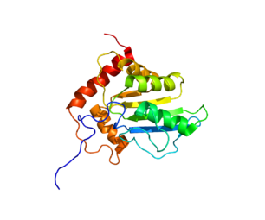
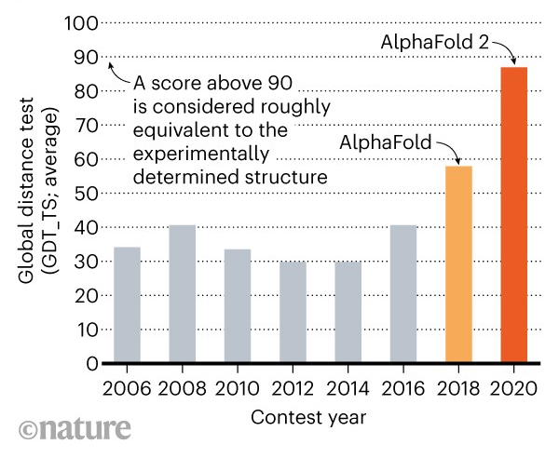
EXAMPLE USE CASE: AlphaFold 2
Accurately predicting protein structure with AlphaFold
AlphaFold 2 AI algorithm (by Google’s DeepMind) “solves a 50-year-old grand challenge in biology”
Clear winner of recent Critical Assessment of protein Structure Prediction (CASP14 - 2020)
Accurately predicts what 3D shapes proteins “fold” into, based on 1D sequence of amino acids
Relies on large dataset of examples (~2.5TB!) + feature selection and Deep Learning techniques
Replaces time-consuming experiments that used to take several weeks/months!
Significant speedup by running AlphaFold on sufficiently capable GPUs
Applications: drug discovery, better understanding diseases, etc.

Slide 22
EXAMPLE USE CASE: AlphaFold 2
CPU vs GPU performance of AlphaFold
9.5x speedup (CPU-only to A100 GPU)
6x speedup (CPU-only to V100 GPU)
~50% speedup (V100 to A100)
Little performance tuning done, some room for potential improvement for both CPU-only and GPU runs
Modest example input (sequence of 779 amino acids)
More significant differences observed with longer input sequences, or using larger dataset (like CASP14)
More GPU memory opens the door for more challenging (longer) input sequences

Slide 23
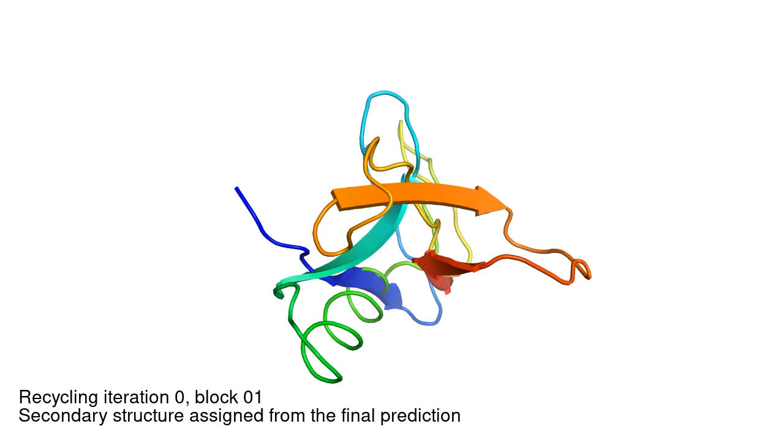
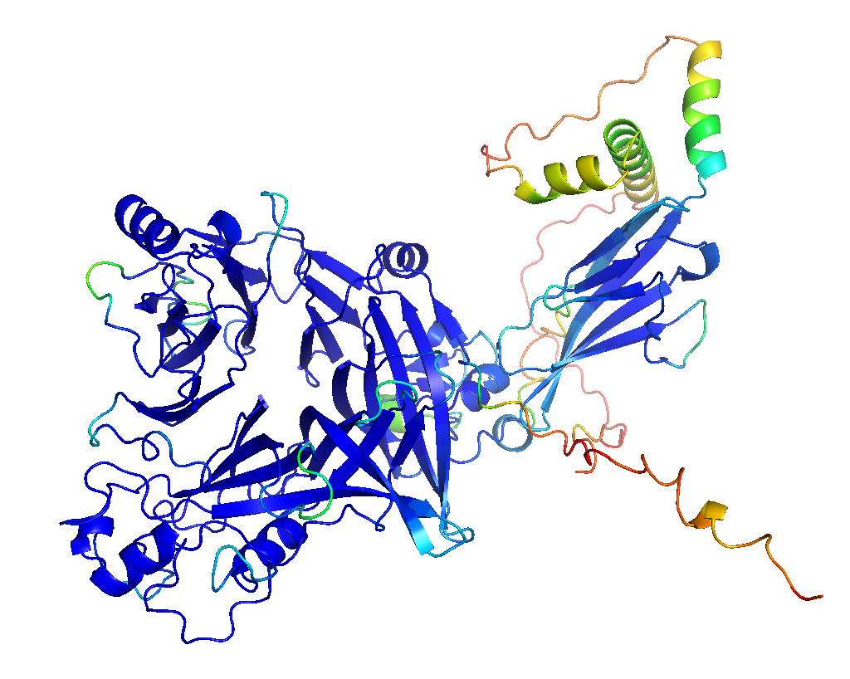
EXAMPLE USE CASE: AlphaFold 2
Iterative refinement of predicted structure + confidence level
Confidence level for prediction is also available
Blue = very confident
Yellow/green = unsure in various degrees
Red = no idea…
Very valuable for domain scientists to interpret result!
AlphaFold iteratively refines prediction of folded protein

Slide 24
EXAMPLE USE CASE: AlphaFold 2
More information on AlphaFold
Protein folding and AlphaFold explained in 2 minutes: https://youtu.be/KpedmJdrTpY
AlphaFold: The making of a scientific breakthrough: https://youtu.be/gg7WjuFs8F4
Blog posts:
https://www.blopig.com/blog/2021/07/alphafold-2-is-here-whats-behind-the-structure-prediction-miracle
https://deepmind.com/blog/article/alphafold-a-solution-to-a-50-year-old-grand-challenge-in-biology
https://deepmind.com/blog/article/putting-the-power-of-alphafold-into-the-worlds-hands
Paper in Nature: https://www.nature.com/articles/s41586-021-03819-2
Source code on GitHub: https://github.com/deepmind/alphafold
Prediction of multi-chain protein complexes with AlphaFold-Multimer: https://deepmind.com/research/publications/2021/protein-complex-prediction-with-alphafold-multimer

Slide 25
Acknowledgements
Thanks to:
Various VSC colleagues for their input:
Alex Domingo (VUB)
Álvaro Simón García (UGent)
Balázs Hajgató (UGent)
Tim Jaenen (FWO)
Kurt Lust (UAntwerpen)
Jan Ooghe (KU Leuven)
Ewald Pauwels (UGent)
Ward Poelmans (VUB)
Jasper Zuallaert (VIB-UGent) for his feedback regarding the AlphaFold use case

Slide 26
More information on VSC
Contact: info@vscentrum.be
Website: https://www.vscentrum.be
Available hardware resources: https://docs.vscentrum.be/en/latest/hardware.html
LinkedIn: https://www.linkedin.com/company/vschpc
YouTube: https://www.youtube.com/channel/UCLtcGAtZQUQEG99ZQpRLl1A
Twitter: https://twitter.com/VSC_HPC
Facebook: https://touch.facebook.com/vschpc

