Slide 1



EuroHPC Centre of Excellence
MultiXscale kickoff meeting - Overview of technical work packages (WP1, WP5, WP6) Caspar van Leeuwen (SURF) - lead WP1
Kenneth Hoste (Ghent University) - lead WP5
Alan O’Cais (University of Barcelona) - lead WP6
23 March 2023
Funded by the European Union. Views and opinions expressed are however those of the author(s) only and do not necessarily reflect those of the European Union orthe European High Performance Computing Joint Undertaking (JU) and countries participating in the project. Neither the European Union nor the granting authority can be held responsible for them.

Slide 2
MultiXscale technical WPs
WP1: Developing a Central Platform for Scientific Software on Emerging Exascale Technologies - Lead: SURF (Caspar)
WP5: Building, Supporting and Maintaining a Central Shared Stack of Optimized Scientific Software Installations - Lead: UGent (Kenneth)
WP6: Community outreach, education, and training - Lead: UB (Alan)
MultiXscale kickoff meeting - Overview of technical work packages (WP1, WP5, WP6) (2023-03-23)

Slide 3
Organization/planning WP1+5+6
How will we organize ourselves + plan our work?
Monthly sync meeting for WP1+WP5+WP6 (2nd Tuesday at 10:00 CE(S)T)
Notes in wiki of MultiXscale/meetings GitHub repo
Project board in MultiXscale GitHub repo (currently only for WP1+WP5)
Track progress (task-based roadmap)
Easy overview when creating deliverables (deliverable-based roadmap)
Creating tickets in other repo’s (EESSI, …) is fine, but have to be linked in issues in WP1_5 repo to maintain single overview of all work done!
MultiXscale kickoff meeting - Overview of technical work packages (WP1, WP5, WP6) (2023-03-23)

Slide 4
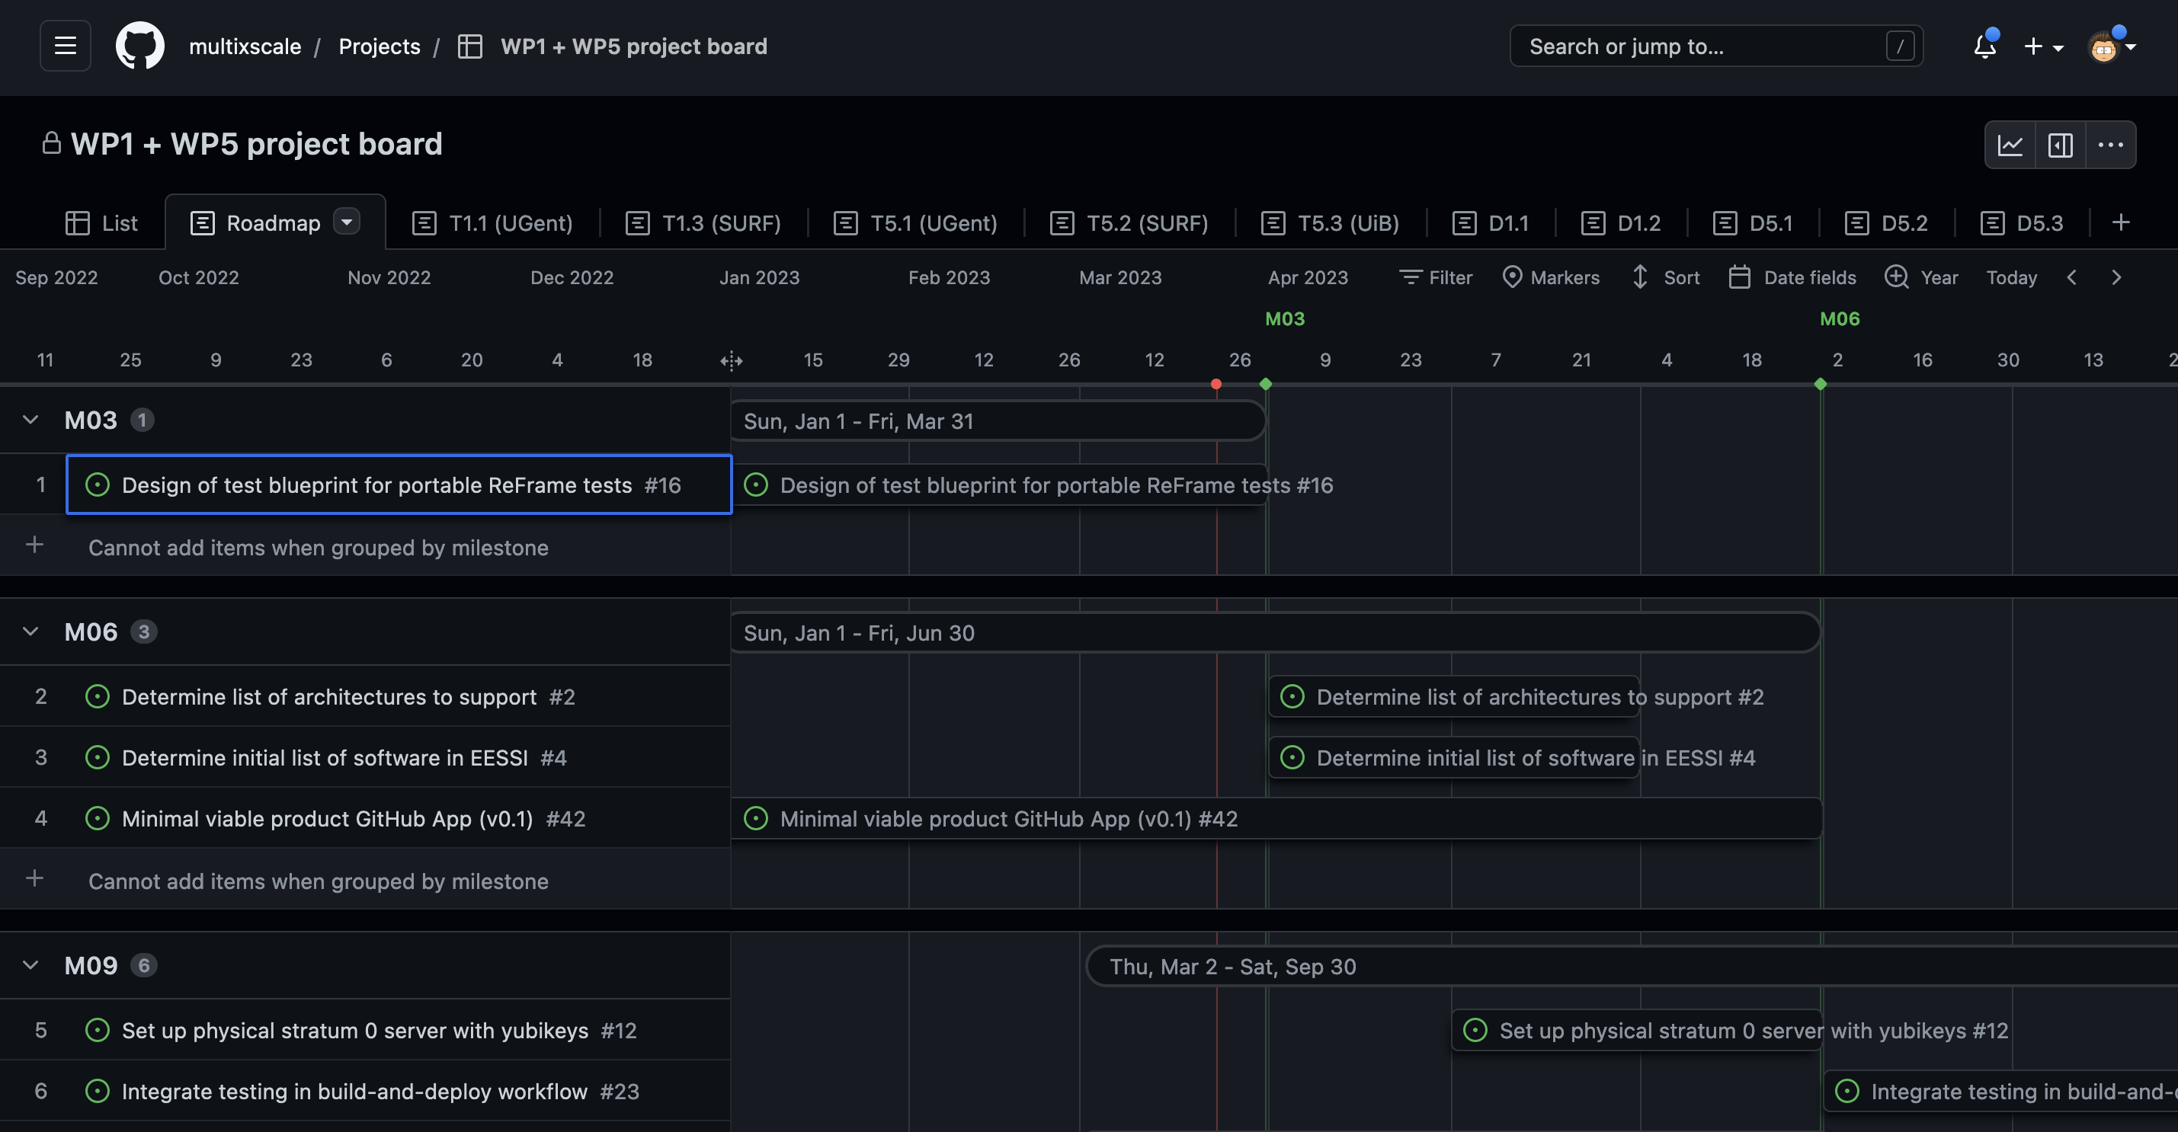

Slide 5
Organization/planning WP1+5+6
MultiXscale Slack for easy day-to-day communication
Slack is a ”way of life” for most people involved in technical WPs
Significantly lowers the threshold to reaching out to others for questions, etc.
Communication via Slack should be considered asynchronous (just like email)
Don’t expect an instant reply from anyone, at any time
Messages in Slack will eventually disappear due to free plan (only last 90 days)
Important and official communication should still be done via email!
MultiXscale kickoff meeting - Overview of technical work packages (WP1, WP5, WP6) (2023-03-23)

Slide 6
WP1: Stabilize and extend EESSI
First year tasks:
T1.1 (UGent, M1-24): Providing a stable, optimized, shared scientific software stack with support for established system architectures
T1.2 (RUG, M10-30): Extending support of the shared software stack to emerging system architectures
T1.3 (SURF, M1-30): Design and creation of a software test suite and facilitating CI for software developers
MultiXscale kickoff meeting - Overview of technical work packages (WP1, WP5, WP6) (2023-03-23)

Slide 7
WP1: Stabilize and extend EESSI
First year deliverables/milestones:
D1.1 (M12, RUG): Report on shared software stack prototype (T1.1, T1.2)
D1.2 (M12, SURF): Plan for the design of a portable test suite (T1.3)
MS 2 (M12, SURF): Shared software stack support for at least 1 accelerator (WP1 through WP5)
MultiXscale kickoff meeting - Overview of technical work packages (WP1, WP5, WP6) (2023-03-23)

Slide 8
T1.1 Goals + status (M1-M24)
Summary: Making EESSI ready for production use
Set up CernVM-FS infrastructure (ongoing) [#12, #14]
NVIDIA GPU support (ongoing) [#1]
Formalize & implement policy for updates (to start, currently manual) [#15]
Determine initial list of software (for Milestone 2) (to start) [#4]
Determine list of architecture support (for Milestone 2) (to start) [#2]
Build software for initial list & architectures (to start) [#3]
Performance evaluation of software (to start) [#7]
MultiXscale kickoff meeting - Overview of technical work packages (WP1, WP5, WP6) (2023-03-23)

Slide 9
T1.2 Goals + status (M10-M30)
Summary: Extending support in EESSI for emerging system architectures
ARM CPU support (ongoing) [#32]
AMD GPU support (to start) [#31]
Intel GPU support (?) (todo) [#33]
MultiXscale kickoff meeting - Overview of technical work packages (WP1, WP5, WP6) (2023-03-23)

Slide 10
T1.3 Goals + status (M1-M30)
Summary: Create a test suite for EESSI
Create blueprint for portable test (ongoing with GROMACS) [#16]
Implement low level tests (ongoing) [#30]
Implement tests for WP2, WP3, WP4 software (to start) [#18 ,#20]
Collect & visualize performance metrics (to start) [#9]
Support WP2, WP3, WP4 in using EESSI in CI (to start) [#21]
Explore solutions for ‘portable’ performance monitoring (to start) [#17] (challenge: what is expected performance on an unknown system?)
MultiXscale kickoff meeting - Overview of technical work packages (WP1, WP5, WP6) (2023-03-23)

Slide 11
WP5: Support + maintain EESSI
First year tasks:
T5.1 (UGent, M1-M12) Setting up a support portal
T5.2 (SURF, M10-M30) Monitoring and testing of the central shared software stack
T5.3 (UiB, M1-M12) Facilitating community contributions to the central software stack
MultiXscale kickoff meeting - Overview of technical work packages (WP1, WP5, WP6) (2023-03-23)

Slide 12
WP5: Support + maintain EESSI
First year deliverables/milestones:
D5.1 (M12, UiB): Community contribution policy and GitHub App
D5.2 (M12, UGent): Support portal
MS 2 (M12, SURF): Shared software stack support for at least 1 accelerator (WP1 through WP5)
MultiXscale kickoff meeting - Overview of technical work packages (WP1, WP5, WP6) (2023-03-23)

Slide 13
T5.1 Goals + status (M1-M12)
Summary: Create support portal for EESSI
Define initial level of support for EESSI (to start) [#24]
Compare alternatives for support portal (ongoing) [#25]
Set up and document support portal (to start) [#26]
Create form or templates for reporting issues (to start) [#34]
Set up periodic rotation for 1st-line support (to start) [#27]
D5.2 Report on support portal (alternatives, motivated selection, …) [#28]
MultiXscale kickoff meeting - Overview of technical work packages (WP1, WP5, WP6) (2023-03-23)

Slide 14
T5.2 Goals + status (M10-M30)
Summary: Monitoring + testing of EESSI (using test suite developed in T1.3)
Decide on schedule for periodic testing (what, where, when) (to start) [#35]
Set up infrastructure for doing periodic testing (on-premise, cloud, …) (to start) [#36]
Set up (automated) periodic functional tests - does it (still) run? (to start) [#49]
Set up periodic correctness tests - does it produce correct results? (to start) [#38]
Set up periodic performance tests - does it (still) perform well? (to start) [#39]
Set up dashboard to present testing results (to start) [#10]
D5.3 Report on testing provided software [#40]
MultiXscale kickoff meeting - Overview of technical work packages (WP1, WP5, WP6) (2023-03-23)

Slide 15
T5.3 Goals + status (M1-M12)
Summary: Bot that automates workflow to add software to EESSI
GitHub App (bot) to automate workflow to add software to EESSI (ongoing) [#41]
Set up infrastructure to build/test/deploy software in EESSI using bot (ongoing) [#45]
Define contribution policy + checklist of requirements for contributions (to start) [#46]
Document semi-automated workflow to contribute to EESSI (to start) [#47]
D5.1 Community contribution policy and GitHub App [#48]
M06: Minimal viable product v0.1: build-and-deploy workflow, enables contributions [#42]
M09: v0.5: integrate testing in workflow + improved status overview in PRs [#43]
M12: v1.0: stable version, incl. dashboard with overview of all bot instances [#44]
MultiXscale kickoff meeting - Overview of technical work packages (WP1, WP5, WP6) (2023-03-23)

Slide 16
WP6: Training
Community outreach, education, and training
First year tasks:
T6.1 (NIC, M3-12): Awareness raising in the community
T6.2 (UiB, M6-24): Infrastructure to support training activities
T6.3 (UB, M6-48): Generating and providing training content
MultiXscale kickoff meeting - Overview of technical work packages (WP1, WP5, WP6) (2023-03-23)

Slide 17
WP6: Training
Community outreach, education, and training
First year deliverables/milestones:
D6.1 (M12, UB): Guidelines for Community Outreach, Education, and Training
MS4 (M21, UB): First training event supported by the Ambassador Program WP 1+5+6
MultiXscale kickoff meeting - Overview of technical work packages (WP1, WP5, WP6) (2023-03-23)

Slide 18
T6.1 Goals + status (M3-M12)
Awareness raising in the community
Create “elevator pitch” to engage community (only running activity)
Lead by NIC/HPCnow!
Intended to be presented at a number of CECAM workshops to raise awareness
Prepare guidelines for Community Outreach, Education and Training
Due in M12
Created a similar deliverable for E-CAM which can be used as a starting point
Will include information on uploading content to Lhumos (the project training portal)
MultiXscale kickoff meeting - Overview of technical work packages (WP1, WP5, WP6) (2023-03-23)

Slide 19
T6.2 Goals + status (M6-M24)
Infrastructure to support training activities
Technical infrastructure: on-demand cloud based resources for training events
Access to resources guaranteed for 2023 (and longer via Azure/AWS sponsorship)
Magic Castle as the platform (Slurm + JupyterHub)
Will need vendor platforms for specialised hardware
Organizational infrastructure: create Ambassador program for CECAM + HPC National Competence Centers (train-the-trainer)
May be able to leverage CASTIEL-2 here
No longer any budget for instructor training (!)
MultiXscale kickoff meeting - Overview of technical work packages (WP1, WP5, WP6) (2023-03-23)

Slide 20
T6.3 Goals + status (M6-M48)
Generating and providing training content
Ideas for training sessions:
EESSI as an end-user (to start, based on EESSI documentation + EESSI demos)
Physical event, could be at HPC Knowledge Meeting 2023 (Barcelona, 17-18 May 2023)
Providing EESSI as hosting site (sysadmin training) (to start)
Virtual event (to maximize interest/participation) - 2023Q4?
Application-training for CoE applications
EESSI as an application developer
Contribution an application/library to EESSI
EESSI test suite: usage + contributing
MultiXscale kickoff meeting - Overview of technical work packages (WP1, WP5, WP6) (2023-03-23)

Slide 21




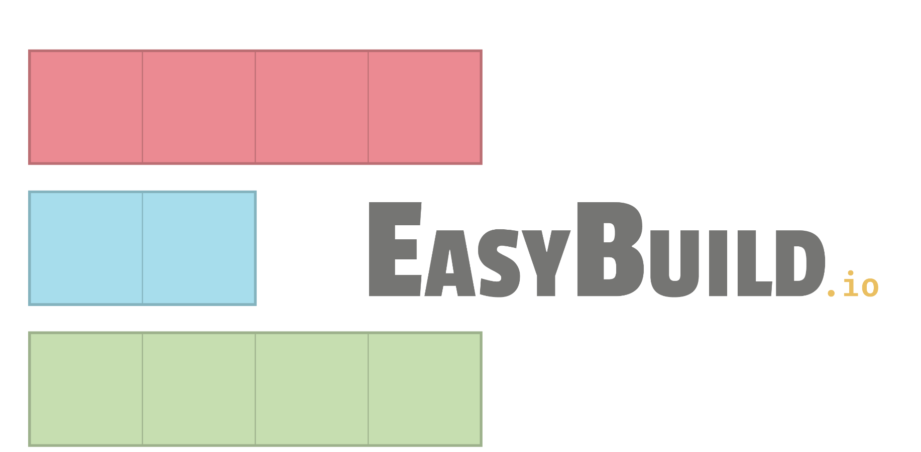








High-level overview of EESSI
Software layer Optimized applications + dependencies
Host OS provides
network & GPU drivers, resource manager (Slurm), ...
Compatibility layer Levelling the ground across client OSs
Testing
Filesystem layer Distribution of the software stack
Host operating system (Linux, macOS, WSL)
MultiXscale kickoff meeting - Overview of technical work packages (WP1, WP5, WP6) (2023-03-23)

Slide 22

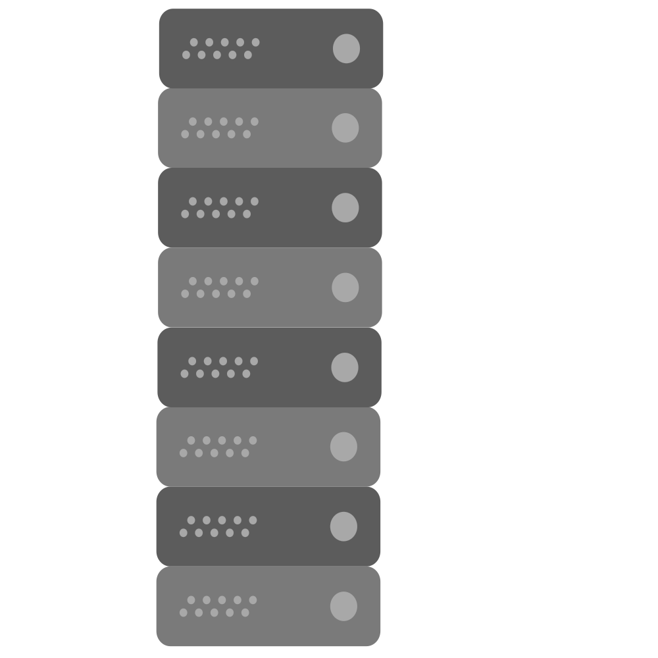





EESSI as a shared software stack
cvmfs.readthedocs.io
(icons via https://www.flaticon.com/authors/smashicons)
HPC cluster X
CernVM-FS Stratum 0
Global distribution of software installations
Centrally managed software stack
Redundant network of “mirrors”
Multiple levels of caching
Same software stack everywhere: laptops, HPC clusters, cloud VMs, …
CernVM-FS
Stratum 1
Squid reverse proxy
Cloud A
Squid forward proxy
MultiXscale kickoff meeting - Overview of technical work packages (WP1, WP5, WP6) (2023-03-23)
22

Slide 23
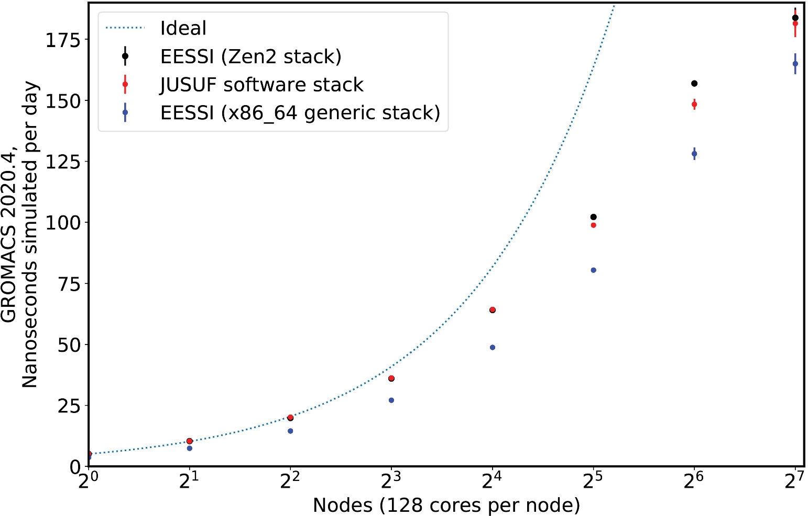
doi.org/10.1002/spe.3075
EESSI paper (open access)
Paper includes proof-of-concept performance evaluation compared to system software stack,
performed at JUSUF @ JSC using GROMACS 2020.4, up to 16,384 cores (CPU-only)

Slide 24
EESSI demo: GROMACS
See also https://eessi.github.io/docs/using_eessi/eessi_demos
Also demos available for Bioconductor, OpenFOAM, TensorFlow
$ source /cvmfs/pilot.eessi-hpc.org/latest/init/bash ... Environment set up to use EESSI pilot software stack, have fun! $ module avail GROMACS TensorFlow OpenFOAM Bioconductor –----- /cvmfs/pilot.eessi-hpc.org/versions/2021.12/software/linux/aarch64/graviton2/modules/all -------
GROMACS/2020.1-foss-2020a-Python-3.8.2 GROMACS/2020.4-foss-2020a-Python-3.8.2 (D)
$ cd eessi-demo/GROMACS; ./run.sh
...
24
Notes:
Do a module avail once we’ve done the sourcing
Some commands are slow (installing cvmfs, sourcing the bash script, running GROMACS), run the commands early and then discuss what they are actually doing

Slide 25
















Web page: https://www.multixscale.eu
Facebook: MultiXscale
Twitter: @MultiXscale
Funded by the European Union. This work has received funding from the European High Performance Computing Joint Undertaking (JU) and countries participating in the project under grant agreement No 101093169.

