Slide 1



Tutorial: writing/contributing easyconfigs
4th EasyBuild User Meeting
January 30th 2019 - Louvain-la-Neuve (Belgium)
https://users.ugent.be/~kehoste/EasyBuild_20190130_tutorial-easyconfigs.pdf
kenneth.hoste@ugent.be https://easybuilders.github.io/easybuild
easybuild@lists.ugent.be https://easybuild.readthedocs.io
https://www.ugent.be/hpc
https://www.vscentrum.be

Slide 2
Contributing to EasyBuild
http://easybuild.readthedocs.io/en/latest/Contributing.html
EasyBuild has improved significantly thanks to the community.
You too can contribute back, by:
  sending feedback
  reporting bugs
  joining the discussion (mailing lists, IRC/Slack, EasyBuild conf calls)
  sharing suggestions/ideas for enhancements & additional features
  contributing easyconfigs, enhancing easyblocks, adding support for new software...
  extending & enhancing documentation

Slide 3
Adding support for additional software
for each software installation, an easyconfig file is required
  defines easyconfig parameters that specify to EasyBuild what to install, and how
  existing easyconfig files can serve as examples
  for version or toolchain updates, a tweaked easyconfig can be generated via eb --try-*
  see https://easybuild.readthedocs.io/en/latest/Writing_easyconfig_files.html
for 'standard' installation procedures, a generic easyblock can be used
  installation can be controlled where needed via easyconfig parameters
for custom installation procedures, a software-specific easyblock is required
  see https://easybuild.readthedocs.io/en/latest/Implementing-easyblocks.html

Slide 4
Writing easyconfig files
https://easybuild.readthedocs.io/en/latest/Writing_easyconfig_files.html
set of values for easyconfig parameters
(strictly speaking order doesn't matter, but we maintain a preferred order & style)
required:
    name, version, toolchain, homepage, description
commonly used:
    easyblock, versionsuffix, source_urls, sources, (build)dependencies, (pre)configopts, (pre)buildopts, (pre)installopts, exts_list, sanity_check_paths, moduleclass

Slide 5
Common generic easyblocks
http://easybuild.readthedocs.io/en/latest/version-specific/generic_easyblocks.html
ConfigureMake
standard './configure' - 'make' - 'make install' installation procedure
CMakeMake
same as ConfigureMake, but using 'cmake' for configuring
PythonPackage
installing an individual Python package ('python setup.py install', 'pip install', ...)
PythonBundle
installing a bundle of Python packages
MakeCp
no (standard) configuration step, build with 'make', install by copying binaries/libraries
Tarball: just unpack sources and copy everything to installation directory
Binary: run binary installer (specified via 'install_cmd' easyconfig parameter)

Slide 6
Easyconfig files vs easyblocks
http://easybuild.readthedocs.io/en/latest/Implementing-easyblocks.html
thin line between using custom easyblock and 'fat' easyconfig with generic easyblock
custom easyblocks are "do once and forget", central solution to build peculiarities
reasons to consider implementing a software-specific easyblock include:
    'critical' values for easyconfig parameters required to make installation succeed
    toolchain-specific aspects of the build and installation procedure (e.g., configure options)
    interactive commands that need to be run
    custom (configure) options for dependencies
    having to create or adjust specific (configuration) files
    'hackish' usage of a generic easyblock

Slide 7
Some useful EasyBuild features
eb --inject-checksums *.eb
    inject (SHA256) checksums for all sources/patches (incl. extensions)
    requirement to contribute back easyconfigs
eb --check-contrib *.eb
    check whether easyconfigs is ready to contribute back
    checks for (some) code style issues (equivalent to --check-style)
        does not (yet) take into account order of easyconfig parameters
    also verifies whether SHA256 checksums are present for all sources/patches

Slide 8
How to contribute easyconfig files
https://easybuild.readthedocs.io/en/latest/Contributing.html
open pull request (PR) to develop branch of easybuild-easyconfigs repository
keep PRs limited in scope (rule of thumb: max. 10 easyconfigs touched per PR)
if possible, submit test report to show the easyconfig(s) works for you
take into account failing unit tests (if any) and comments by reviewer (if any)
be patient...
enjoy eternal glory once your pull request has been merged!

Slide 9
can be a major hurdle for contributors
Potential contributors may not be familiar (yet) with git...
Do they have to learn git first before they can contribute?

Slide 10





So you want to contribute to ...
To contribute one or more easyconfig files,
you first need to prepare:
I shall say do zis only once!
create a GitHub account via
https://github.com/easybuilders/easybuild-easyconfigs
git clone git@github.com:YOU/easybuild-easyconfigs.git
(change this bit!)

Slide 11
Branch, stage, commit, push
Once you have cloned the easyconfigs repository, you can really get to work...
# create and check out a new branch
$ git checkout -b funnybranchname
# stage the new/changed easyconfig file(s)
$ git add easybuild/easyconfigs/s/scikit-learn/*.eb
# commit the changes with a sensible commit message
$ git commit -m "update scikit-learn to 0.19.1"
# push your branch to your fork on GitHub
$ git push origin funnybranchname
(this may be different in your setup, see git remote -v)

Slide 12
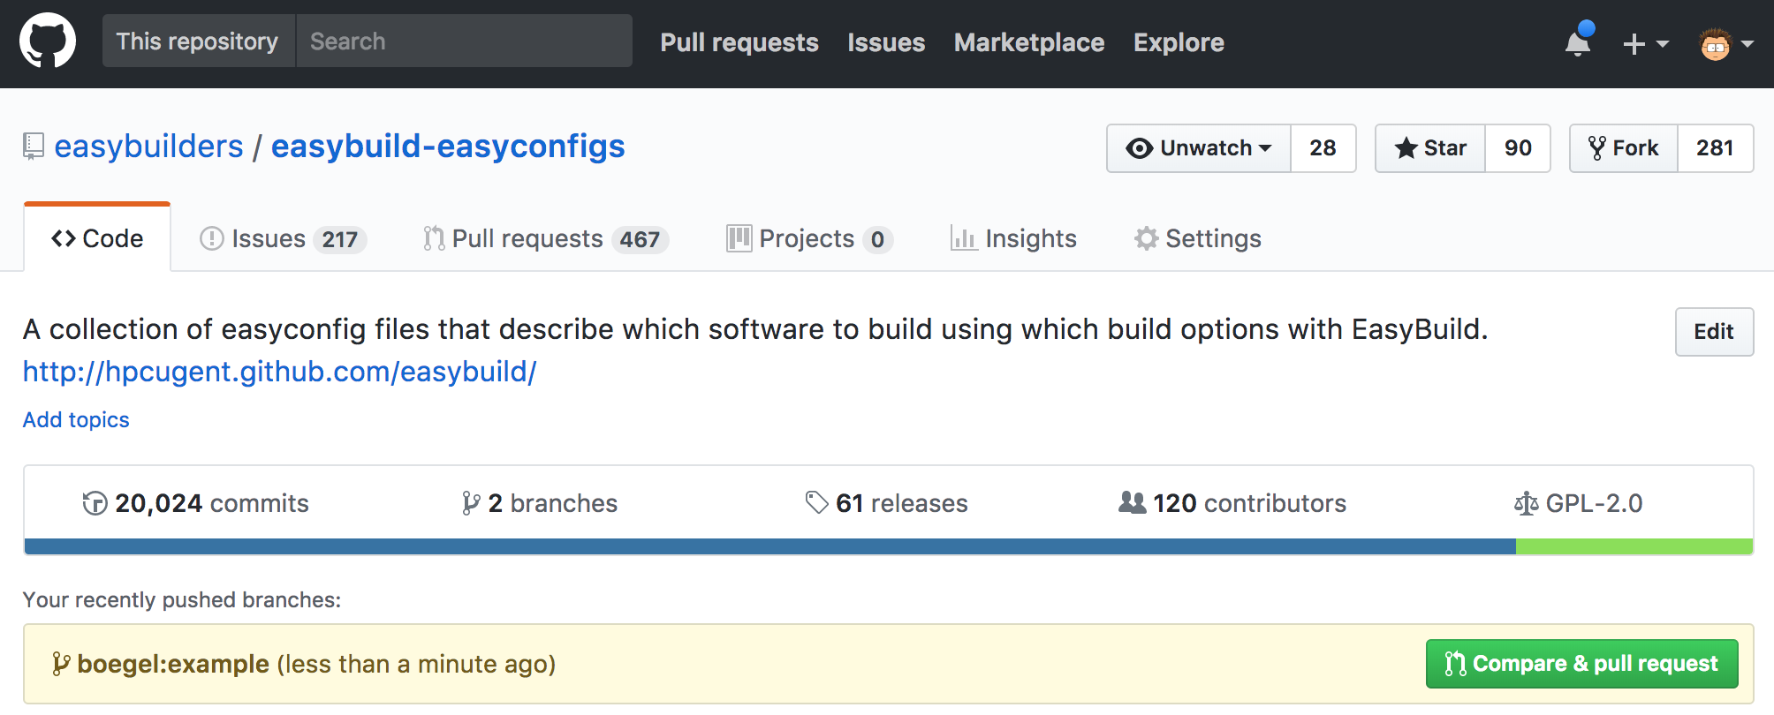
Clickety, clickety, click.
Next, log on to and open a pull request...
You can use this useful button , if you're quick enough!

Slide 13
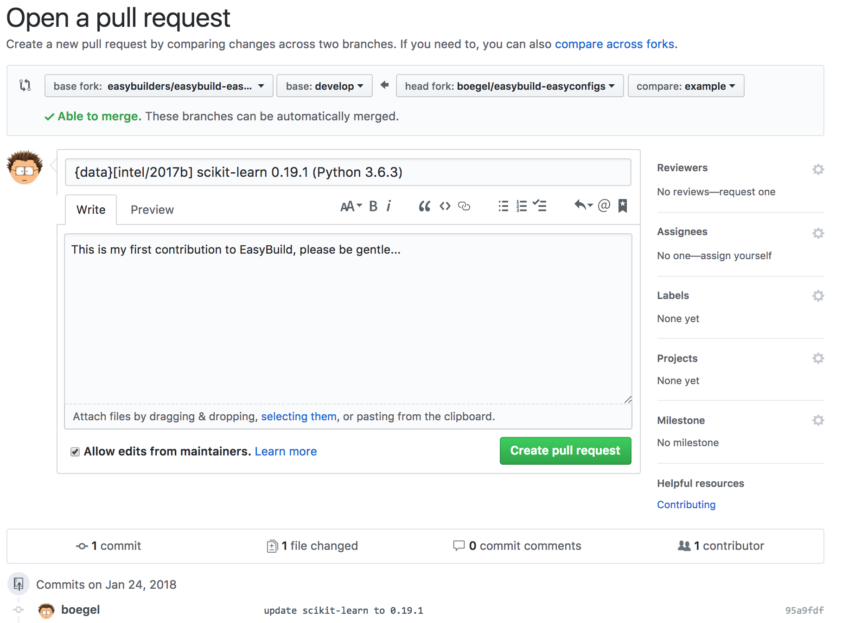

Almost there...
Not too quick...
target develop
tweak PR title
(brief description)
double-check changed files
If you're sure, click the shiny green button...

Slide 14
Are we done yet?
once your pull request is open, your changes will be:
  quickly tested by (automagically)
  reviewed by a maintainer
  thoroughly tested by at least one person
additional changes may be requested...
... which means you may have to go back to git
maybe even multiple times... (spread over multiple hours/days)

Slide 15
Fine-tuning your contribution
Do you still remember the funny branch name you used for that PR?
# check out your branch again
$ git checkout funnybranchname
# edit some files, as requested by the friendly reviewer
$ vim ...
# commit (all) your changes (careful there...)
$ git commit -am "fixed suggestions by reviewer"
# push your updated branch to GitHub to update the PR
$ git push origin funnybranchname

Slide 16
Too much overhead, manual steps...
"Isn't there an easier/more efficient way for doing this?!"
  need to come up with a sensible funny branch name first...
  4 git commands to prepare the contribution
  at least 4 (well aimed) mouse clicks to open the pull request
  if requested, N x 3 more git commands for fine-tuning the PR
  + a bit of cleanup afterwards
  (delete branch both in local repository clone and on GitHub)
All of this assuming you:
  take into account the project policies (code style, etc.)
  don't mess up with git at any time...

Slide 17
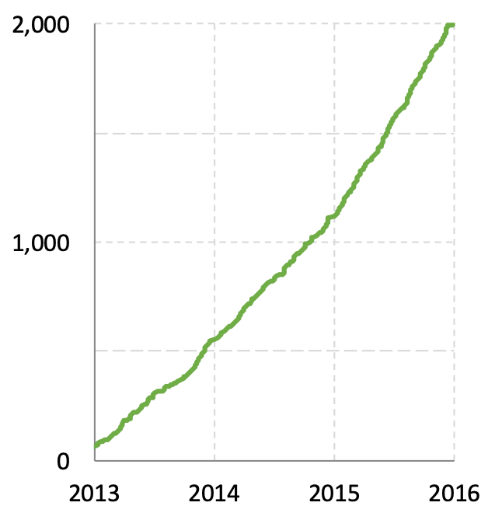
Contributions to
# easyconfig pull requests
more incoming contributions in 2015
    ~500 easyconfig PRs in 2013 & 2014
    almost double that in 2015...
several people were struggling with the contribution procedure
    mainly because they were not sufficiently familiar with git
    most candidate contributors were not (experienced) software developers
    resulted in a lot of frustration & wasted time
    some people even gave up on contributing :(
quite annoying for a project that aims to automate things...

Slide 18
GitHub integration in
https://easybuild.readthedocs.io/en/latest/Integration_with_GitHub.html
goals:
    automate contribution workflow
    avoid direct interaction with git and
initial implementation added support for:
    opening new PRs & updating existing PRs
    downloading & using easyconfigs from a PR
    uploading test reports to a PR
limited to easyconfig files, for now...
    but implemented such that it is easy to extend to easyblocks, and even the EasyBuild framework itself
eb --new-pr
eb --update-pr
eb --from-pr
eb --upload-test-report

Slide 19
Under the covers
GitPython (https://pypi.python.org/pypi/GitPython)
    Python library to interact with
GitHub REST API (https://developer.github.com/v3)
    to automate interaction with GitHub (less clickety, clickety)
keyring Python package (https://pypi.python.org/pypi/keyring)
    Python library that provides access to system keyring
    required to securely store GitHub token

Slide 20
Checking configuration for GitHub integration
eb --check-github
$ eb --check-github
Checking status of GitHub integration...
Making sure we're online...OK
* GitHub user... boegel => OK
* GitHub token... e87..3b1 (len: 40) => OK (validated)
* git command... OK ("git version 1.8.3.1")
* GitPython module... OK (GitPython version 2.1.1)
* push access to boegel/easybuild-easyconfigs repo @ GitHub... OK
* creating gists... OK
* location to Git working dirs... OK (/home/example)
All checks PASSed!
Status of GitHub integration:
* --from-pr: OK
* --new-pr: OK
* --review-pr: OK
* --update-pr: OK
* --upload-test-report: OK
various checks are performed to verify whether required
stuff is in place

Slide 21
Checking configuration for GitHub integration
eb --check-github
$ eb --check-github
Checking status of GitHub integration...
Making sure we're online...OK
* GitHub user... boegel => OK
* GitHub token... e87..3b1 (len: 40) => OK (validated)
* git command... OK ("git version 1.8.3.1")
* GitPython module... OK (GitPython version 2.1.1)
* push access to boegel/easybuild-easyconfigs repo @ GitHub... OK
* creating gists... OK
* location to Git working dirs... OK (/home/example)
All checks PASSed!
Status of GitHub integration:
* --from-pr: OK
* --new-pr: OK
* --review-pr: OK
* --update-pr: OK
* --upload-test-report: OK
overview of what is supported is produced based on
result of checks

Slide 22
Opening new pull requests
eb --new-pr
$ eb --new-pr sklearn.eb
== temporary log file in case of crash /tmp/eb-Iv07fs/easybuild-inS8Ny.log
== fetching branch 'develop' from
https://github.com/easybuilders/easybuild-easyconfigs.git...
== copying easyconfigs to
/tmp/eb-Iv07fs/git-working-dirhYsAA_/easybuild-easyconfigs...
Opening pull request
* target: easybuilders/easybuild-easyconfigs:develop
* from: boegel/easybuild-easyconfigs:20180125211924_new_pr_scikit-learn0191
* title: "{data}[intel/2017b] scikit-learn v0.19.1"
* description:
"""
(created using `eb --new-pr`)
"""
* overview of changes:
.../s/scikit-learn/scikit-learn-0.19.1-intel-2017b-Python-3.6.3.eb | 31 +++++++++++++
1 file changed, 31 insertions(+)
Opened pull request: https://github.com/easybuilders/easybuild-easyconfigs/pull/12345
== Temporary log file(s) /tmp/eb-Iv07fs/easybuild-inS8Ny.log* have been removed.
== Temporary directory /tmp/eb-Iv07fs has been removed.
one single 'eb' command
no 'git' commands, no clickety on GitHub

Slide 23
Opening new pull requests
eb --new-pr
$ eb --new-pr sklearn.eb
== temporary log file in case of crash /tmp/eb-Iv07fs/easybuild-inS8Ny.log
== fetching branch 'develop' from
https://github.com/easybuilders/easybuild-easyconfigs.git...
== copying easyconfigs to
/tmp/eb-Iv07fs/git-working-dirhYsAA_/easybuild-easyconfigs...
Opening pull request
* target: easybuilders/easybuild-easyconfigs:develop
* from: boegel/easybuild-easyconfigs:20180125211924_new_pr_scikit-learn0191
* title: "{data}[intel/2017b] scikit-learn v0.19.1"
* description:
"""
(created using `eb --new-pr`)
"""
* overview of changes:
.../s/scikit-learn/scikit-learn-0.19.1-intel-2017b-Python-3.6.3.eb | 31 +++++++++++++
1 file changed, 31 insertions(+)
Opened pull request: https://github.com/easybuilders/easybuild-easyconfigs/pull/12345
== Temporary log file(s) /tmp/eb-Iv07fs/easybuild-inS8Ny.log* have been removed.
== Temporary directory /tmp/eb-Iv07fs has been removed.
repository is cloned to temporary directory,
develop branch is checked out as a base

Slide 24
Opening new pull requests
eb --new-pr
$ eb --new-pr sklearn.eb
== temporary log file in case of crash /tmp/eb-Iv07fs/easybuild-inS8Ny.log
== fetching branch 'develop' from
https://github.com/easybuilders/easybuild-easyconfigs.git...
== copying easyconfigs to
/tmp/eb-Iv07fs/git-working-dirhYsAA_/easybuild-easyconfigs...
Opening pull request
* target: easybuilders/easybuild-easyconfigs:develop
* from: boegel/easybuild-easyconfigs:20180125211924_new_pr_scikit-learn0191
* title: "{data}[intel/2017b] scikit-learn v0.19.1"
* description:
"""
(created using `eb --new-pr`)
"""
* overview of changes:
.../s/scikit-learn/scikit-learn-0.19.1-intel-2017b-Python-3.6.3.eb | 31 +++++++++++++
1 file changed, 31 insertions(+)
Opened pull request: https://github.com/easybuilders/easybuild-easyconfigs/pull/12345
== Temporary log file(s) /tmp/eb-Iv07fs/easybuild-inS8Ny.log* have been removed.
== Temporary directory /tmp/eb-Iv07fs has been removed.
auto-derived
branch name
GitHub repository to push to
a new branch is created & pushed
(you can specify the branch name yourself)

Slide 25
Opening new pull requests
eb --new-pr
$ eb --new-pr sklearn.eb
== temporary log file in case of crash /tmp/eb-Iv07fs/easybuild-inS8Ny.log
== fetching branch 'develop' from
https://github.com/easybuilders/easybuild-easyconfigs.git...
== copying easyconfigs to
/tmp/eb-Iv07fs/git-working-dirhYsAA_/easybuild-easyconfigs...
Opening pull request
* target: easybuilders/easybuild-easyconfigs:develop
* from: boegel/easybuild-easyconfigs:20180125211924_new_pr_scikit-learn0191
* title: "{data}[intel/2017b] scikit-learn v0.19.1"
* description:
"""
(created using `eb --new-pr`)
"""
* overview of changes:
.../s/scikit-learn/scikit-learn-0.19.1-intel-2017b-Python-3.6.3.eb | 31 +++++++++++++
1 file changed, 31 insertions(+)
Opened pull request: https://github.com/easybuilders/easybuild-easyconfigs/pull/12345
== Temporary log file(s) /tmp/eb-Iv07fs/easybuild-inS8Ny.log* have been removed.
== Temporary directory /tmp/eb-Iv07fs has been removed.
the easyconfig file is renamed
and moved to the right location

Slide 26
Opening new pull requests
eb --new-pr
$ eb --new-pr sklearn.eb
== temporary log file in case of crash /tmp/eb-Iv07fs/easybuild-inS8Ny.log
== fetching branch 'develop' from
https://github.com/easybuilders/easybuild-easyconfigs.git...
== copying easyconfigs to
/tmp/eb-Iv07fs/git-working-dirhYsAA_/easybuild-easyconfigs...
Opening pull request
* target: easybuilders/easybuild-easyconfigs:develop
* from: boegel/easybuild-easyconfigs:20180125211924_new_pr_scikit-learn0191
* title: "{data}[intel/2017b] scikit-learn v0.19.1"
* description:
"""
(created using `eb --new-pr`)
"""
* overview of changes:
.../s/scikit-learn/scikit-learn-0.19.1-intel-2017b-Python-3.6.3.eb | 31 +++++++++++++
1 file changed, 31 insertions(+)
Opened pull request: https://github.com/easybuilders/easybuild-easyconfigs/pull/12345
== Temporary log file(s) /tmp/eb-Iv07fs/easybuild-inS8Ny.log* have been removed.
== Temporary directory /tmp/eb-Iv07fs has been removed.
the pull request is prepared:
target develop branch, title & description

Slide 27
Opening new pull requests
eb --new-pr
$ eb --new-pr sklearn.eb
== temporary log file in case of crash /tmp/eb-Iv07fs/easybuild-inS8Ny.log
== fetching branch 'develop' from
https://github.com/easybuilders/easybuild-easyconfigs.git...
== copying easyconfigs to
/tmp/eb-Iv07fs/git-working-dirhYsAA_/easybuild-easyconfigs...
Opening pull request
* target: easybuilders/easybuild-easyconfigs:develop
* from: boegel/easybuild-easyconfigs:20180125211924_new_pr_scikit-learn0191
* title: "{data}[intel/2017b] scikit-learn v0.19.1"
* description:
"""
(created using `eb --new-pr`)
"""
* overview of changes:
.../s/scikit-learn/scikit-learn-0.19.1-intel-2017b-Python-3.6.3.eb | 31 +++++++++++++
1 file changed, 31 insertions(+)
Opened pull request: https://github.com/easybuilders/easybuild-easyconfigs/pull/12345
== Temporary log file(s) /tmp/eb-Iv07fs/easybuild-inS8Ny.log* have been removed.
== Temporary directory /tmp/eb-Iv07fs has been removed.
a high-level overview of the changes
is shown (similar to output of 'git stat')

Slide 28
Opening new pull requests
eb --new-pr
$ eb --new-pr sklearn.eb
== temporary log file in case of crash /tmp/eb-Iv07fs/easybuild-inS8Ny.log
== fetching branch 'develop' from
https://github.com/easybuilders/easybuild-easyconfigs.git...
== copying easyconfigs to
/tmp/eb-Iv07fs/git-working-dirhYsAA_/easybuild-easyconfigs...
Opening pull request
* target: easybuilders/easybuild-easyconfigs:develop
* from: boegel/easybuild-easyconfigs:20180125211924_new_pr_scikit-learn0191
* title: "{data}[intel/2017b] scikit-learn v0.19.1"
* description:
"""
(created using `eb --new-pr`)
"""
* overview of changes:
.../s/scikit-learn/scikit-learn-0.19.1-intel-2017b-Python-3.6.3.eb | 31 +++++++++++++
1 file changed, 31 insertions(+)
Opened pull request: https://github.com/easybuilders/easybuild-easyconfigs/pull/12345
== Temporary log file(s) /tmp/eb-Iv07fs/easybuild-inS8Ny.log* have been removed.
== Temporary directory /tmp/eb-Iv07fs has been removed.
the pull request is opened automatically,
using the GitHub API & token

Slide 29
Opening a pull request is now... easy!
$ mv sklearn.eb scikit-learn-0.19.1-intel-2017b-Python-3.6.3.eb
$ mv scikit*.eb easybuild/easyconfigs/s/scikit-learn
$ git checkout develop && git pull upstream develop
$ git checkout -b scikit_learn_0191_intel_2017b
$ git add easybuild/easyconfigs/s/scikit-learn
$ git commit -m "{data}[intel/2017b] scikit-learn v0.19.1"
$ git push origin scikit_learn_0191_intel_2017b
+ log into GitHub to actually open the pull request (clickety, clickety...)
one single eb command
no git commands
no GitHub interaction
no (local) branch to clean up
metadata is automatically
derived from easyconfig
saves a lot of time!
eb --new-pr sklearn.eb

Slide 30
Updating existing pull requests
eb --update-pr
to update a PR: provide PR#, updated files and commit message
$ eb --update-pr 12345 sklearn.eb --pr-commit-msg "minor style fixes"
== temporary log file in case of crash /tmp/eb-EKe1WF/easybuild-w1Ycat.log
== Determined branch name corresponding to easybuilders/easybuild-easyconfigs
PR #12345: 20180125211924_new_pr_scikit-learn0191
== fetching branch '20180125211924_new_pr_scikit-learn0191' from https://github.com/boegel/easybuild-easyconfigs.git...
== copying easyconfigs to /tmp/eb-EKe1WF/git-working-dirbIzGHn/easybuild-easyconfigs...
Overview of changes:
.../s/scikit-learn/scikit-learn-0.19.1-intel-2017b-Python-3.6.3.eb | 2 +-
1 file changed, 1 insertion(+), 1 deletion(-)
Updated easybuilders/easybuild-easyconfigs PR #12345 by pushing to branch boegel/20180125211924_new_pr_scikit-learn0191
== Temporary log file(s) /tmp/eb-EKe1WF/easybuild-w1Ycat.log* have been removed.
== Temporary directory /tmp/eb-EKe1WF has been removed.

Slide 31
Updating existing pull requests
eb --update-pr
branch that corresponds with PR is determined automatically
$ eb --update-pr 12345 sklearn.eb --pr-commit-msg "minor style fixes"
== temporary log file in case of crash /tmp/eb-EKe1WF/easybuild-w1Ycat.log
== Determined branch name corresponding to easybuilders/easybuild-easyconfigs
PR #12345: 20180125211924_new_pr_scikit-learn0191
== fetching branch '20180125211924_new_pr_scikit-learn0191' from https://github.com/boegel/easybuild-easyconfigs.git...
== copying easyconfigs to /tmp/eb-EKe1WF/git-working-dirbIzGHn/easybuild-easyconfigs...
Overview of changes:
.../s/scikit-learn/scikit-learn-0.19.1-intel-2017b-Python-3.6.3.eb | 2 +-
1 file changed, 1 insertion(+), 1 deletion(-)
Updated easybuilders/easybuild-easyconfigs PR #12345 by pushing to branch boegel/20180125211924_new_pr_scikit-learn0191
== Temporary log file(s) /tmp/eb-EKe1WF/easybuild-w1Ycat.log* have been removed.
== Temporary directory /tmp/eb-EKe1WF has been removed.

Slide 32
Updating existing pull requests
eb --update-pr
PR branch is downloaded to temporary directory,
updated files are copied
$ eb --update-pr 12345 sklearn.eb --pr-commit-msg "minor style fixes"
== temporary log file in case of crash /tmp/eb-EKe1WF/easybuild-w1Ycat.log
== Determined branch name corresponding to easybuilders/easybuild-easyconfigs
PR #12345: 20180125211924_new_pr_scikit-learn0191
== fetching branch '20180125211924_new_pr_scikit-learn0191' from https://github.com/boegel/easybuild-easyconfigs.git...
== copying easyconfigs to /tmp/eb-EKe1WF/git-working-dirbIzGHn/easybuild-easyconfigs...
Overview of changes:
.../s/scikit-learn/scikit-learn-0.19.1-intel-2017b-Python-3.6.3.eb | 2 +-
1 file changed, 1 insertion(+), 1 deletion(-)
Updated easybuilders/easybuild-easyconfigs PR #12345 by pushing to branch boegel/20180125211924_new_pr_scikit-learn0191
== Temporary log file(s) /tmp/eb-EKe1WF/easybuild-w1Ycat.log* have been removed.
== Temporary directory /tmp/eb-EKe1WF has been removed.

Slide 33
Updating existing pull requests
eb --update-pr
updated files are renamed and moved to right location
$ eb --update-pr 12345 sklearn.eb --pr-commit-msg "minor style fixes"
== temporary log file in case of crash /tmp/eb-EKe1WF/easybuild-w1Ycat.log
== Determined branch name corresponding to easybuilders/easybuild-easyconfigs
PR #12345: 20180125211924_new_pr_scikit-learn0191
== fetching branch '20180125211924_new_pr_scikit-learn0191' from https://github.com/boegel/easybuild-easyconfigs.git...
== copying easyconfigs to /tmp/eb-EKe1WF/git-working-dirbIzGHn/easybuild-easyconfigs...
Overview of changes:
.../s/scikit-learn/scikit-learn-0.19.1-intel-2017b-Python-3.6.3.eb | 2 +-
1 file changed, 1 insertion(+), 1 deletion(-)
Updated easybuilders/easybuild-easyconfigs PR #12345 by pushing to branch boegel/20180125211924_new_pr_scikit-learn0191
== Temporary log file(s) /tmp/eb-EKe1WF/easybuild-w1Ycat.log* have been removed.
== Temporary directory /tmp/eb-EKe1WF has been removed.

Slide 34
Updating existing pull requests
eb --update-pr
changes are committed, high-level overview is shown (cfr. 'git stat')
$ eb --update-pr 12345 sklearn.eb --pr-commit-msg "minor style fixes"
== temporary log file in case of crash /tmp/eb-EKe1WF/easybuild-w1Ycat.log
== Determined branch name corresponding to easybuilders/easybuild-easyconfigs
PR #12345: 20180125211924_new_pr_scikit-learn0191
== fetching branch '20180125211924_new_pr_scikit-learn0191' from https://github.com/boegel/easybuild-easyconfigs.git...
== copying easyconfigs to /tmp/eb-EKe1WF/git-working-dirbIzGHn/easybuild-easyconfigs...
Overview of changes:
.../s/scikit-learn/scikit-learn-0.19.1-intel-2017b-Python-3.6.3.eb | 2 +-
1 file changed, 1 insertion(+), 1 deletion(-)
Updated easybuilders/easybuild-easyconfigs PR #12345 by pushing to branch boegel/20180125211924_new_pr_scikit-learn0191
== Temporary log file(s) /tmp/eb-EKe1WF/easybuild-w1Ycat.log* have been removed.
== Temporary directory /tmp/eb-EKe1WF has been removed.

Slide 35
Updating existing pull requests
eb --update-pr
modified branch is pushed to GitHub to update the PR
$ eb --update-pr 12345 sklearn.eb --pr-commit-msg "minor style fixes"
== temporary log file in case of crash /tmp/eb-EKe1WF/easybuild-w1Ycat.log
== Determined branch name corresponding to easybuilders/easybuild-easyconfigs
PR #12345: 20180125211924_new_pr_scikit-learn0191
== fetching branch '20180125211924_new_pr_scikit-learn0191' from https://github.com/boegel/easybuild-easyconfigs.git...
== copying easyconfigs to /tmp/eb-EKe1WF/git-working-dirbIzGHn/easybuild-easyconfigs...
Overview of changes:
.../s/scikit-learn/scikit-learn-0.19.1-intel-2017b-Python-3.6.3.eb | 2 +-
1 file changed, 1 insertion(+), 1 deletion(-)
Updated easybuilders/easybuild-easyconfigs PR #12345 by pushing to branch boegel/20180125211924_new_pr_scikit-learn0191
== Temporary log file(s) /tmp/eb-EKe1WF/easybuild-w1Ycat.log* have been removed.
== Temporary directory /tmp/eb-EKe1WF has been removed.

Slide 36
Updating a PR in 1, 2, 3
First, figure out the (funny) branch name corresponding to the PR...
$ git checkout scikit_learn_0191_intel_2017b
$ cd easybuild/easyconfigs/s/scikit-learn
$ vim scikit-learn-0.19.1-intel-2017b-Python-3.6.3.eb
$ git add scikit*.eb
$ git commit -m "fix typo"
$ git push origin scikit_learn_0191_intel_2017b
one single eb command
no git commands
no GitHub interaction
no (local) branch to clean up
no local branch to clean up
once PR is merged
saves a lot of time!
eb --update-pr 12345 sklearn.eb --pr-commit-msg "fix typo"

Slide 37
Using easyconfigs from a PR
eb --from-pr
no need to manually download easyconfigs to feed them to eb
PR is (virtually) merged with current develop branch under /tmp
very useful when testing contributions!
$ eb --from-pr 12345
== temporary log file in case of crash /tmp/eb-kQRw7W/easybuild-HU4hce.log
== processing EasyBuild easyconfig /tmp/eb-kQRw7W/files_pr12345/s/scikit-learn/scikit-learn-0.19.1-intel-2017b-Python-3.6.3.eb
== building and installing scikit-learn/0.19.1-intel-2017b-Python-3.6.3...
== fetching files...
== creating build dir, resetting environment...
== unpacking...
== patching...
== preparing...
== configuring...
== building...
== testing...
== installing...

Slide 38
Uploading test reports to a PR
eb --upload-test-report
combined with --from-pr to test contribution and report results in PR
test report with info on host & environment is uploaded as a gist
a comment is added in the PR to trigger a notification by GitHub
--from-pr
$ eb --from-pr 12345 --upload-test-report
...
== building and installing scikit-learn/0.19.1-intel-2017b-Python-3.6.3...
...
== COMPLETED: Installation ended successfully
...
Adding comment to easybuild-easyconfigs issue #12345: 'Test report by @boegel
**SUCCESS**
Build succeeded for 1 out of 1 (1 easyconfigs in this PR)
<hostname> - Linux CentOS 7.5, Intel Xeon CPU E5-2680 v3 @ 2.50GHz, Python 2.7.5
See https://gist.github.com/3c...58 for a full test report.'
== Test report uploaded to https://gist.github.com/3c...58 and mentioned in a comment in easyconfigs PR#12345
== Build succeeded for 1 out of 1

Slide 39
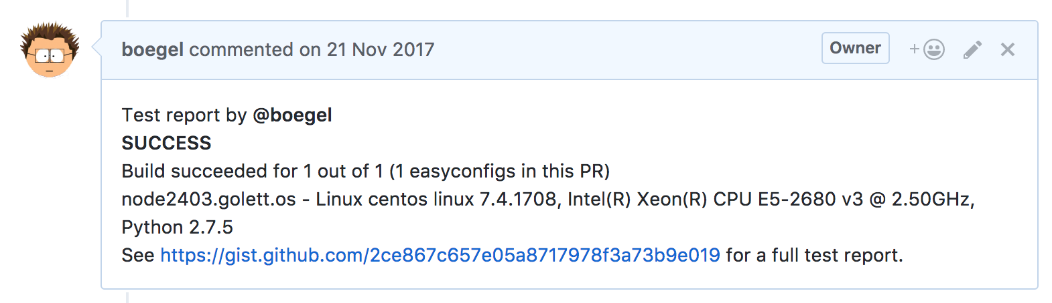
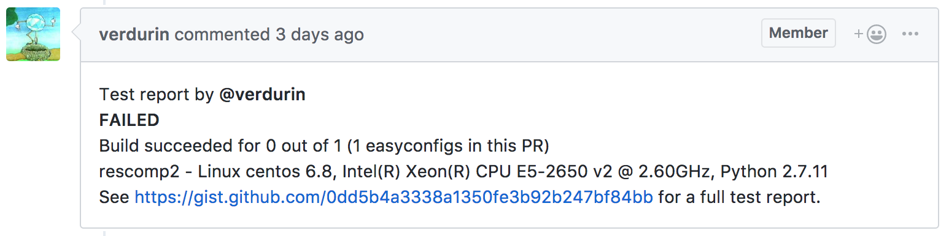
Uploading test reports to a PR
eb --upload-test-report

Slide 40
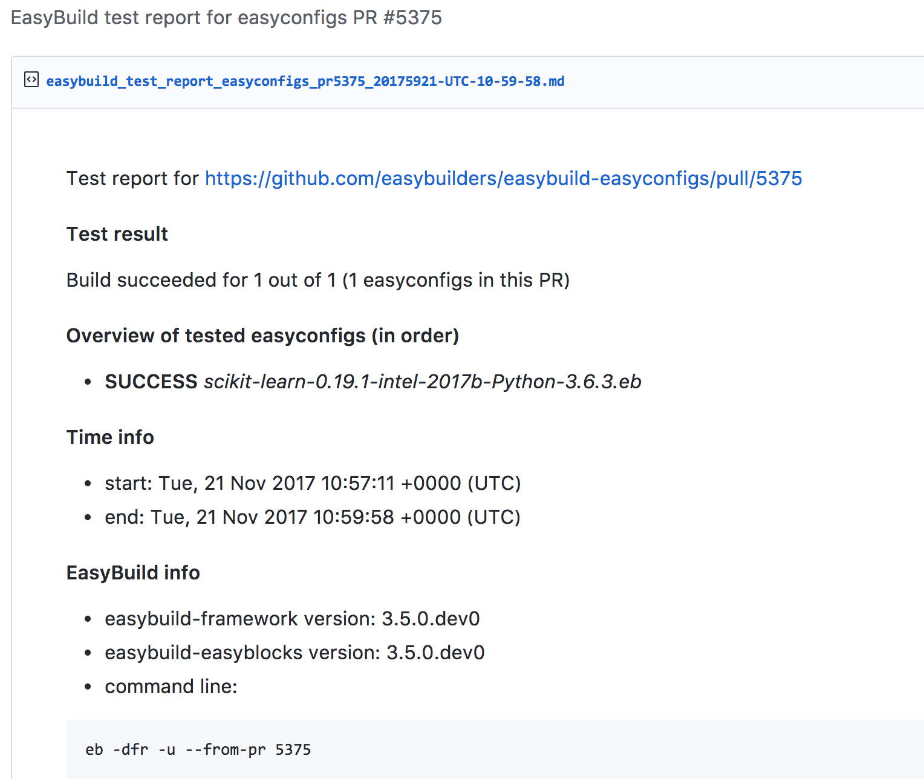
Uploading test reports to a PR
eb --upload-test-report

Slide 41
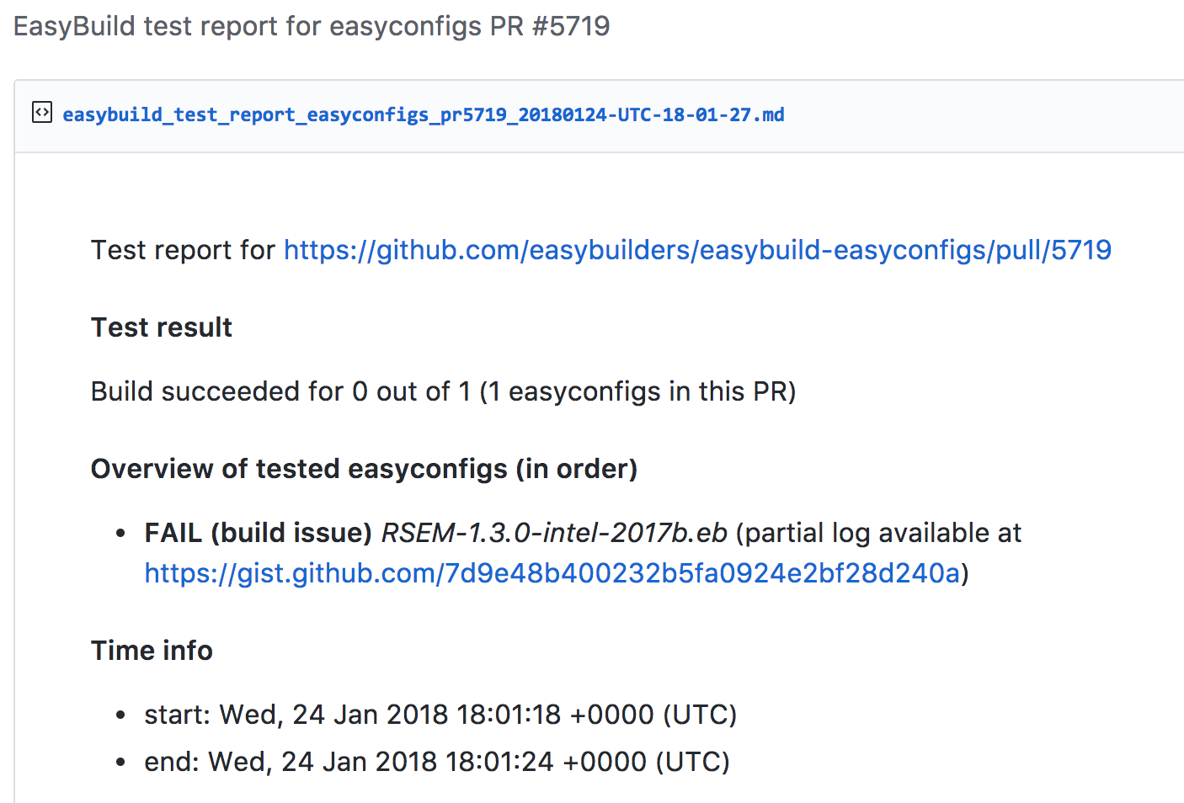
Uploading test reports to a PR
eb --upload-test-report
a separate gist provides partial build log

Slide 42
Reviewing pull requests
eb --review-pr
reviewer should ideally also compare new easyconfig files
with existing ones for the same software
    just a version bump or different toolchain?
    also other changes?
    to check whether fixes that are already in place in
    develop branch are not overlooked
this goes beyond what GitHub can do
quite tedious to do manually...
what are the most relevant easyconfigs to compare with?
    same software (major) version, same toolchain (version), ...

Slide 43
Previewing & reviewing pull requests
eb --preview-pr
eb --review-pr
(multi)diff between contributed easyconfig and existing one(s)
can be used both to preview a contribution and to review a PR
removed
$ eb --review-pr 5736
Comparing BamTools-2.5.1-intel-2017b.eb with
BamTools-2.5.0-intel-2017b.eb
=====
2 - version = '2.5.0' (1/1)
2 + version = '2.5.1' (1/1)
-----
11 - checksums = ['dd4185bdba6e3adf2c24b7f93a57233d'] (1/1)
11 + checksums = ['98e90632058f85bd5eed6088b3ff912e'] (1/1)
-----
added
comparison is done with (most) relevant easyconfigs in current develop branch

Slide 44
Merging pull requests
eb --merge-pr
verifies whether PR is eligible to be merged, and merges it if so
$ eb --merge-pr 5722
easybuilders/easybuild-easyconfigs PR #5722 was submitted by vanzod, you are using GitHub account 'boegel'
Checking eligibility of easybuilders/easybuild-easyconfigs PR #5722 for merging...
* targets develop branch: OK
* test suite passes: OK
* last test report is successful: OK
* approved review: OK (by boegel)
* milestone is set: OK (3.6.0)
Review OK, merging pull request!
Adding comment to easybuild-easyconfigs issue #5722:
'Going in, thanks @vanzod!'
merging pull requests can be
done from the command line
(after approved visual review)

Slide 45
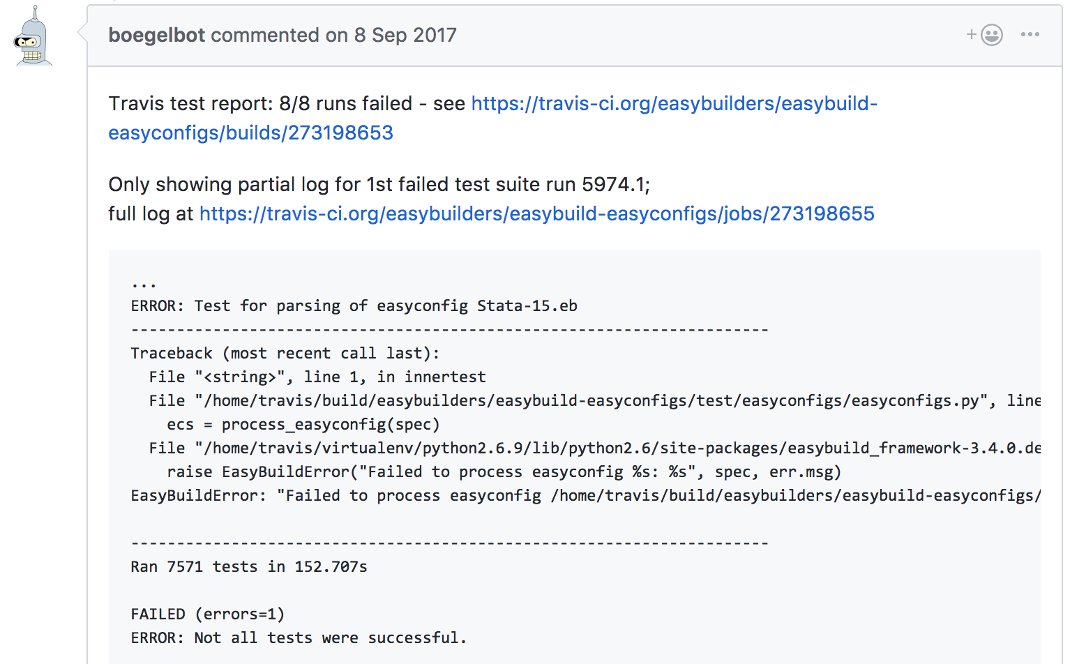
boegelbot
bot that creates comments in PRs if tests fail in Travis CI
  mainly to trigger GitHub to send notifications
  also to trigger contributor to fix problems w/o intervention of a human/maintainer
also automatically re-triggers tests that failed
because of flukes in Travis CI (e.g. connectivity issues)
see https://github.com/boegel/boegelbot

Slide 46
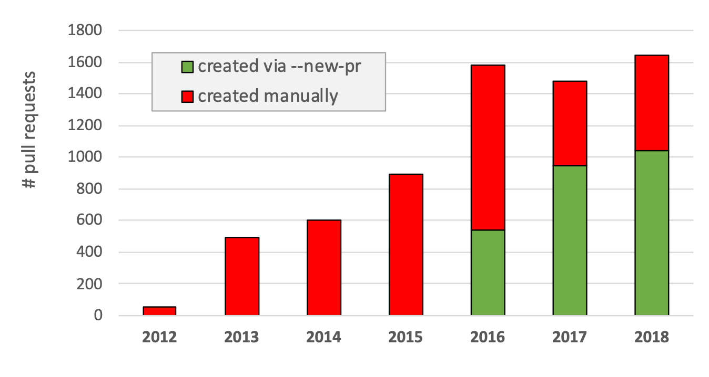
Impact on contributions (easyconfigs)
> 500 PRs opened using eb --new-pr in 2016 (34% of total)
almost 1000 PRs in 2017 using --new-pr (63%), just over 1000 PRs in 2018 (63%)
~80% more PRs in 2016 & 2017 compared to 2015; over 1,600 PRs in 2018

Slide 47
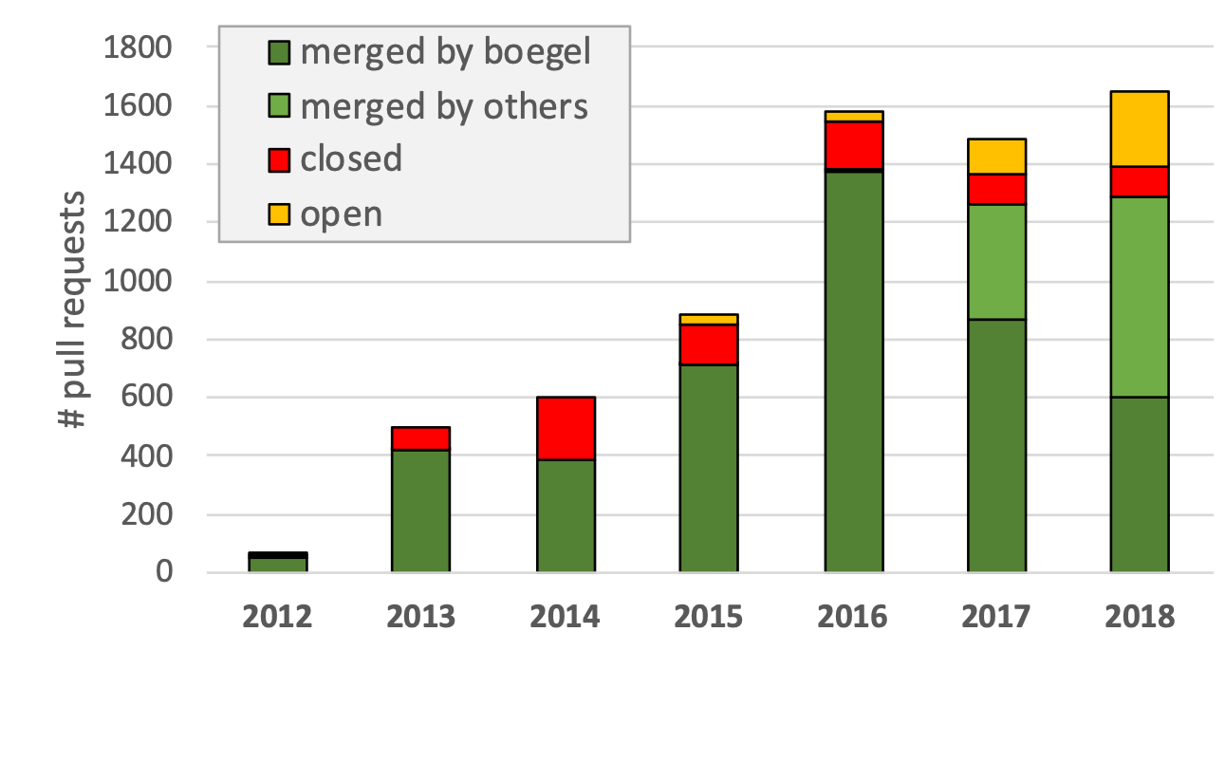
Impact on contributions (easyconfigs)
GitHub integration has helped (a lot) to keep pace with incoming PRs
85-% of PRs gets merged (there's usually a good reason for the ones that are not)
would have been difficult without automation due to amount of PRs

Slide 48
Tutorial: writing/contributing easyconfigs
4th EasyBuild User Meeting
January 30th 2019 - Louvain-la-Neuve (Belgium)
https://users.ugent.be/~kehoste/EasyBuild_20190130_tutorial-easyconfigs.pdf
kenneth.hoste@ugent.be https://easybuilders.github.io/easybuild
easybuild@lists.ugent.be https://easybuild.readthedocs.io
https://www.ugent.be/hpc
https://www.vscentrum.be

