Slide 1
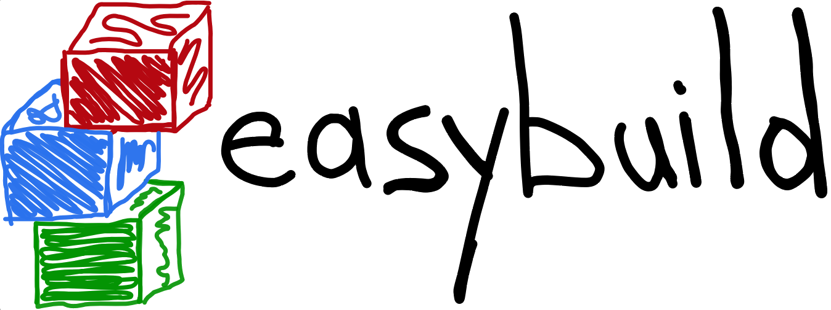


State of the Union
4th EasyBuild User Meeting
January 30th 2019 - Louvain-la-Neuve (Belgium)
https://users.ugent.be/~kehoste/EasyBuild_20190130_state-of-the-union.pdf
kenneth.hoste@ugent.be https://easybuilders.github.io/easybuild easybuild@lists.ugent.be https://easybuild.readthedocs.io
https://www.ugent.be/hpc
https://www.vscentrum.be

Slide 2
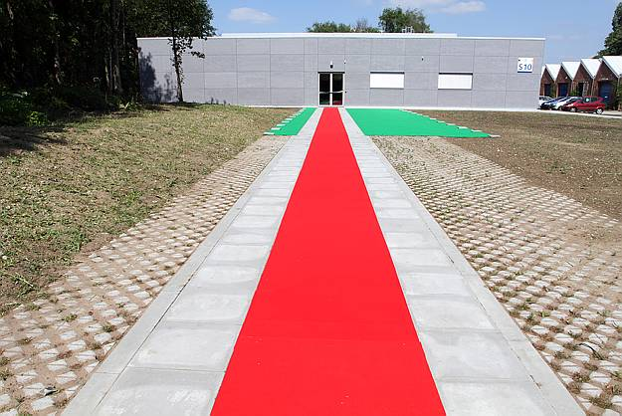

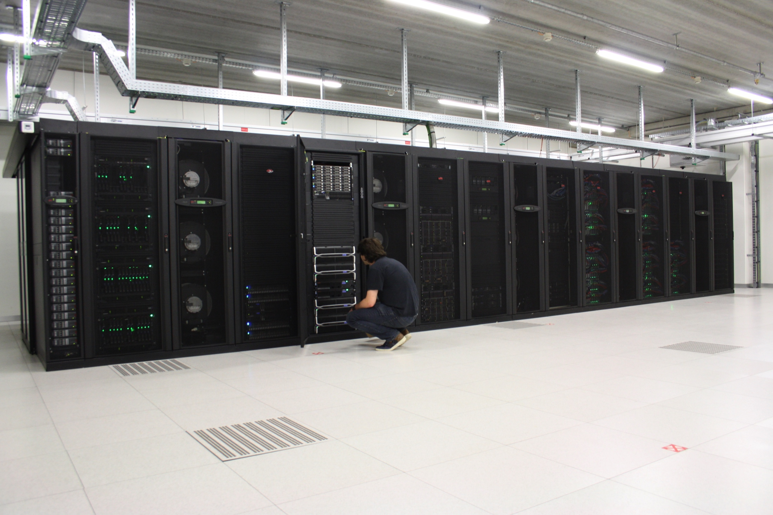
HPC-UGent
part of central IT department of Ghent University (Belgium)
centralised scientific computing services, training & support
for researchers of UGent, industry & knowledge institutes
core values: empowerment - centralisation - automation - collaboration
member of Flemish Supercomputer Centre (VSC) https://www.vscentrum.be
birth place of EasyBuild (summer 2009)

Slide 3

kenneth.hoste@ugent.be @boegel (GitHub, IRC, Slack) @kehoste (Twitter)
whoami
Masters & PhD in Computer Science from UGent
joined HPC-UGent team in October 2010
main tasks: user support & training, software installations
inherited maintenance of (something that looked like) EasyBuild in 2011
slowly also became EasyBuild lead developer & release manager
likes family, beer, loud music, FOSS, helping people, dad jokes, stickers, ...
doesn't like CMake, SCons, Bazel, setuptools, software dependencies, ...

Slide 4
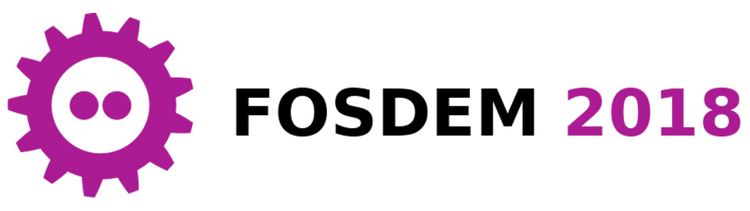

How to make package managers cry
https://archive.fosdem.org/2018/schedule/event/how_to_make_package_managers_cry https://www.youtube.com/watch?v=NSemlYagjIU
me venting ~7 years of frustration with getting scientific software installed
TensorFlow as main motivator
sarcastic tone for dramatic effect (it worked!)
lots of feedback (and ideas for an extended version of the talk)
clearly hit a nerve...

Slide 5
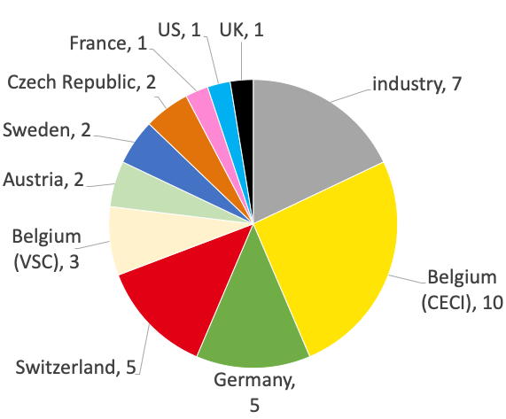
4th EasyBuild User Meeting: 39 attendees (10 countries)
Cenearo diviti Gluo
IBM Red Hat Sylabs
Previous user meetings:
2016: 19 (HPC-UGent)
2017: 35 (JSC)
2018: 45 (SurfSARA)

Slide 6
EUM19 agenda (Wednesday, Jan 30th 2019)
[10.00am] Welcome (prof. Bernard Nysten, UCLouvain)
[10.15am] EasyBuild: State of the Union (Kenneth Hoste, HPC-UGent)
[12.00pm] lunch break
[1.00pm] site presentations: CECI, CSCS, IT4Innovations, Fred Hutch
[3.00pm] coffee break
[3.30pm] Tutorial on creating/contributing easyconfig files (Kenneth Hoste)
[4.00pm] Hands-on session (+ brewery visits)

Slide 7
EUM19 agenda (Thursday, Jan 31st 2019) [1/2]
[09.00am] Collective Knowledge framework (Grigori Fursin, diviti)
[09.30am] OpenHPC introduction (Adrian Reber, Red Hat)
[10.00am] ReFrame, A Regression Testing and Continuous Integration Framework for HPC systems (Victor Holanda Rusu, CSCS)
[10.30am] Hands-on session + coffee break
[11.20am] Deploying Electronic-Structure Codes with EasyBuild (Yann Pouillon, University of Cantabria) [remote]
[12.00pm] lunch break

Slide 8
EUM19 agenda (Thursday, Jan 31st 2019) [2/2]
[1.00pm] Singularity 3.0 (Eduardo Arango, Sylabs)
[2.00pm] Hands-on session (+ coffee break)
[3.00pm] Cloud & local software deployment using CVMFS, EasyBuild & Lmod (Davide Vanzo, Vanderbilt University) [remote]
[4.00pm] Lmod/XALT update (Robert McLay, TACC) [remote]
[4.45pm] Python at Compute Canada (Bart Oldeman, ComputeCanada) [remote]
[5.15pm] Hands-on session
[6.30pm] Group dinner (sponsored by HPC-UGent)

Slide 9
EUM19 agenda (Friday, Feb 1st 2019)
[9.00am] Modules: automatic and consistent handling of module file dependencies (Xavier Delaruelle, CEA)
[9.30am] Ansible module for EasyBuild (Olivier Mattelaer, UCLouvain/CISM)
[10.00am] Finding a home for EasyBuild in EuroHPC (Alan O'Cais, JSC)
[10.30am] (coffee break +) hands-on session (+ lunch break)
[1.00pm] Spack: a Package Manager For Scientific Software (Massimiliano Culpo, EPFL)
[1.45pm] (coffee break +) hands-on session (+ brewery visits)

Slide 10
Live streaming & recording of all EUM19 talks
Live streaming of all talks via the (brand new) EasyBuild YouTube channel https://www.youtube.com/channel/UCqPyXwACj3sjtOho7m4haVA
(or https://tiny.cc/easybuild_youtube)
Talk recordings should be available there shortly after each talk
Talks from all 4 previous EasyBuild User Meetings are also listed there, together with other talks on EasyBuild and related tools (see playlists)

Slide 11

2nd EasyBuild User Survey
anonymous survey via
intention was to get better insight in EasyBuild community & usage
survey invitations sent via EasyBuild mailing list, Slack/IRC + Twitter
36 questions, 11 min. to fill out (on average)
93 responses (up from 77 last year)
assumed to give a fairly relevant view (but results interpreted with a grain of salt)
(results are discussed out of order compared to order of questions in survey)
￼

Slide 12
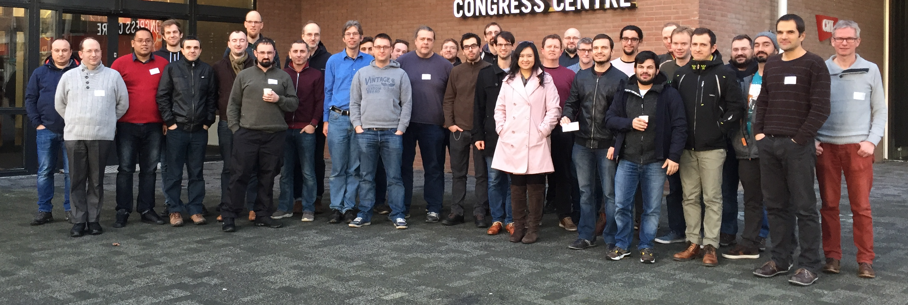
group picture 3rd EasyBuild User Meeting @ SurfSARA (Jan 2018)
The EasyBuild community
EasyBuild community has been growing rapidly the last couple of years
hundreds of HPC sites and companies worldwide, incl. JSC, CSCS, SURFsara, Pfizer, ...
very welcoming & supportive to newcomers

Slide 13
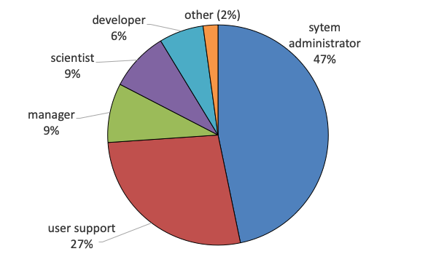
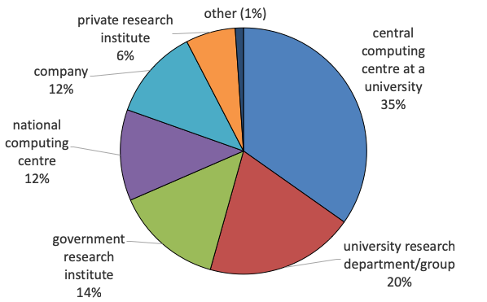
2nd EasyBuild User Survey
What is your primary profile?
What type of organisation do you work for?
Clear bias towards sysadmins & user support.
(very similar results compared to previous survey for both)
￼

Slide 14
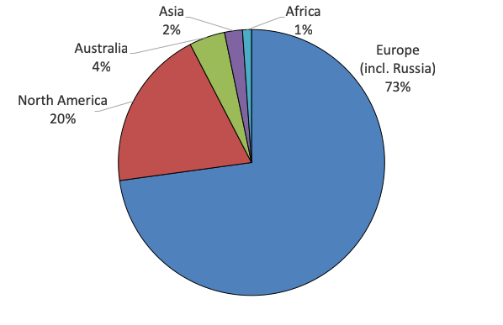
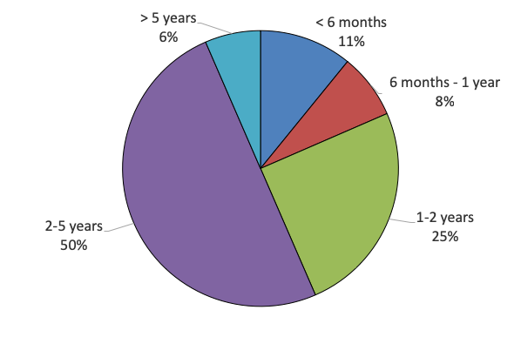
2nd EasyBuild User Survey
In which part of the world are you located?
How long have you been using EasyBuild?
Small shift to more Europe (64% ☞ 73%), less North America (27% ☞ 20%) Spack effect?
Small shift to "long-term" (> 1 year) users, "new" users (< 1 year) from 26% to 19%
￼

Slide 15
is ...
not YABT (Yet Another Build Tool) it does not replace build tools like cmake or make; it wraps around them
not a replacement for your favourite package manager (yum, apt-get, ...) it leverages some tools & libraries provided by the OS (glibc, OpenSSL, libibverbs, ...)
not a magic solution to all your (software compilation/installation) problems... you may still run into compiler errors (if nobody else has already taken care of it)

Slide 16
is ...
a uniform interface that wraps around software installation procedures
a huge time-saver, by automating tedious/boring/repetitive tasks
a way to provide a consistent software stack to your users
an expert system for software installation on HPC systems
a platform for collaboration with HPC sites worldwide
a way to let users to manage their own software stack on HPC systems

Slide 17
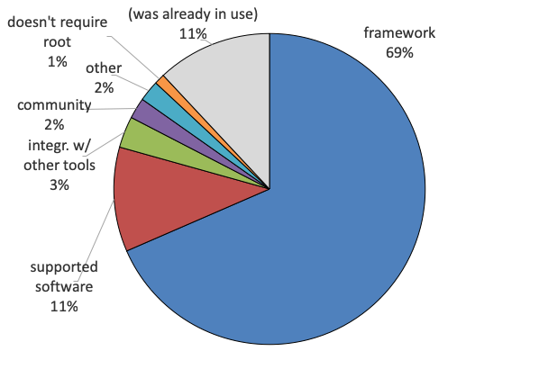
2nd EasyBuild User Survey
What is the main aspect of EasyBuild that convinced you to start using it?
Framework functionality (67% ☞ 69%) and supported software (18% ☞ 11%) remain biggest factors.
￼

Slide 18
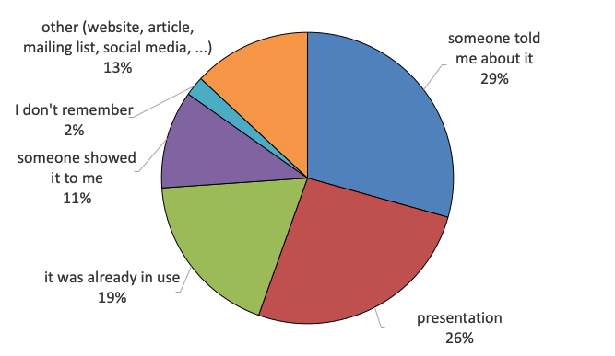
2nd EasyBuild User Survey
How did you first learn about EasyBuild?
Majority is still by word-of-mouth (79% ☞ 67%),
significant increase of "already in use" (4% ☞ 19%)
￼

Slide 19
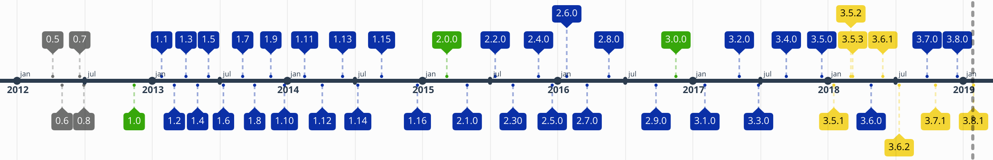
6 years of (stable)
in-house development at HPC-UGent since summer 2009
first public release in April 2012 (EasyBuild v0.5)
first stable release on November 13th 2012, during SC'12 (EasyBuild v1.0)
intention was to get feedback, but gradually a community emerged around it...
frequent stable releases since then (latest: EasyBuild v3.8.1, Jan 29th 2019)
community-driven development: bug reports, feature requests, contributions

Slide 20
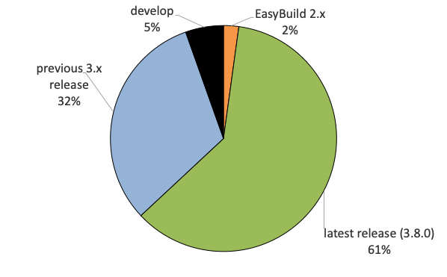
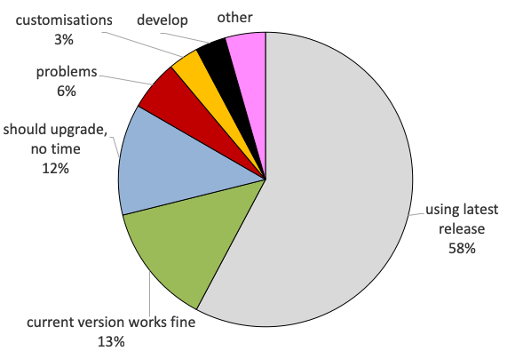
2nd EasyBuild User Survey
Which EasyBuild version do you use?
If you're not using the latest release, why not?
95% relies on EasyBuild releases, majority is up-to-date with most recent version. (very similar to previous survey)
(very similar to previous survey)
￼

Slide 21
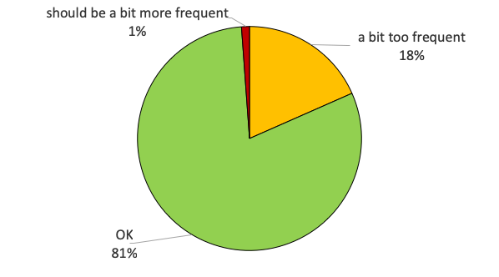
2nd EasyBuild User Survey
How do you like the frequency of EasyBuild releases?
significant increase in 'OK' compared to previous survey: 65% ☞ 81%
￼

Slide 22
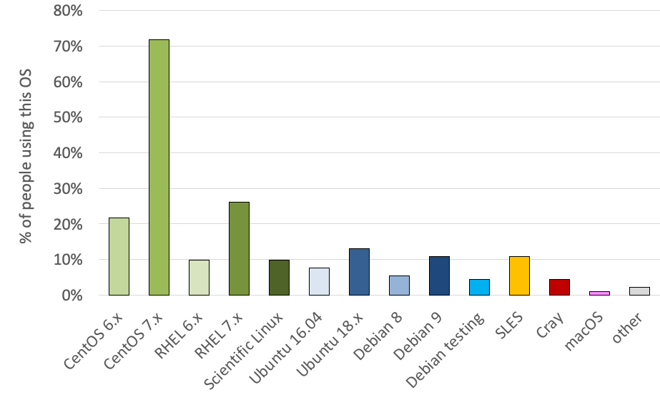
2nd EasyBuild User Survey
On which operating system(s) do you use EasyBuild (most commonly)?
(multiple answers possible)
Red Hat based distros are most prevalent (green)
20% still using CentOS 6.x, 10% RHEL6 (Python 2.6)
minority use Debian-based OS (blue), SLES, or Cray
￼

Slide 23
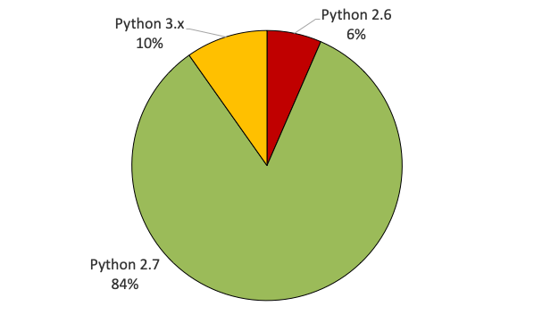
2nd EasyBuild User Survey
Which Python version do you usually use to run EasyBuild?
vast majority uses Python 2.7 (83% ☞ 84%)
significant decline for Python 2.6 (16% ☞ 6%)
I want to talk to the people who are already using EasyBuild on top of Python 3... (more people use Python 3.x than Python 2.6?!)
￼

Slide 24
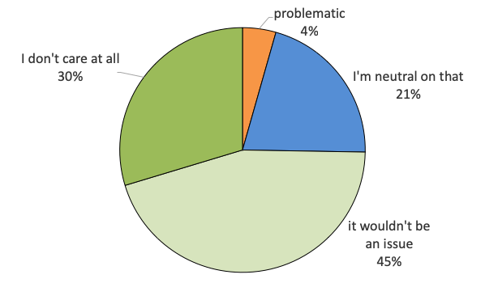
2nd EasyBuild User Survey
How troublesome would it be for you if EasyBuild becomes incompatible with Python 2.6?
no longer supporting Python 2.6 would probably not have a high impact
nobody answered "disastrous"
declining number of people care about Python 2.6 (13% ☞ 4%)
some people stuck on CentOS 6 or RHEL 6 have installed Python 2.7
￼

Slide 25
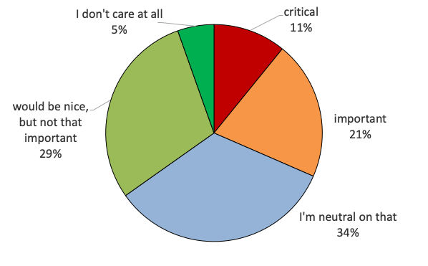
2nd EasyBuild User Survey
How important is it to you that EasyBuild becomes compatible with Python 3?
results are quite similar to previous survey
slightly more people worry about Python 3 compatibility (27% ☞ 32%)
more people consider it critical (4% ☞ 11%)
Python 2 is end-of-line Jan 1st 2020... (https://www.python.org/dev/peps/pep-0373)
... yet RHEL8 will still include python2 (?!)
￼

Slide 26

EasyBuild 4.0
see also https://github.com/easybuilders/easybuild/issues/447
(preliminary) ETA: summer 2019
Goals:
compatibility with Python 3 (+ Python 2.7, maybe still Python 2.6)
no (required) dependencies
no vsc-install, vsc-base, setuptools required
single-tarball releases on PyPI
rather than 3+1 releases now (framework, easyblocks, easyconfigs + 'easybuild' meta-package)
different GitHub repositories will stay (different rate of development)
Deprecating the dummy toolchain, adding system toolchain as replacement
custom easyblock for Open MPI
switch to using 'pip' as default installer for Python packages (?)
2
3
￼

Slide 27
Python 3 support is work-in-progress
2
3
porting effort to allow running EasyBuild with Python 3 already under way
intention is to work on Python 3 support in parallel with EasyBuild 3.x
see separate 4.x branch in easybuild-framework repository
4.x branch is kept in sync with current develop
current status:
relevant code from vsc-install + vsc-base ingested into easybuild-framework
all Python 3 syntax errors fixed: all Python modules in framework can be imported
EasyBuild configuration works
tests pass for easybuild.tools.filetools module
￼

Slide 28

Python 3 support is work-in-progress
2
3
Planning:
first all framework tests should pass on top of Python 3 (WIP, about halfway there?)
step by step, small PRs that are easy to review
after framework, easyblocks can be ported (minor effort, mostly imports?)
nothing much to do for easyconfigs?
testing, testing, testing...
EasyBuild 4.0.0 release with (experimental?) support for Python 3
Actively helping out with this effort is very much appreciated!
see label: https://github.com/easybuilders/easybuild-framework/labels/python3
￼

Slide 29
Community (common) toolchains
http://easybuild.readthedocs.io/en/latest/Common-toolchains.html
intel and foss¹ toolchains are most commonly used in EasyBuild community
helps to focus efforts of HPC sites using one or both of these toolchains
updated twice a year, clear versioning scheme: <year>{a,b} (2017b, 2018a, ...)
latest version:
foss/2019a binutils 2.31.1, GCC 8.2, OpenMPI 3.1.3, OpenBLAS 0.3.5 (incl. (Sca)LAPACK), FFTW 3.3.8
intel/2019b binutils 2.31.1 + GCC 8.2 as base Intel compilers 2019.1.144, Intel MPI 2018.4.274, Intel MKL 2019.1.144
(1) FOSS: Free and Open Source Software
￼

Slide 30
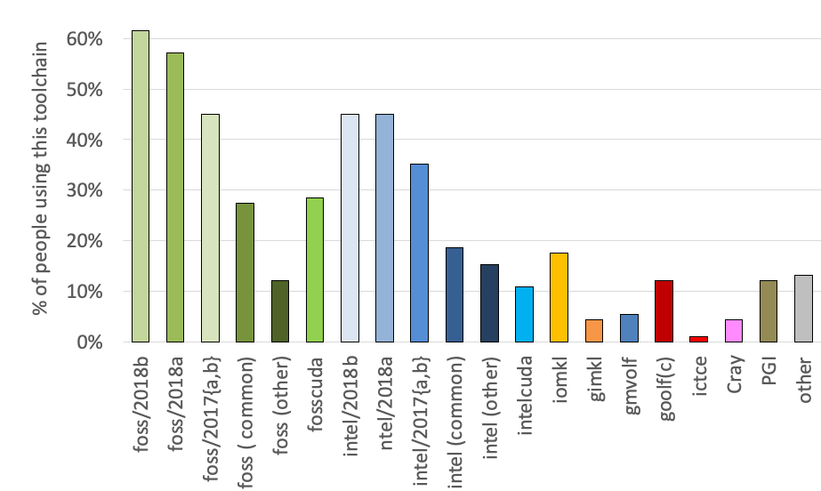
2nd EasyBuild User Survey
Which (full) toolchain(s) do you use? (check all that apply)
(recent) foss & intel toolchains most used
Significant shift to most recent versions compared to previous survey
declining use of old common versions
other most common: fosscuda, iomkl
￼

Slide 31
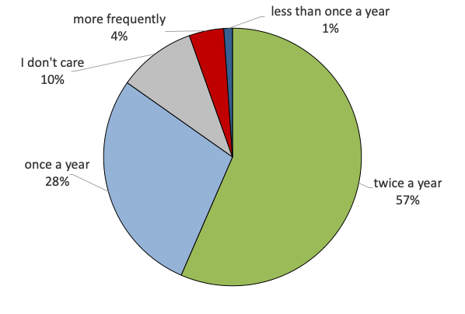
2nd EasyBuild User Survey
How frequently should the 'foss' and 'intel' common toolchains be updated?
preference for current update frequency (twice per year) has increased (47% ☞ 57%)
slight decrease for "once a year" (37% ☞ 28%)
no changes planned
￼

Slide 32
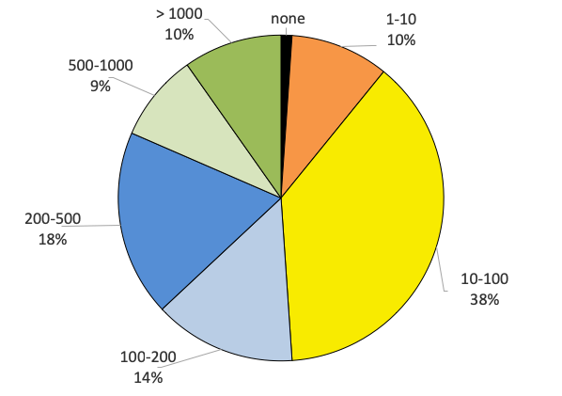
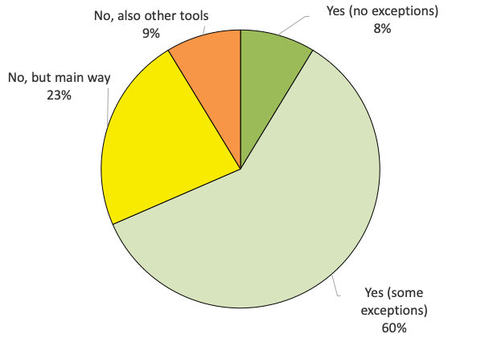
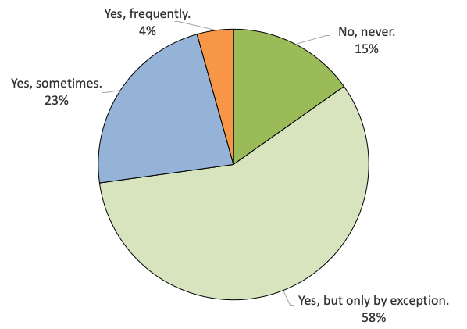
2nd EasyBuild User Survey
How many software installations did you perform in the last year using EasyBuild?
Is EasyBuild your only way of installing (scientific) software?
Do you still install (scientific) software manually?
(all fairly similar to previous survey)
￼

Slide 33
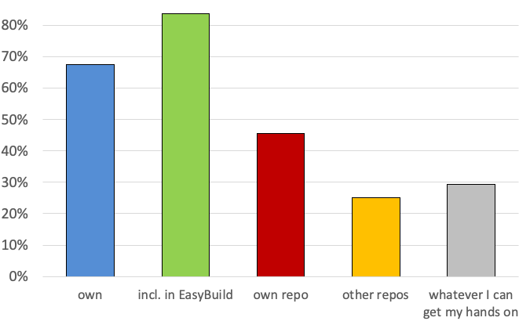
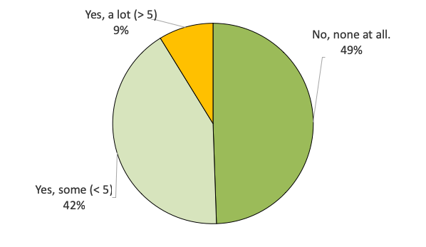
2nd EasyBuild User Survey
Which easyconfig files do you use? (check all that apply)
Do you use any custom easyblocks?
85% uses easyconfigs included with EasyBuild 67% uses own easyconfigs 45% maintains own repo (very similar to previous survey)
(very similar to previous survey)
￼

Slide 34
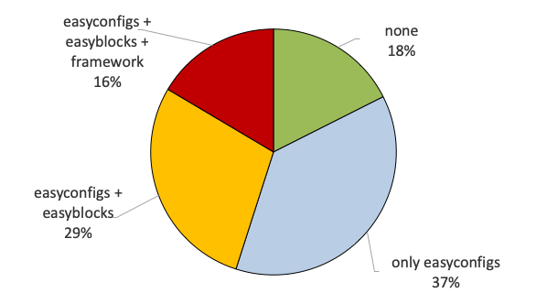
2nd EasyBuild User Survey
Have you made any site-specific customisations to EasyBuild?
fairly similar to previous survey
~45% indicated having customised code
reasons?
contributed back?
￼

Slide 35
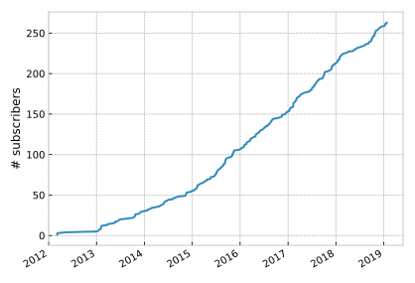
EasyBuild mailing list (subscribers)
Over 250 people subscribed to EasyBuild mailing list, still growing...
(2016) +50
(2018) +55
(2015) +55
(2017) +60
(2014) +30
(2013) +25

Slide 36
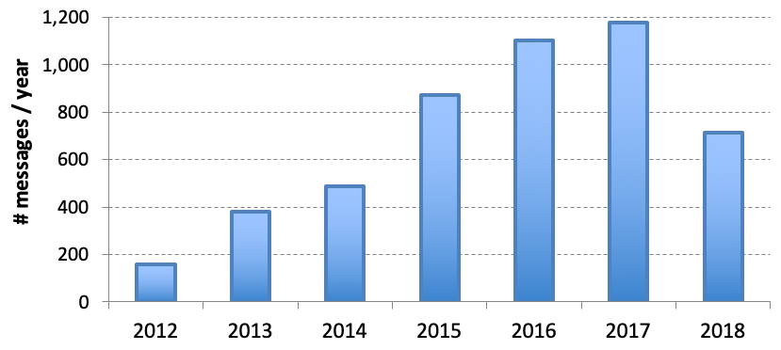

EasyBuild mailing list (traffic)
Traffic on EasyBuild mailing list peaked in 2017, most likely due to EasyBuild Slack channel.
effect

Slide 37
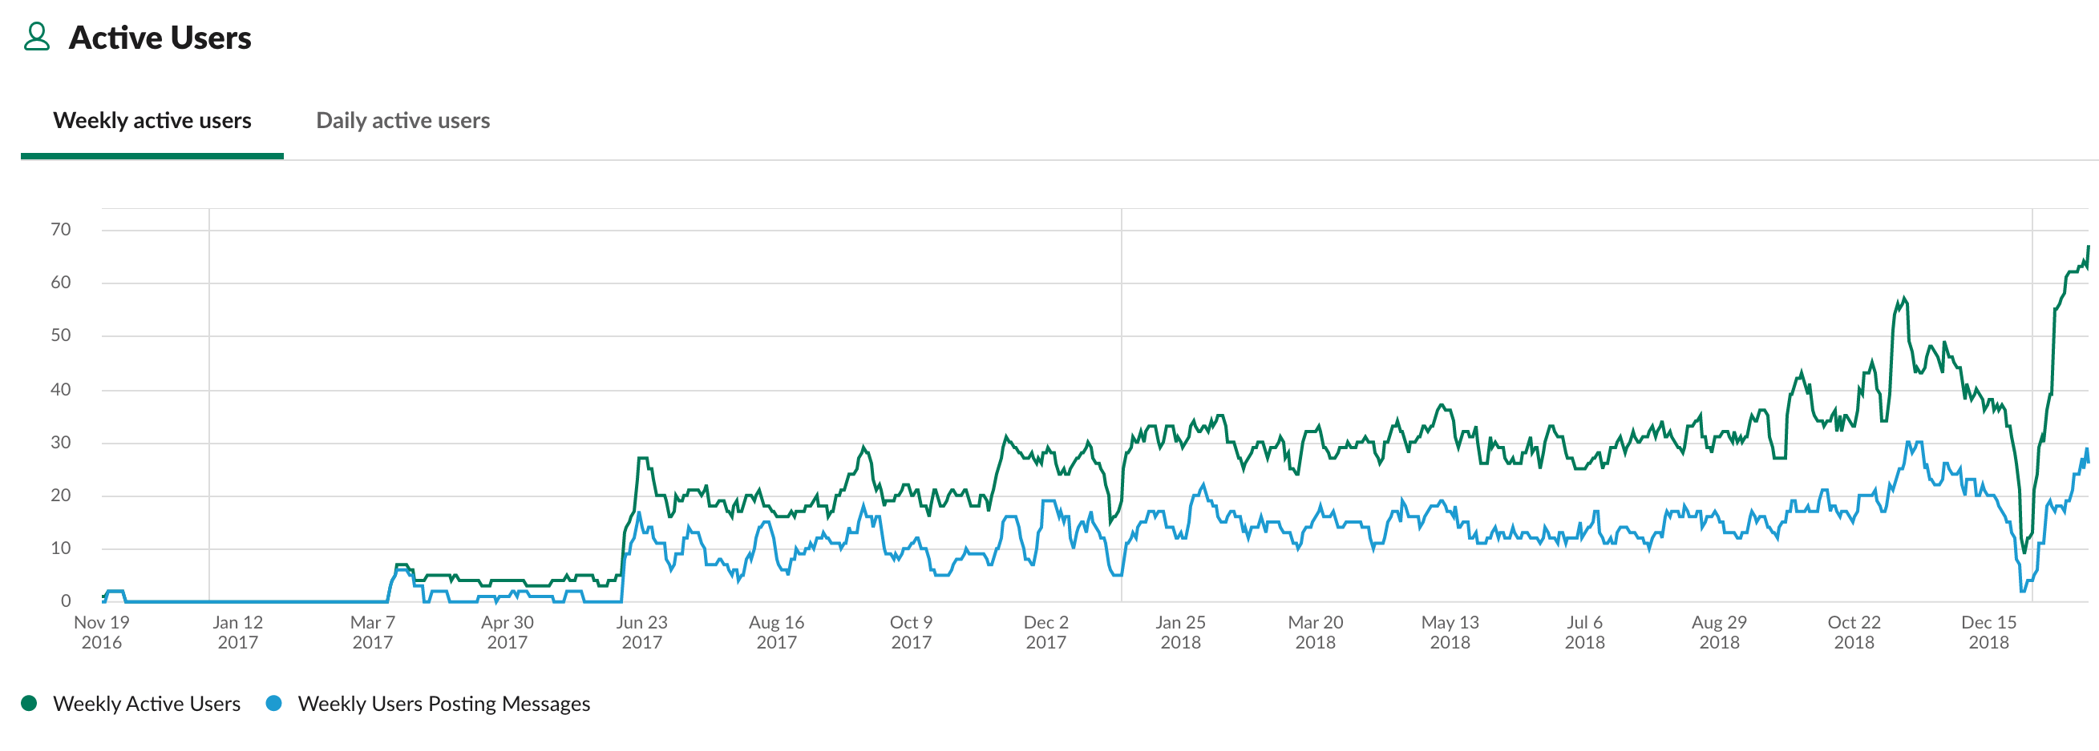
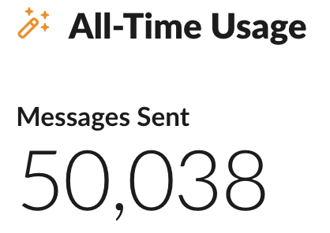
(+ IRC) channel
#general on easybuild.slack.com is linked with #easybuild on IRC (freenode)
~130 members on Slack channel (+ about 15 (also) on IRC)
steady growth in activity: 30-40 weekly active users
self-invite via https://easybuild-slack.herokuapp.com !

Slide 38
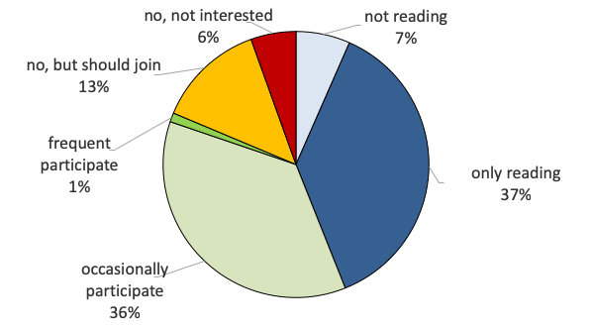
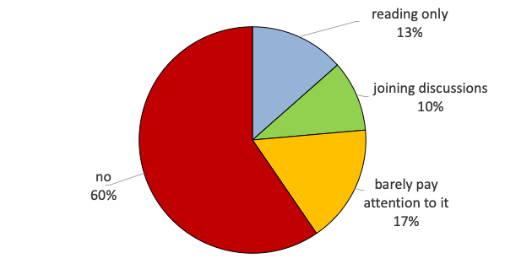
2nd EasyBuild User Survey
Are you subscribed to the EasyBuild mailing list?
Do you use the EasyBuild IRC/Slack channel?
(very similar to previous survey)
A significant part of the EasyBuild community remains silent.
IRC/Slack is not the right place to make "big" decisions, since less than 25% actually pays attention to it.
￼

Slide 39
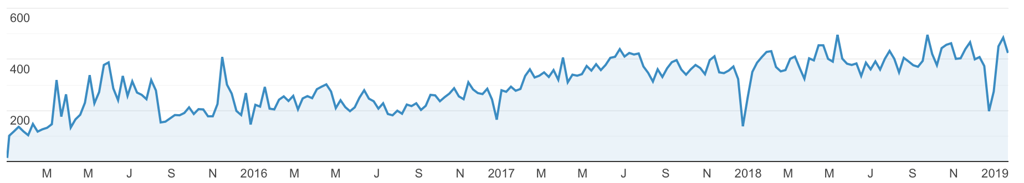
documentation stats
EasyBuild documentation at https://easybuild.readthedocs.io 400-500 weekly visitors
(source: Google Analytics)

Slide 40
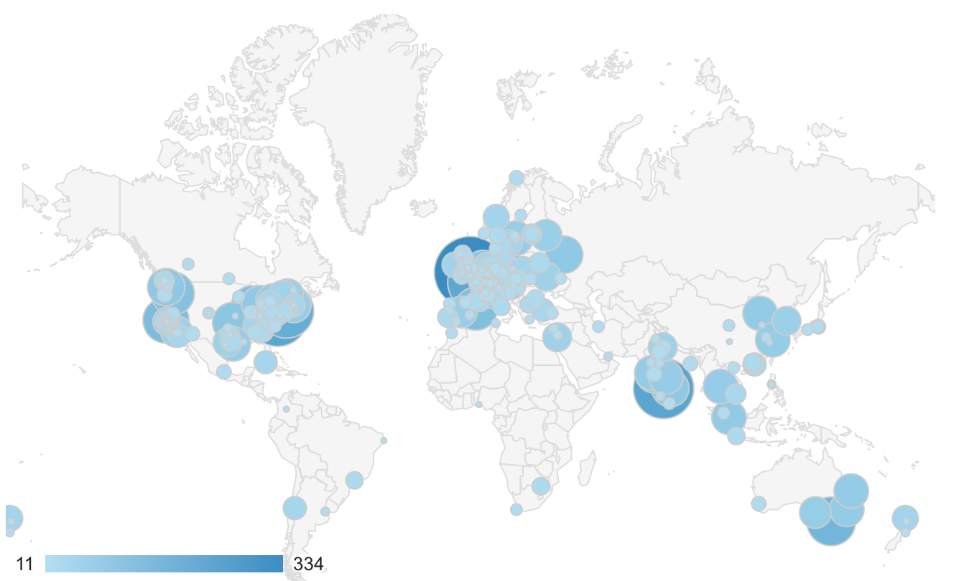
The sun never sets on ...
cities from where https://easybuild.readthedocs.io was visited at least 10 times during the last year
(source: Google Analytics)

Slide 41
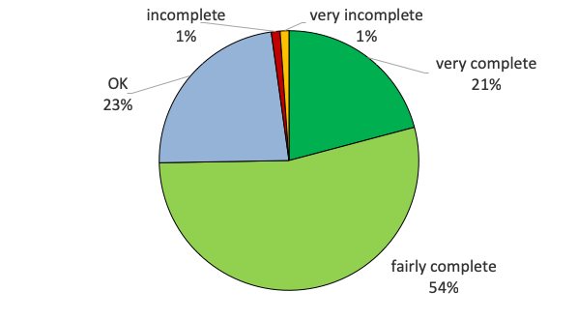
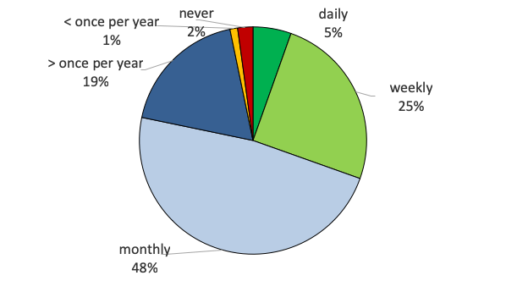
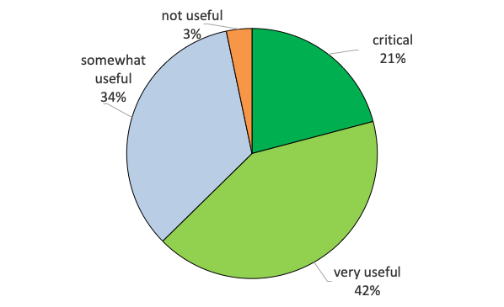
2nd EasyBuild User Survey
How complete is the EasyBuild documentation?
How often do you consult the EasyBuild documentation?
How useful is the EasyBuild documentation to you?
fairly to very complete according to ~75% (small decline compared to previous survey, was 81%)
> 75% consults documentation monthly or more frequent
97% finds it at least somewhat useful (nobody answered "totally useless")
￼

Slide 42
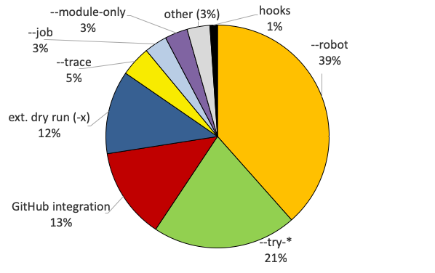
2nd EasyBuild User Survey
What is your favourite EasyBuild feature?
quite different compared to previous survey (but list of suggested answers is also different)
￼

Slide 43
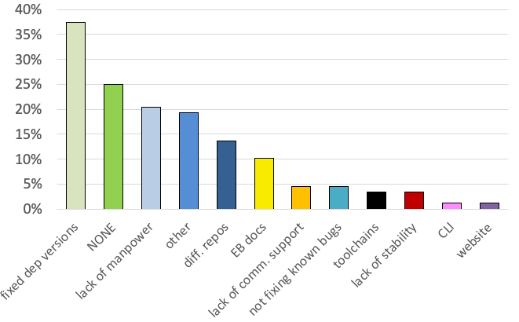
2nd EasyBuild User Survey
Which parts of EasyBuild do you not like? (check all that apply)
"other" category (~20%) is very diverse:
lacking documentation
no uninstall support
lack of support for Python 3
...
￼

Slide 44
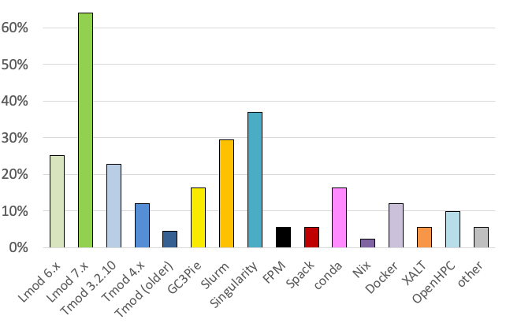
2nd EasyBuild User Survey
Do you use any other tools/projects in combination with EasyBuild?
vast majority uses Lmod as modules tool
similar to previous survey (when adding Lmod 6.x + 7.x)
~30% uses Slurm in combination with EasyBuild (eb --job)?
Singularity has become more popular (27% ☞ 37%)
16% also uses conda...
￼

Slide 45
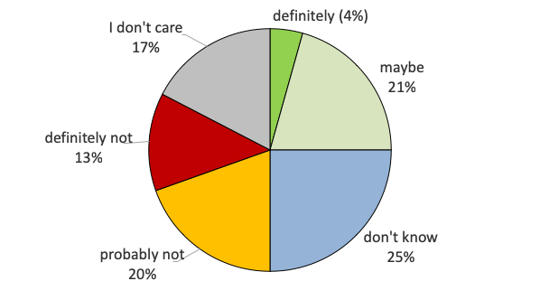
2nd EasyBuild User Survey
If a commercial support option would be available, would you consider purchasing it?
(very similar to previous survey)
￼

Slide 46
Using a custom module naming scheme
a couple of different module naming schemes are included in EasyBuild
see --avail-module-naming-schemes
specify active module naming scheme via --module-naming-scheme
default: EasyBuildMNS (<name>/<version>-<toolchain>-<versionsuffix>)
you can implement your own module naming scheme relatively easily
specify how to compose module name using provided metadata
via Python module that defines custom derivative class of ModuleNamingScheme
make EasyBuild aware of it via --include-module-naming-schemes
decouple naming of install dirs vs modules via --fixed-installdir-naming-scheme
￼

Slide 47
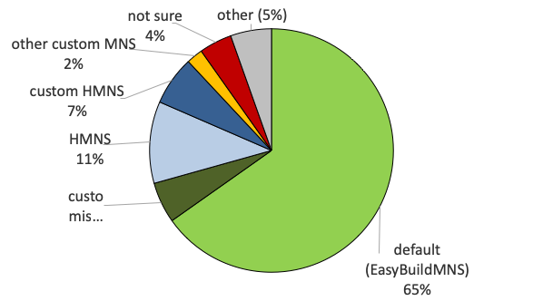
2nd EasyBuild User Survey
Which module naming scheme do you use?
(very similar to previous survey)
￼

Slide 48
Flat module naming scheme
legend
all modules are always available for loading
long(er) module names
'module avail' may be overwhelming for users
too easy to load incompatible modules together
(not available)
(available)
(loaded)
GCC/5.3.0
GCC/6.1.0
OpenMPI/1.10.2-GCC-5.3.0
OpenMPI/2.1.0-GCC-5.3.0
OpenMPI/1.10.3-GCC-6.1.0
OpenMPI/2.1.0-GCC-6.1.0
FFTW/3.3.4-gompi-2016.04
FFTW/3.3.6-gompi-2016.04
FFTW/3.3.4-gompi-2016.07
FFTW/3.3.6-gompi-2016.07
￼

Slide 49
Hierarchical module naming scheme (1)
modules are organised in a tree-like fashion
initially, only 'core' modules are available for loading
typically 3 hierarchy levels: core, compiler-dependent, MPI-dependent
other modules are only visible via 'module spider'
legend
(not available)
(available)
(loaded)
GCC/5.3.0
GCC/6.1.0
Core level
OpenMPI/1.10.6
OpenMPI/2.1.0
OpenMPI/1.10.6
OpenMPI/2.1.0
Compiler level (compiler-dependent)
MPI level (MPI-dependent)
FFTW/3.3.4
FFTW/3.3.5
FFTW/3.3.6
FFTW/3.3.4
FFTW/3.3.5
FFTW/3.3.6
￼

Slide 50
Hierarchical module naming scheme (2)
legend
Core modules may extend $MODULEPATH with an additional location
loading a Core module may make more modules available
in this example, loading a GCC module makes OpenMPI modules available
(not available)
(available)
(loaded)
GCC/5.3.0
GCC/6.1.0
Core level
OpenMPI/1.10.6
OpenMPI/2.1.0
OpenMPI/1.10.6
OpenMPI/2.1.0
Compiler level (compiler-dependent)
MPI level (MPI-dependent)
FFTW/3.3.4
FFTW/3.3.5
FFTW/3.3.6
FFTW/3.3.4
FFTW/3.3.5
FFTW/3.3.6
￼

Slide 51
Hierarchical module naming scheme (3)
even more modules may be made available by loading other modules
for example, loading an OpenMPI modules reveals MPI-dependent modules
EasyBuild can organise modules in hierarchy for you!
legend
(not available)
(available)
(loaded)
GCC/5.3.0
GCC/6.1.0
Core level
OpenMPI/1.10.6
OpenMPI/2.1.0
OpenMPI/1.10.6
OpenMPI/2.1.0
Compiler level (compiler-dependent)
MPI level (MPI-dependent)
FFTW/3.3.4
FFTW/3.3.5
FFTW/3.3.6
FFTW/3.3.4
FFTW/3.3.5
FFTW/3.3.6
￼

Slide 52
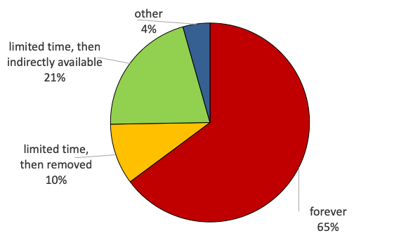
2nd EasyBuild User Survey
How long are modules installed with EasyBuild available to users?
increase for "limited time, then indirectly available": 14% ☞ 21%
￼

Slide 53
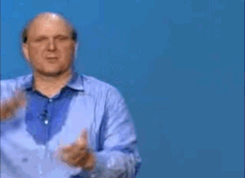
Contributors, contributors, contributors...
￼

Slide 54
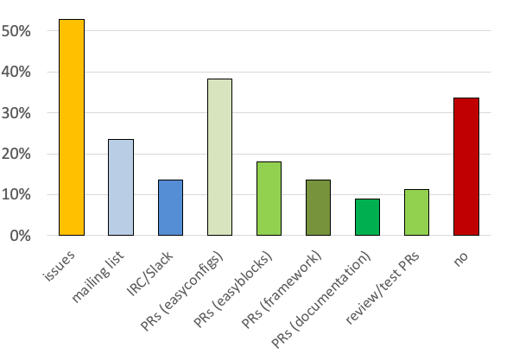
2nd EasyBuild User Survey
Do you actively contribute to EasyBuild? (check all that apply)
Overall minor decline:
mailing list (35% ☞ 23%)
IRC/Slack (18% ☞ 13%)
easyconfig PRs (49% ☞ 38%)
easyblock PRs (26% ☞ 18%)
framework PRs (18% ☞ 13%)
review/testing of PRs (18% ☞ 11%)
Increase for issues (47% ☞ 53%)
Similar for documentation + no contr.
￼

Slide 55
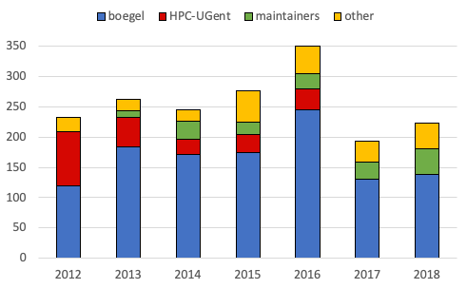
Overview of contributions (framework)
less PRs than back in 2016 (mostly due to lack of time by boegel)
~20% of PRs by maintainers other than boegel + additional 20% by others
￼

Slide 56
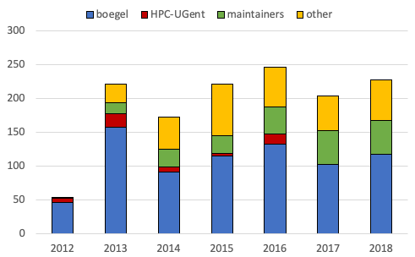
Overview of contributions (easyblocks)
25% of PRs by maintainers other than boegel + additional 25% by others
mostly maintenance of existing easyblocks
￼

Slide 57
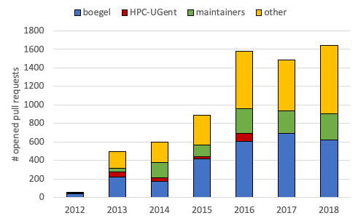
Overview of contributions (easyconfigs)
explosive growth in easyconfig PRs since 2016 (partially thanks to --new-pr)
stabilised in last couple of years; ~1,600 PRs in 2018
growing ratio of PRs from contributors that are not maintainers (~45% in 2018)
￼

Slide 58

Overview of unique contributors (total)
over 80 unique contributors to EasyBuild framework so far
recently reached 100 total unique contributors for easyblocks, 200 for easyconfigs!
steadily growing number of unique contributors to easyconfigs
￼

Slide 59

Overview of unique contributors (per year)
~25 unique contributors per year to EasyBuild framework
30-35 unique contributors per year to easyblocks, fairly stable in recent years)
steadily growing number of unique contributors per year for easyconfigs (100 in 2019?)
￼

Slide 60

Maintainers, maintainers, maintainers, ...
￼

Slide 61










attending EUM'19
EasyBuild maintainers
attending FOSDEM'19
https://easybuild.readthedocs.io/en/latest/Maintainers.html
Since summer 2017, there are 10 EasyBuild maintainers. Since May 2018, there is a rotating "maintainer-of-the-week" (MotW) role.
Damian Alvarez - @damianam (Jülich Supercomputing Centre)
Miguel Dias Costa - @migueldiascosta (National University of Singapore)
Pablo Escobar - @pescobar (sciCORE, University of Basel)
Kenneth Hoste - @boegel (HPC-UGent)
Adam Huffman - @verdurin (Big Data Institute, University of Oxford)
Alan O’Cais - @ocaisa (Jülich Supercomputing Centre)
Bart Oldeman - @bartoldeman (ComputeCanada)
Ward Poelmans - @wpoely86 (Free University of Brussels)
Åke Sandgren - @akesandgren (Umeå University, Sweden)
Davide Vanzo - @vanzod (Vanderbilt University)
￼

Slide 62

2nd EasyBuild User Survey
How would you rate the overall quality of EasyBuild?
100% positive!
(nobody answered "could be better" or "pretty bad")
(very similar to previous survey)
￼

Slide 63
2nd EasyBuild User Survey
Do you have any suggestions for additional features? (1/2)
support for uninstalling packages (with check on dependencies)
better support for filtering/hiding dependencies
"containers, containers, containers"
support for skipping sanity check (supported since EasyBuild 3.7.0 via skipsteps)
"steep learning curve"
missing documentation on best practices / common workflows
￼

Slide 64
2nd EasyBuild User Survey
Do you have any suggestions for additional features? (2/2)
list of dependency versions per toolchain (esp. for common toolchains)
loosen up the restriction on dependency versions
semi-auto creation of easyconfigs based on existing ones (WIP: eb --new)
installing multiple packages in a single-directory more easily
better error reporting / readability of build logs
support for using multiple module naming schemes at once
￼

Slide 65
Future work: changes w.r.t. Python (packages)
We're actively looking into some changes w.r.t. handling of:
installation of Python interpreter + standard library (with batteries incl.)
now done using "full" toolchain (foss/intel/...)
looking into installing Python with subtoolchain (GCCcore) + separate bundle with Python packages that require MPI/BLAS/LAPACK
installation of Python packages for different Python versions
now done with separate easyconfigs/installation directories/modules
considering switch to ComputeCanada approach (see Bart's remote talk on Thu)
single easyconfig/installdir/module combined some Python sys.path magic to automatically pick up the right installation based on active Python version
￼

Slide 66

Future work: testing contributions in isolation
Testing contributions in isolation:
mainly relevant for easyconfig PRs
avoid that OS packages on test system affect test result
test contributions both in:
minimal environment
fully loaded system (Boost, zlib, etc. installed in OS)
different (versions of) Linux distros
via (standardised?) Singularity images
￼

Slide 67
5th EasyBuild User Meeting
Party edition?
Sometime late 2019 or early 2020...
Let me know if you're interested in hosting it!

Slide 68
Questions?
kenneth.hoste@ugent.be http://easybuilders.github.io/easybuild
easybuild@lists.ugent.be http://easybuild.readthedocs.io

Slide 69
State of the Union
4th EasyBuild User Meeting
January 30th 2019 - Louvain-la-Neuve (Belgium)
https://users.ugent.be/~kehoste/EasyBuild_20190130_state-of-the-union.pdf
kenneth.hoste@ugent.be https://easybuilders.github.io/easybuild easybuild@lists.ugent.be https://easybuild.readthedocs.io
https://www.ugent.be/hpc
https://www.vscentrum.be

