Slide 2

HPC-Ugent update
Functional domain ICT
University cluster UD3
HPC-UGent user meeting 19 May 2025
hpc@ugent.be https://www.ugent.be/hpc
Notes:
Vermelden van VSC3.0 oefening

Slide 3
AGENDA
Overview of HPC-UGent activities, future plans, best practices and VSC opportunities
Review of user poll results
Q&A
Sandwich lunch after the meeting

Slide 4
About HPC-UGent

Slide 5
ABOUT HPC-UGent
Mission
HPC-UGent provides centralised scientific computing services, training, and support for researchers from Ghent University, industry, and other knowledge institutes.
HPC-UGent is part of the ICT functional domain of Ghent University, and is a strategic partner of the Flemish Supercomputer Center (VSC).

Slide 6
ABOUT HPC-UGent
1 Mission – 2 Teams
Support research and scientific computing (service cluster: user relation management)
Compute infrastructure (service cluster: service management and operations)
Functional Domain ICT
University Service Real Estate and Campus Facilities, ICT and Student Facilities’ (UD3)

Slide 7
ABOUT HPC-UGent
Support research and scientific computing (‘support’)
Team leader Ewald Pauwels
Currently 7 staff members
Tasks include
Helpdesk for scientific computing
Resource and project follow-up
Documentation for scientific computing
Software installation as a service
Training and user outreach
UGent contribution in various EuroHPC projects
UGent representation in VSC

Slide 8
ABOUT HPC-UGent
Compute infrastructure (’ops’)
Team leader Wouter Depypere
Currently 8 staff members
Tasks include
Maintain and upgrade HPC clusters, ensuring stability and availability
Allocate compute resources and storage capacity
Provide solutions for storing, securing, and accessing large data sets
Continuously improve and expand the HPC infrastructure to meet growing computing needs

Slide 9
Activities & updates

Slide 10

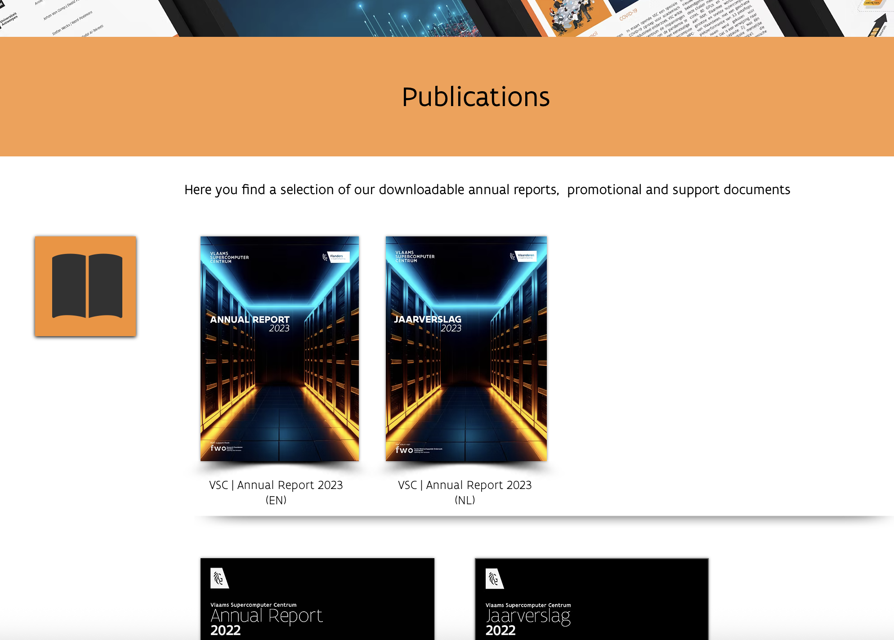

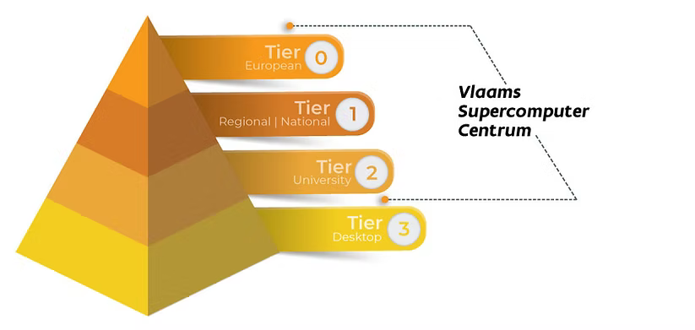
https://www.vscentrum.be/publications

Slide 11
Tier2 infrastructure
Currently 7 clusters in production:
3 CPU clusters: doduo, gallade, shinx (victini, skitty)
3 GPU clusters: joltik, accelgor, litleo
1 interactive debug cluster: donphan
Main shared storage:
$VSC_HOME 0.09 PB (64% full)
$VSC_DATA 1.9 PB (83% full)
$VSC_SCRATCH 1.7 PB (77% full)
https://docs.hpc.ugent.be/infrastructure/

Slide 12
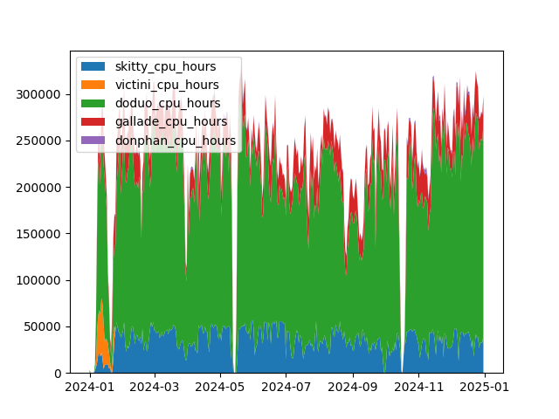
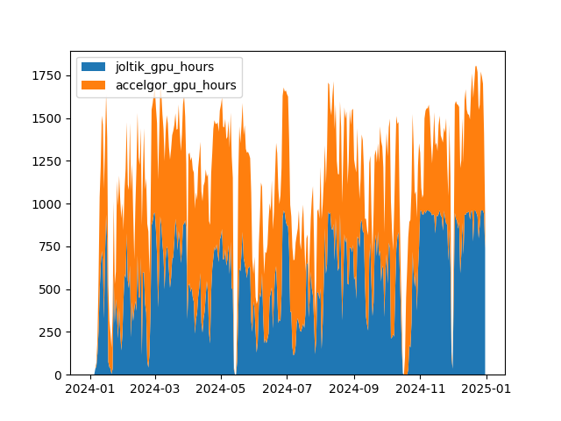
Tier2 usage
Average usage (assuming 100% uptime, so underestimate):
doduo 57% accelgor 68%
gallade 59% joltik 59%

Slide 13
Tier2 usage
Usage across institutes in 2024
 | #users | CPU | GPU
UAntwerpen | 36 | 4.7% | 3.4%
VUB | 21 | 0.0% | 0.5%
UGent | 1945 | 94.9% | 93.2%
KULeuven/UHasselt | 50 | 0.1% | 2.8%
Other institutes, companies | 43 | 0.3% | 0.1%
Usage by personnel category
 | #users | CPU | GPU
Students | 1023 | 11.2% | 9.9%
Researchers | 1072 | 88.7% | 90.1%
We welcome the usage of the HPC infrastructure for teaching and training
https://docs.hpc.ugent.be/teaching_training

Slide 14
Tier2 data policy
WELL BEFORE leaving university, users should offload their data
Clean up (delete)
Transfer data to coworkers
Take personal backups
Data transfer by HPC staff should be last resort measure
error-prone, manual process, risks storage integrity risks
very time-consuming
https://docs.hpc.ugent.be/sites/hpc_policies/#data-access-retention

Slide 15
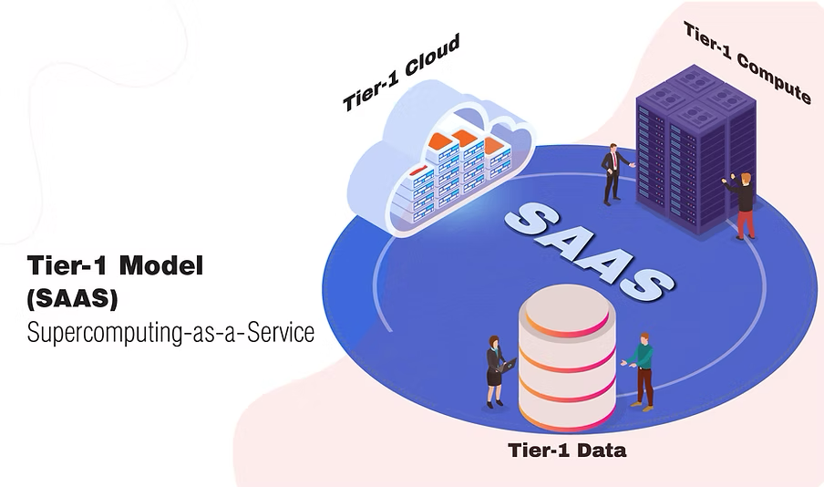
TIER1 – VSC INFRASTRUCTURE

Slide 16
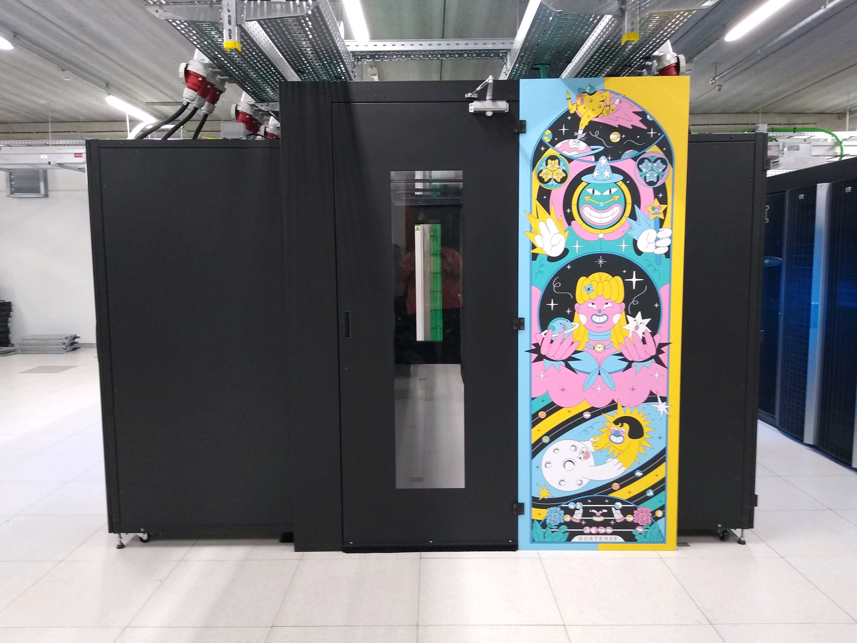
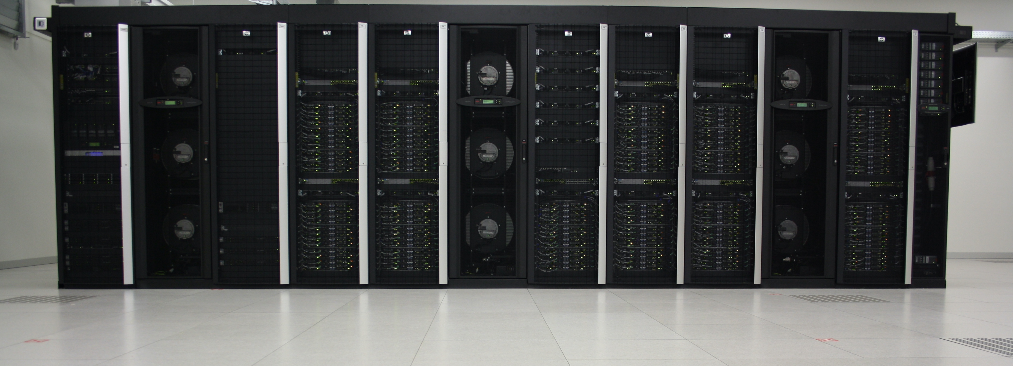
TIER1 – VSC INFRASTRUCTURE
Maintenance and support by HPC-UGent teams

Slide 17
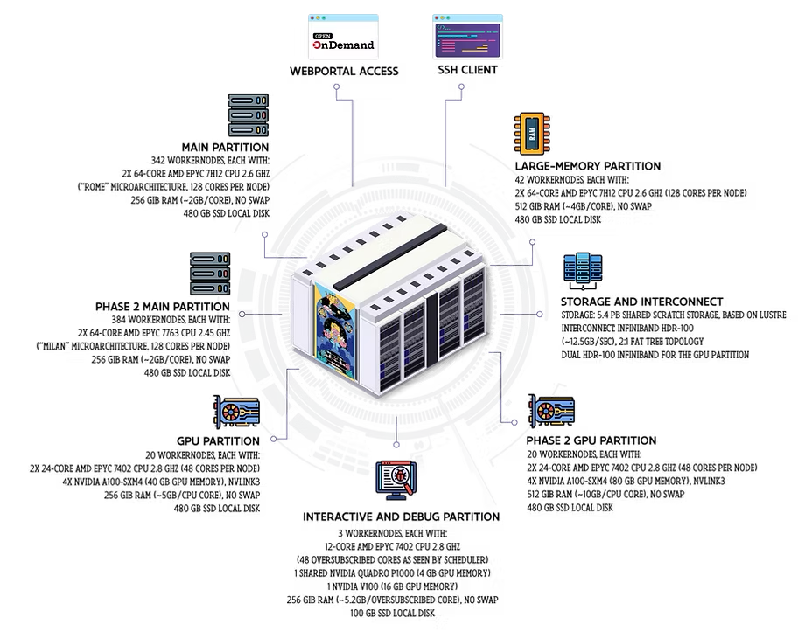
TIER1 COMPUTE Hortense
+100.000 cores and 80 GPUs
Project based access
Starting grant
Project (next cutoff: 2 June)
Collaborative grant
Industry
https://www.vscentrum.be/compute

Slide 18
TIER1 COMPUTE Hortense
5 - 14 May: resolving cooling issues
RHEL9 for all Milan nodes
Nov 2025:
Decommissioning Rome partition
End 2025:
New Tier1 at VUB

Slide 19
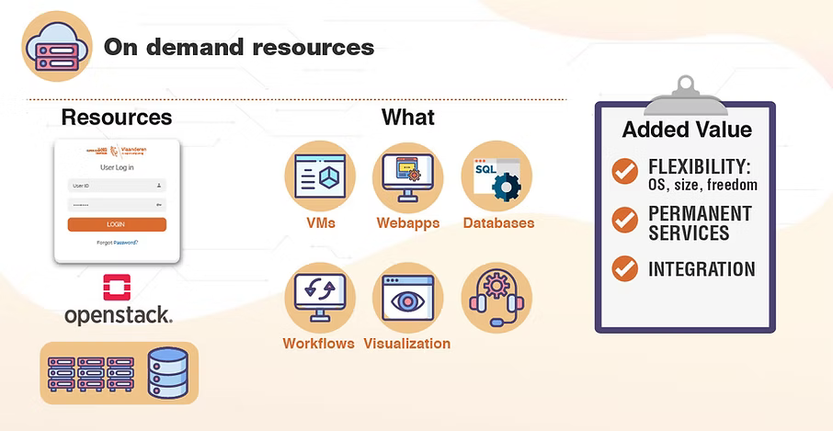
TIER1 CLOUD
Unmanaged VMs
For power users
Project based access
Starting grant
Project (no cutoffs)
https://www.vscentrum.be/cloud

Slide 20
TIER1 data
Storage management platform
Active (HPC) research data
Metadata, automation, sharing
Project based access
Starting grant
8 months
Project (no cutoffs)
4 years
5 TB – 1 PB
https://www.vscentrum.be/data

Slide 21
Helpdesk

Slide 22
helpdesk

Slide 23
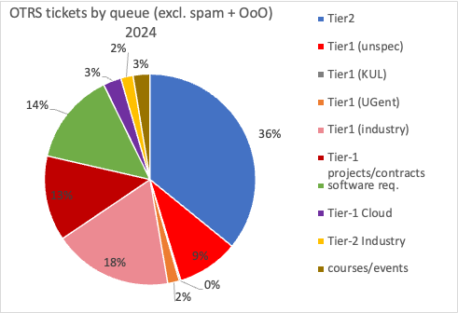
helpdesk
In 2024, we tackled:
2.710 tickets related to Tier2 UGent hpc@ugent.be
667 tickets related to Tier1 Compute compute@vscentrum.be
87 tickets related to Tier1 Cloud cloud@vscentrum.be
474 software installation requests (Tier1+Tier2)
320 active Tier1 Compute projects
28 active Tier1 Cloud projects

Slide 24
helpdesk

Slide 25
helpdesk

Slide 26
helpdesk

Slide 27
helpdesk

Slide 28
Software installation
2023 analysis indicated: ~30% installed software modules is never used
Starting 2025, we are looking closer at software installation requests.
Cost reporting
“This installation took about <> hours of effort, which is roughly equivalent to <> Euro of institutional cost.”
Requesting software usage report
“By submitting a software installation request, you are committing to sending back a software usage report.”
https://docs.hpc.ugent.be/software_installation_requests

Slide 29
Software installation
So far in 2025:
112 software installation requests received
89 installations executed
25 software usage reports received

Slide 30
user poll results

Slide 31
User poll results
Affiliation | Count
Association - UGent | 181
Association - KU Leuven | 160
Association - VUB | 64
Association - UAntwerpen | 44
Private company | 21
Other Research Institute | 16
Multiple Universities | 15
Association - UHasselt | 10
SOC - VIB | 9
Public Sector organization | 5
SOC - imec | 4
SOC - VITO | 2
SOC - FlandersMake | 2
Total | 534
As part of broader VSC poll
Will be done yearly
Sent out 5 Nov 2024
Closed 17 Dec 2024
In total: 534 respondents

Slide 32
User poll results
49% of VSC respondents indicate using services managed by HPC-UGent
Feedback on Tier1 services
Check out VSC year report
Focusing on UGent Tier2 feedback

Slide 33
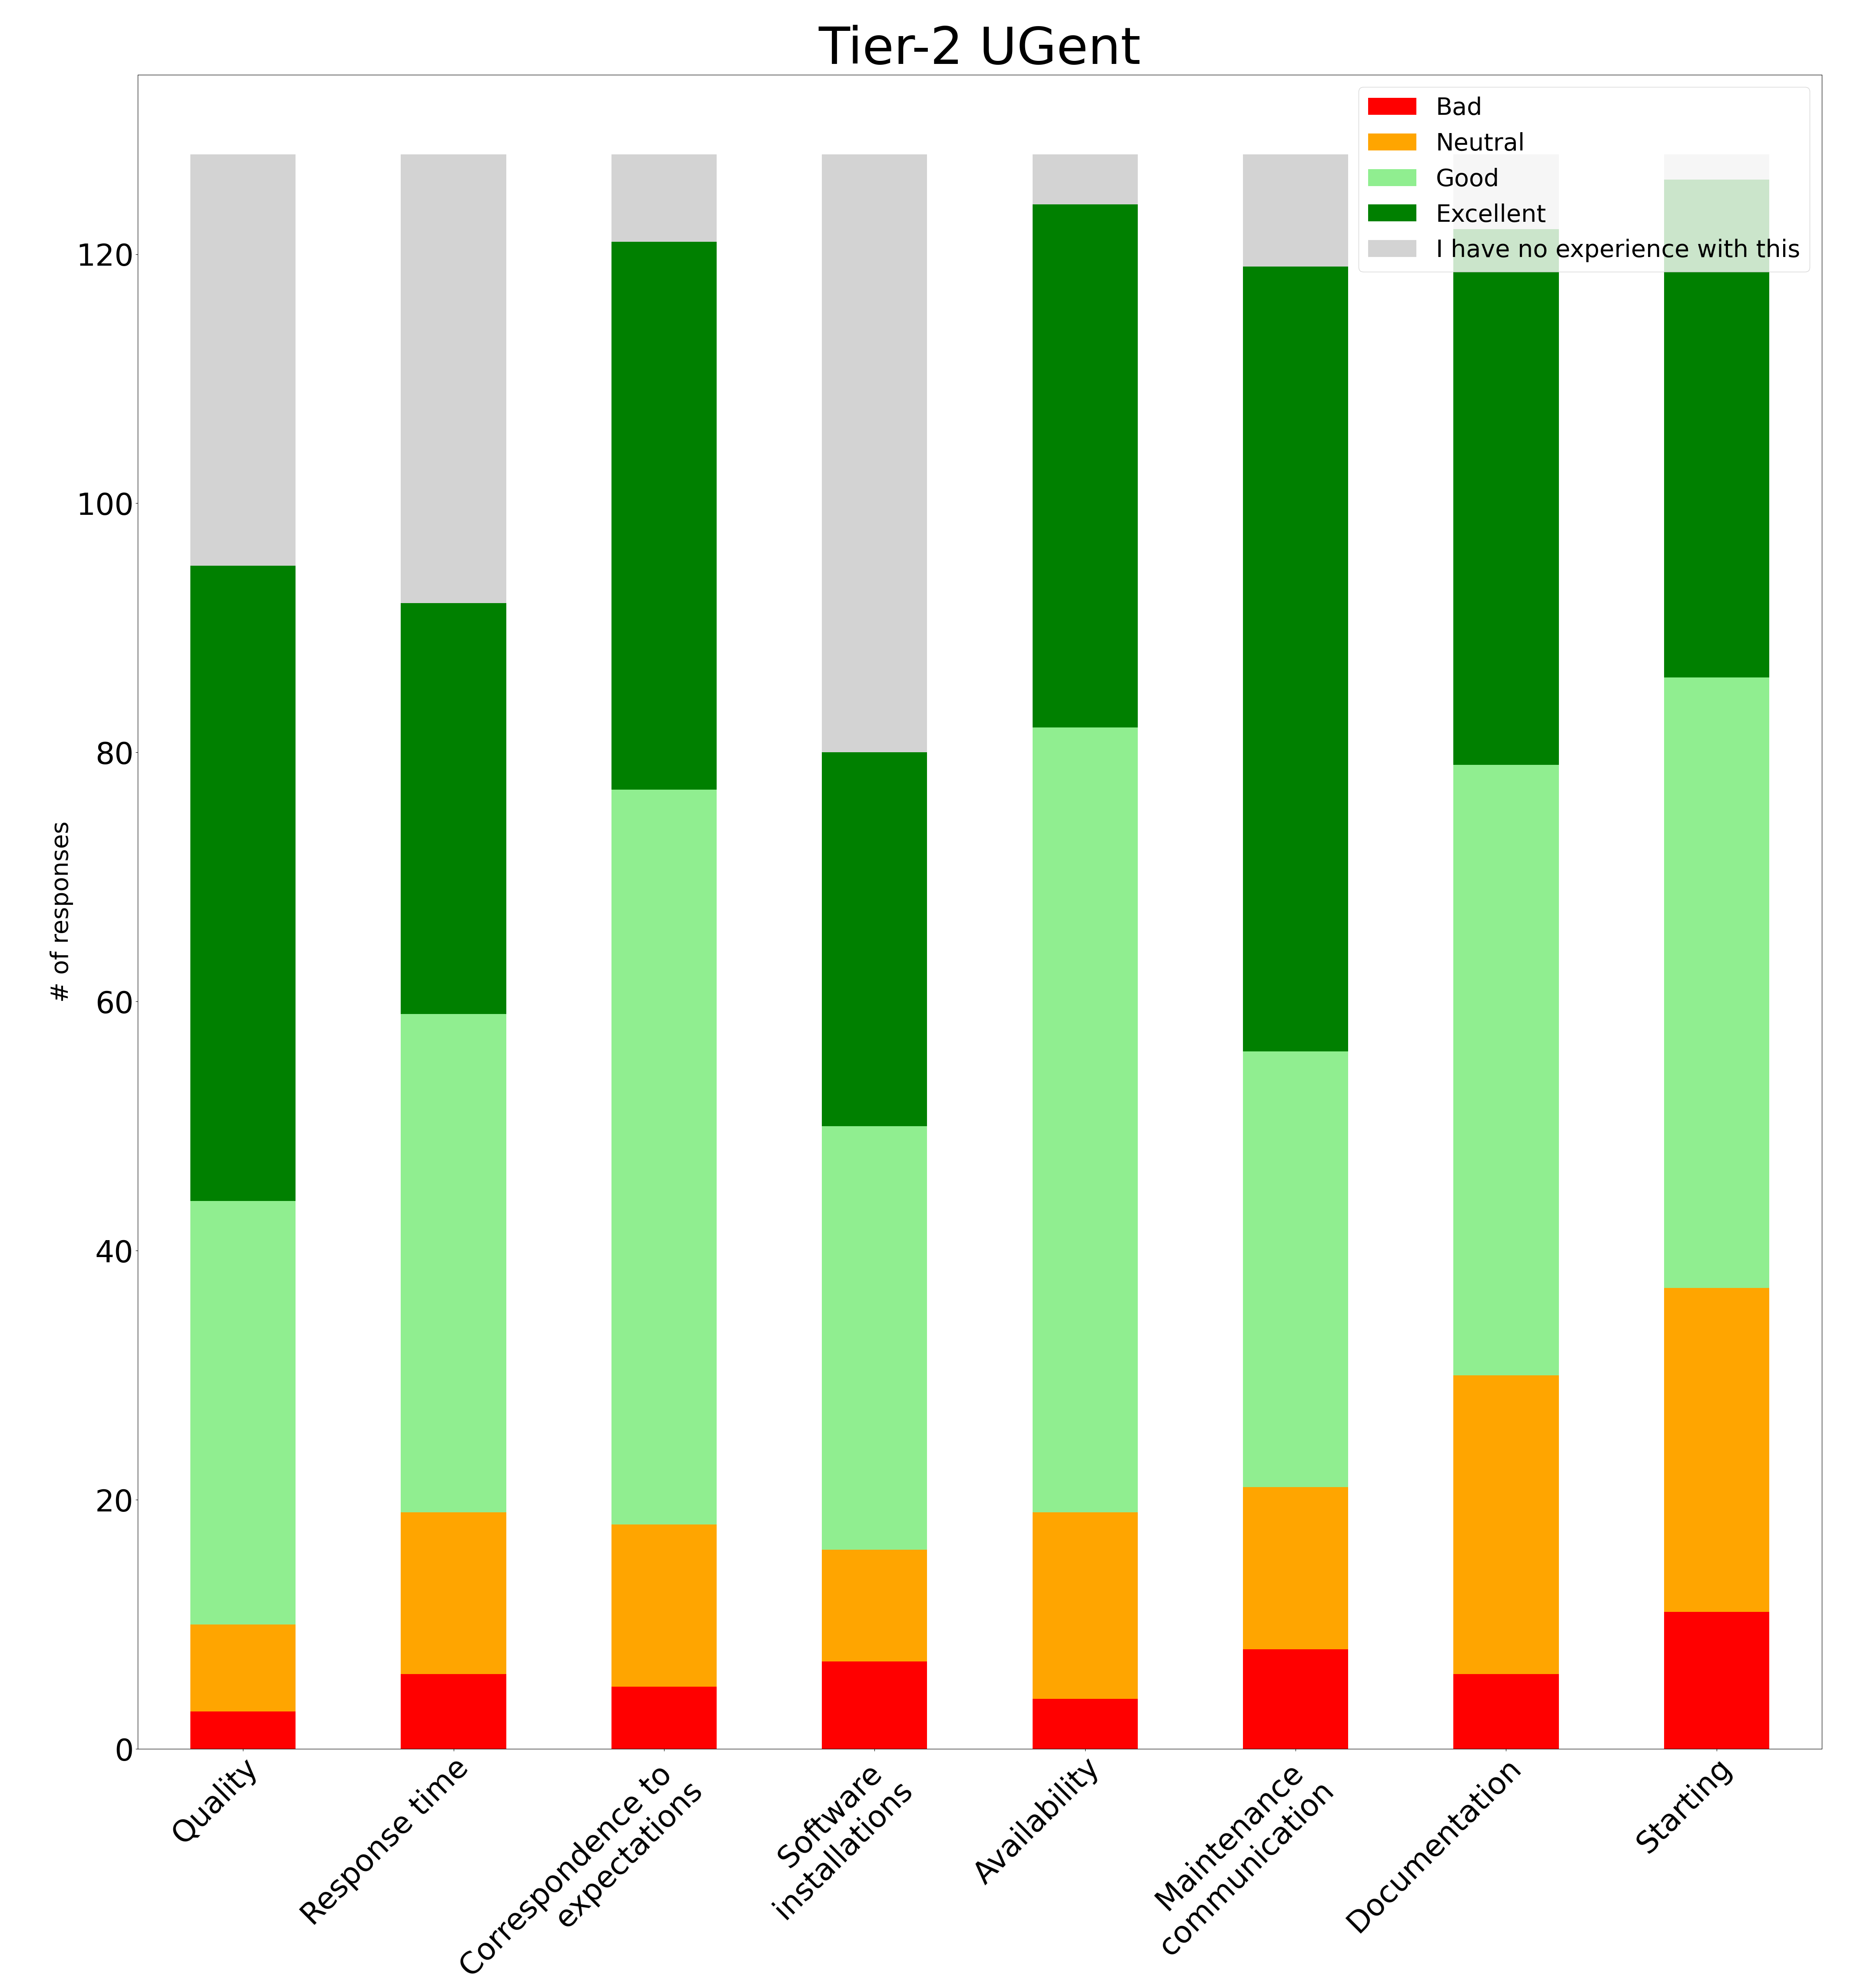
User poll results
Users reporting service as good/excellent:
90% (85/95) - Quality
79% (73/92) - Response time
85% (103/121) - Correspondence to expectations
80% (64/80) - Software installations
85% (105/124) - Availability
82% (98/119) - Maintenance communication
75% (92/122) - Documentation
71% (89/126) - Starting

Slide 34
User poll results
Suggestions to improve HPC-UGent services?
Infrastructure
More GPUs (2)

Slide 35
User poll results
Suggestions to improve HPC-UGent services?
Documentation
Simpler documentation, cheat sheets (2)
Update existing documentation (1)
Better documentation for the webportal (1)
Shared documentation for applications (1)
More application-specific practical examples (1)
Documentation/best practices for conda (2), docker (1), Rstudio (1), Slurm (1), Dask (1), Nextflow (1)

Slide 36
User poll results
Suggestions to improve HPC-UGent services?
User experience
Consult cluster status on VSC status page (1)
Way to consult power usage footprint of jobs (1)
Increase timeout duration in web portal (2)
Way to estimate queue time (1)
Reduce (GPU) queuing times (5)
Allocate more staff for the helpdesk (5)
More patience with (beginning) users (1)

Slide 37
User poll results
Suggestions to improve HPC-UGent services?
Software
Faster response time for software installation requests (5)
Container images for popular software (1)
Easier way to work with different modules and toolchains (e.g. conda) (1)
Support for Pixi (1)
Homogeneous toolchains/software over all clusters (1)
Improve speed of standard BLAS for AMD CPUs (1)
MKL for AMD and enable AVX2 (1)

Slide 38
User poll results
Suggestions to improve HPC-UGent services?
Data
Way to delete data of ex-user (1)
Clarify sharing permissions in documentation (1)
Shared database repositories (1)
Share research data across VOs or with researchers without vsc-id (1)

Slide 39
User poll results
Suggestions for specific training?
Domain-specific training (2)
E.g. bioinformatics, MD, DFT
Specific scientific software training (2)
Rstudio, Gaussian,
Custom environments (conda) (1)
Containers (1)
Parallel computing (1)

Slide 40
European efforts

Slide 41





HPC-UGent contributes to EuroHPC
https://www.multixscale.eu
https://easybuild.io
Consortium:
CSC-IT Centre for Science
GÉANT
IT4Innovations National Supercomputing Center
University of Tartu
Ghent University
NORDUnet
https://eessi.io

Slide 42
Questions ? feedback ? Comments ?

