Slide 1
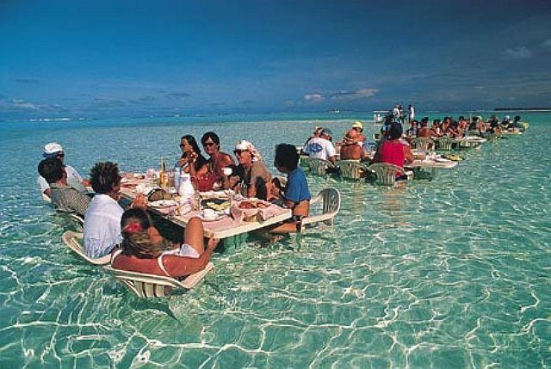
Unique Homo characteristics
Are they compatible with a more aquatic past?
Marc Verhaegen & Mario Vaneechoutte
Human Evolution
Past, Present & Future
Friday May 10th 2103
Grange St. Paul’s Hotel, London, UK

Slide 2
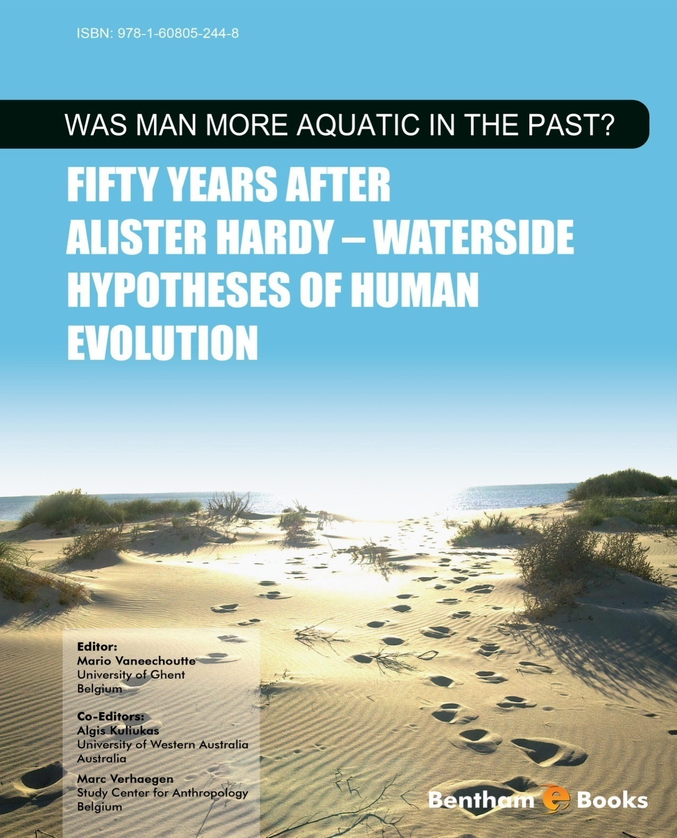
Mario Vaneechoutte, Algis Kuliukas, Marc Verhaegen. 2011.
Was Man more aquatic in the past?
Bentham e-books
Contributors
Phillip V. Tobias
Elaine Morgan
Michael Crawford
Michel Odent
Stephen Munro
Pierre-François Puech
Erika Schagatay
Marcel Williams
Wang-Chak Chan
Anna Gislèn
Leigh Broadhurst
Richard Ellis
Tess Williams

Slide 3
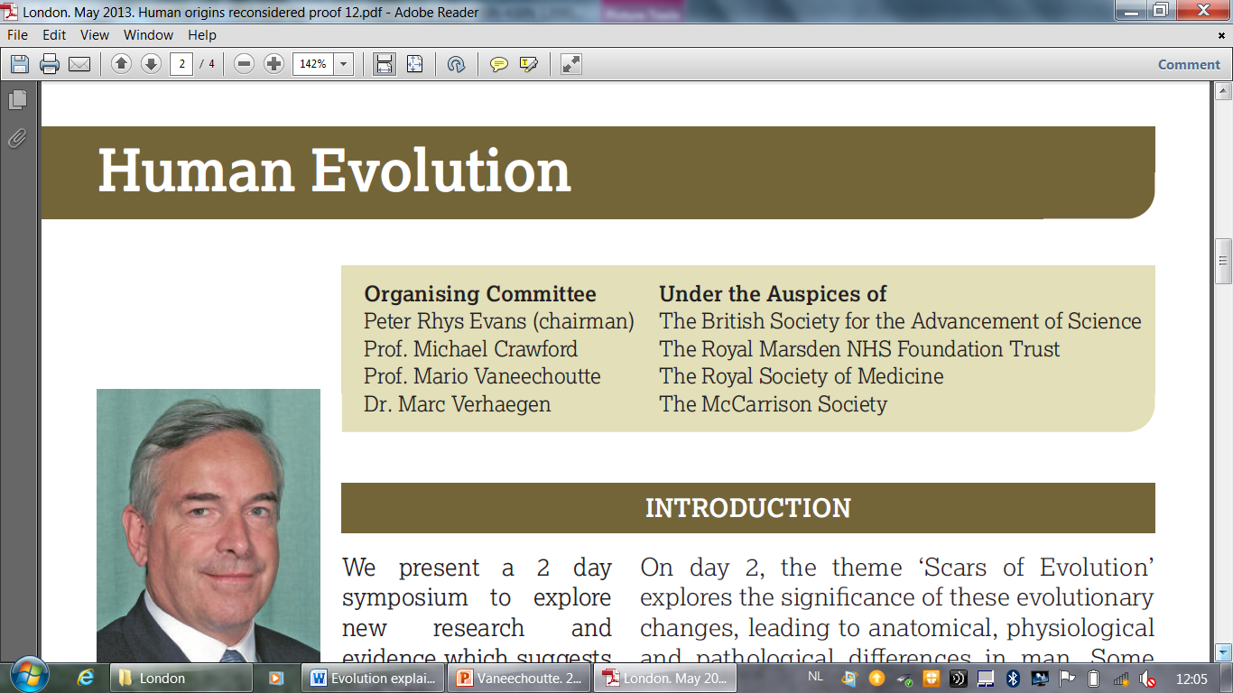
Human Evolution
Past, Present & Future
8-10th May 2013
Grange St. Paul’s Hotel, London, UK
MANY THANKS to Peter Rhys Evans and Margaret Ijegbai!

Slide 4
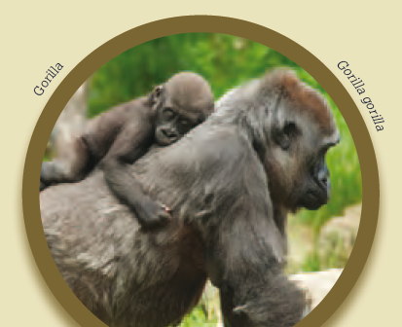
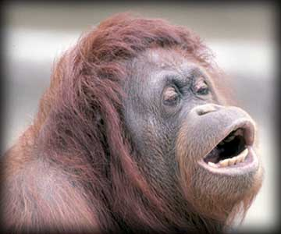
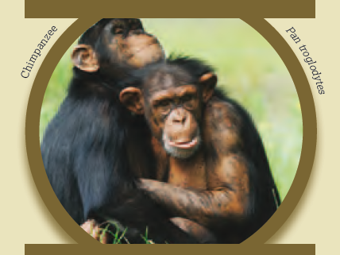
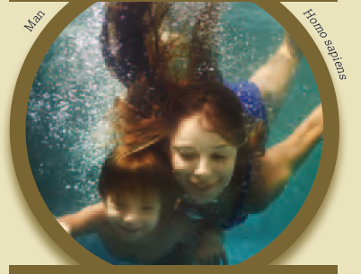
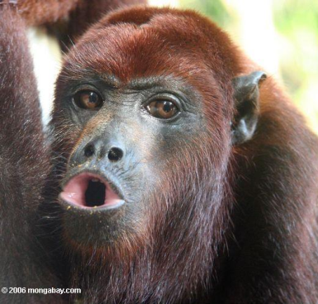
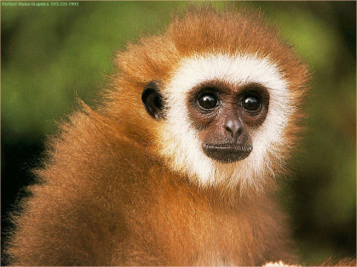
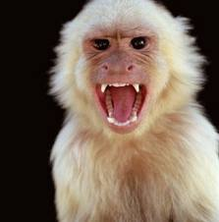
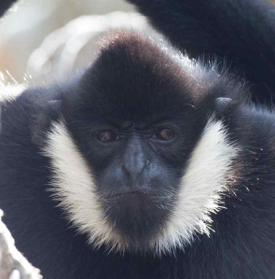
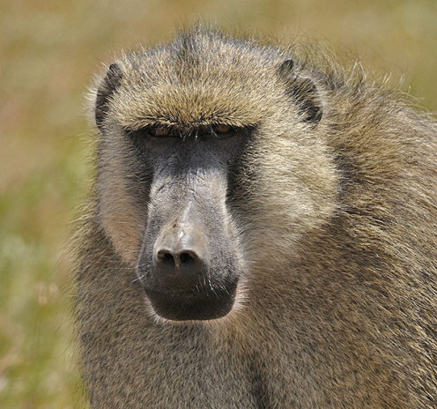
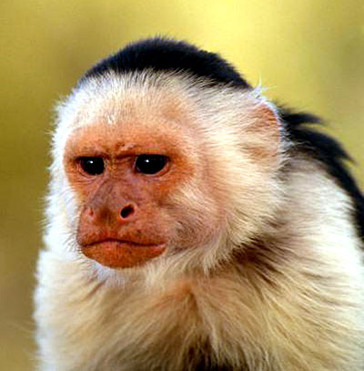
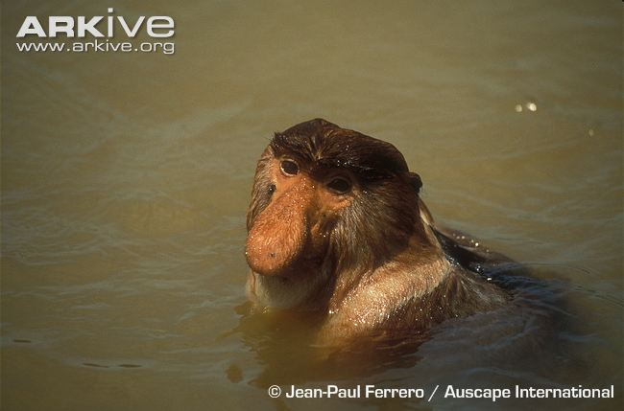
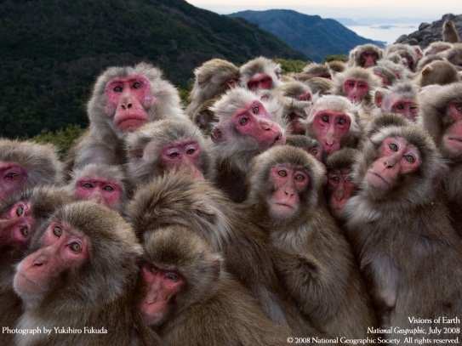
Homo sapiens is an extremely special primate/mammal

Slide 5
Homo sapiens is an extremely special primate/mammal
1. Behaviour: humans are fond of water and are good swimmers and divers
2. Upright (orthograde) bipedality – ‘streamlining’: head-spine-legs in one line
3. Skin: Hairless (naked) – subcutaneous fat deposits/layers – eccrine glands/sweat
4. Vision: reduced colour vision – [underwater vision: constricted pupils]
5. Olfaction: strongly reduced – photic sneeze – external nose
6. Manual dexterity and tactility
7. Water and salt household: wasting water and salt
Eccrine sweat glands all over the body
Multipyramidal kidneys: Unconcentrated urine
Crying – Spitting – Drinking only small quantities
[No sodium hunger]
8. Sexuality & Reproduction:
Low vaginal pH – Hymen – Permanent labiae majores
Permanent breasts – Concealed ovulation
Waterbirth – Long umbilical cord - Absence of placentophagy
Face-to-face mating

Slide 6
Homo sapiens is an extremely special primate/mammal
9. Large brains: 3 x larger than Pan & Gorilla:
Fat neonates - Need for ω3 fatty acids and iodine - Large brains
SRGAP2 multiplications: more dendrites: brain growth + complexity
10. Cardiopulmonary system:
Voluntary breath control (mouth) + automated control (nose)
Strong diving reflex
Countercurrent venes
[11. Oropharyngeal morphology/Facial flexibility:]
External nose - everted lips - philtrum - mouth breathing
Parabolic - Soft palate – Incisorlike canines
Descended larynx – Flexible tongue
[12. Song:]
Vocal learning / Breath control / Melody – Rhyyhm – Syntax
[13. Speech:]
Vocal learning / Breath control / Prosody – Rhythm – Syntax/Word order
[14. Genetics: fast evolution of human genome with strong selection since 3 Mya]
ΔCMAH: no Neu5Gc sialic acids, present in all other (terrestrial?) mammals
ΔPTERVs: ancestor not in Africa between 4 and 2 Ma?
many other

Slide 7
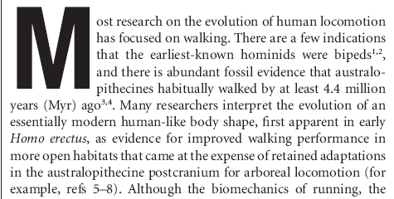
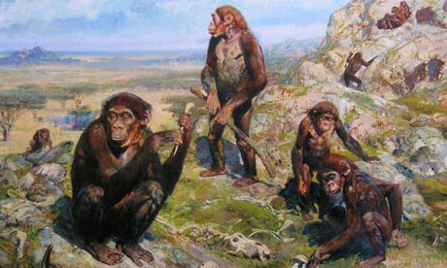
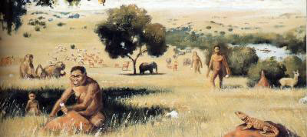
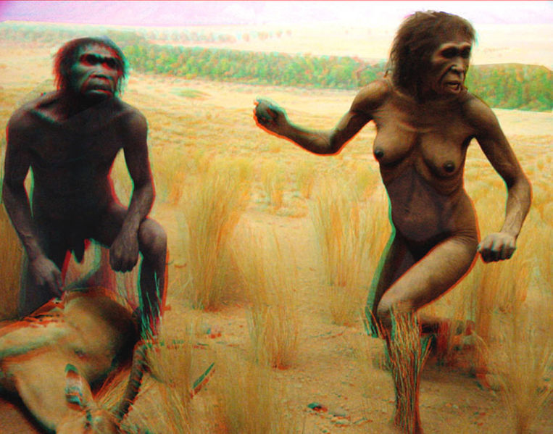
Established theory of human past: open plain, running past
Human characteristics (bipedality, large brain, nakedness)
are explainable as an adaptation to open plains and endurance running
Morgan: Savannah hypothesis
Bender R, Tobias PV, Bender N. 2012.
The savannah hypotheses: Origin, reception and impact on paleoanthropology.
Hist Phil Life Sci 34: 147-184.

Slide 8
More-aquatic-past hypotheses of human evolution
The Aquatic Ancestor Hypothesis (AAH) claims that
many/most/all of these characteristics
are most straightforwardly explained
by assuming that they evolved as adaptations to a wading/swimming/diving lifestyle
of our direct hominin ancestors, between 5 million and 200 000 years ago.
Different views of proponents of the AAH
1. Degree of aquaticness:
1. Occasional wading was sufficient to explain upright bipedality: Kuliukas, Niemitz
2. Diving (at least parttime – in shallow water)
is essential to understand e.g. voluntary breath control: most proponents
2. Timing of most aquatic period
[1. At the time of the LCA: 6–4 Ma: Hardy, Morgan]
2. H. erectus: 2 Ma–50 ka: Verhaegen, Munro
A swimming/diving lifestyle is most explicit with H. erectus
3. Early H. sapiens: < 200 ka:
Kuliukas: wading to explain transition from knuckle walking/quadrupedal? to bipedal
Verhaegen: wading/standing fully upright (for fishing with spears and nets)
to explain transition from swimming/diving/back floating
to fully upright position with straight long legs/running

Slide 9
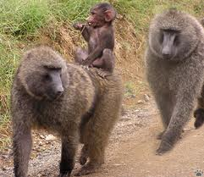
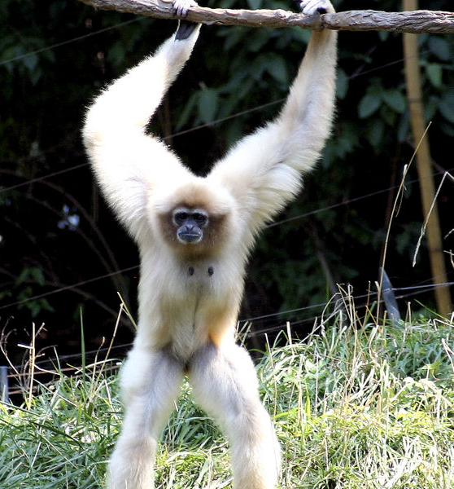
Some misconceptions about the Latest Common Ancestor
claims of the AAH
1. Did we go from arboreal quadrupedal apes = on 4 feet in trees
to terrestrial bipedal humans? = on 2 feet on ground
Are apes (and the LCA, 7-5 Ma) quadrupedal & arboreal?
NO: already, partially bipedal: below branch hanging (cfr. gibbons)
Baboons did go from tree to ground:
Baboons: quadrupedal, hairy, strongly snouted
↔ Homo: bipedal, naked, flat-faced
Chimp & Gorilla: knuckle walkers: retrogression to more quadrupedal locomotion?
Homo: fully (orthograde) upright: basically an adaptation to streamlining for swimming/diving?

Slide 10
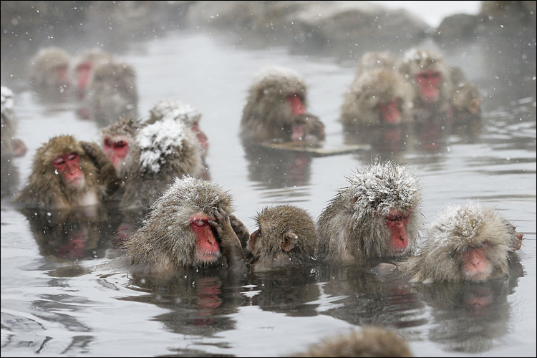
Some misconceptions about the Latest Common Ancestor
claims of the AAH
2. Monkeys are arboreal, afraid of water: MONKEY = TREE
Japanese macaques bathing in hot spring
Swimming proboscis monkey
Diving macaque monkeys

Slide 11
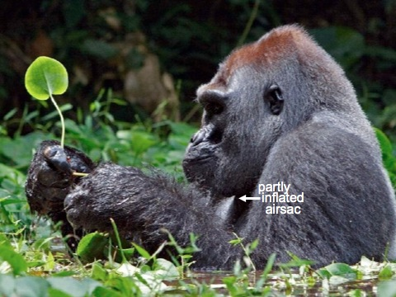
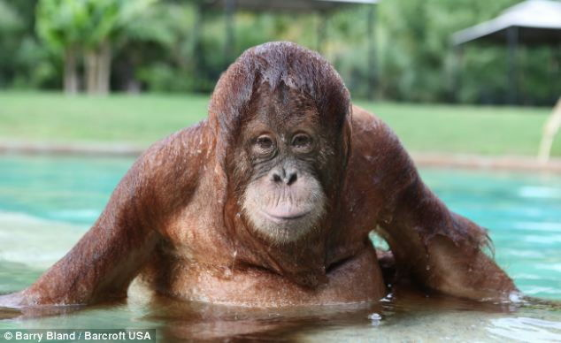
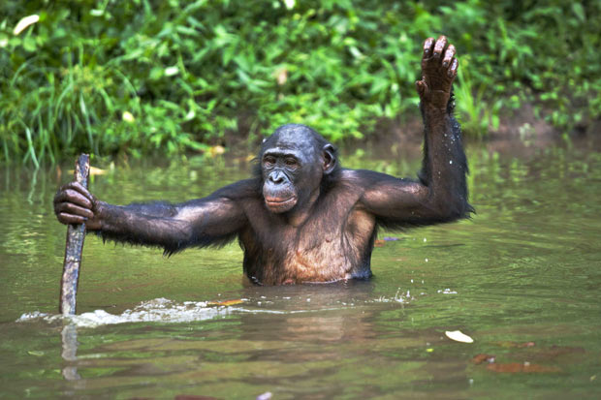
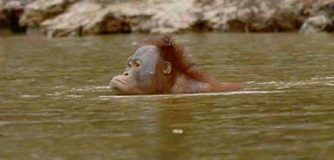
Some misconceptions about the Latest Common Ancestor
claims of the AAH
3. Monkeys and apes are arboreal, afraid of water: MONKEY = TREE
Wading gorilla
Wading orangutan
Wading bonobo with stick
Swimming orangutan

Slide 12
Criticisms of the Aquatic Ancestor Hypothesis (AAH)
Most criticisms of AAH
1. make erroneous claims that there is no fossil evidence to support the AAH
2. are general, philosophical, not very concrete:
Fallacy of the single cause
Umbrella hypothesis: AAT must be wrong, because it tries to explain too much
A human evolution theory of everything
AAH proponents sum up a long list of unrelated characteristics,
whereby always some will fit with an aquatic past,
by mere coincidence
Observation: Homo is an extraordinary species:
a long list of features that are unlike other primates/mammals
!! Mostly not incompatible with a more aquatic past
!! Frequently very incompatible with a long distance running over open plains past.
What follows is a brief summary out of a long list of ‘unrelated’ characteristics
that ‘coincidentally’ fit with a more aquatic past of our species
Final remark:
After all, an ‘umbrella hypothesis’ might be very welcome,
because we need to explain so many characteristic features of our species.

Slide 13
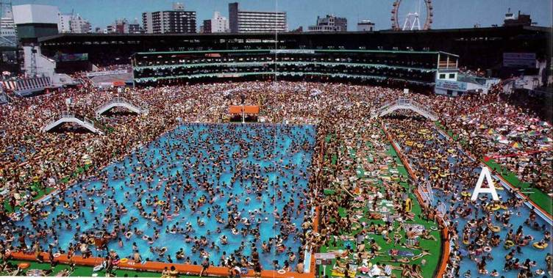
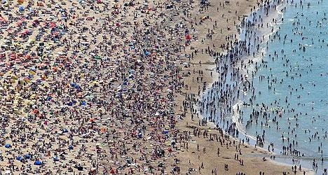
1. Behaviour: Humans are fond of water and good swimmers
Elaine Morgan: 'Hotel rooms with a sea-view are the most expensive ...'

Slide 14
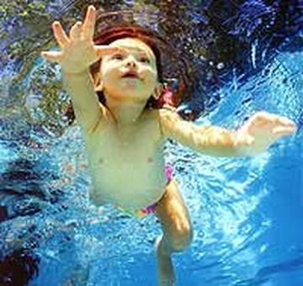
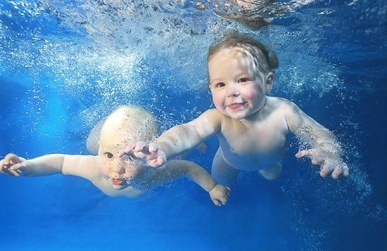
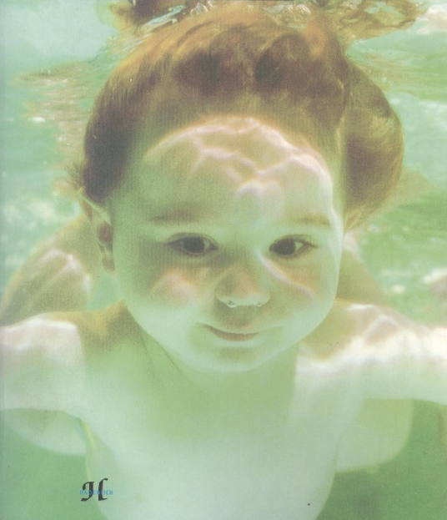
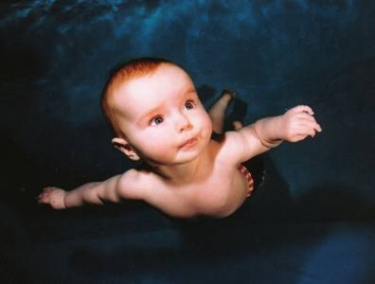
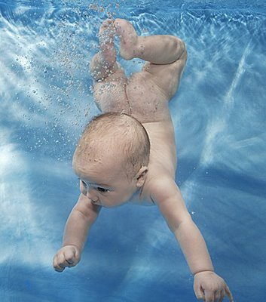
1. Behaviour: Humans are fond of water and good swimmers
Hardy A. 1960. Was Man more aquatic in the past? New Scientist 7: 642-645.
Meijers D. 2013. Aquatic reflexes in newborn humans. This conference

Slide 15
1. Behaviour: Humans are fond of water and good swimmers
Current world records under water swimming, deep dive
Discipline | Aim | Method | Male record | Female record
Static apnea (STA) | duration | apnea at rest floating in a pool | 11’ 35” | 8‘ 23’’
Dynamic apnea with fins (DYN) | distance | horizontal swimming in a pool with fins | 265 m | 225 m
Dynamic apnea without fins (DNF | distance | horizontal swimming in a pool without fins | 218 m | 160 m
Constant weight with fins (CWT) | depth | vertical swimming down and up with fins | 124 m | 101 m
Constant weight without fins (CNF) | depth | vertical swimming down and up without fins | 95 m | 62 m
Free immersion (FIM) | depth | pulling down and up on a rope | 120 m | 85 m
Child and adult aquatic behaviour and swimming/diving extraordinary prestations:
not incompatible with a more aquatic past
Schagatay E. 2011. Chapter 7. In: Was Man more aquatic?
Schagatay E. 2013. Human breath-hold diving ability. This conference

Slide 16
2. Only fully upright (orthograde) bipedal animals:
Head-spine-legs in 1 line
bipedals not fully upright: dinosaurs → birds
kangooroo
occasionally upright bipedal mammals: bears, bush antilopes, mangust, otter
occasionally upright bipedal primates:
gibbon, gorilla, bonobo
long-nosed monkey (Nasalis larvatus): most aquatic nonhuman primate
We are only primates/terrestrial mammals with Head – Spine – Legs in 1 line. Also in:
Penguins: amphibious divers, also with bipedal ancestors (birds)
Pinnipeds: amphibious divers
Cetaceans, Sirenians: full aquatics
Not incompatible with a more aquatic past.
Rather incompatible with open plain running past: Unusual for terrestrial locomotion:
After all, humans are very slow runners
Notes:
Adriaens. 2007. Page 176: 'De semi-aquatische levenswijze werd ook in verband gebracht met de evolutie naar bipedale locomotie, aangezien de mensachtigen het lichaam rechtop dienden te houden in het water om te kunnen ademen'
This does not explain fully upright posture. Diving and swimming do.
Waterbewoners . Als ze zwemmen, leggen ze hun benen achter hun romp, in het verlengde ervan: waterschildpadden, zeeleguanen, krokodillen, pinguïns, eenden in het water, zeeroofdieren.

Slide 17
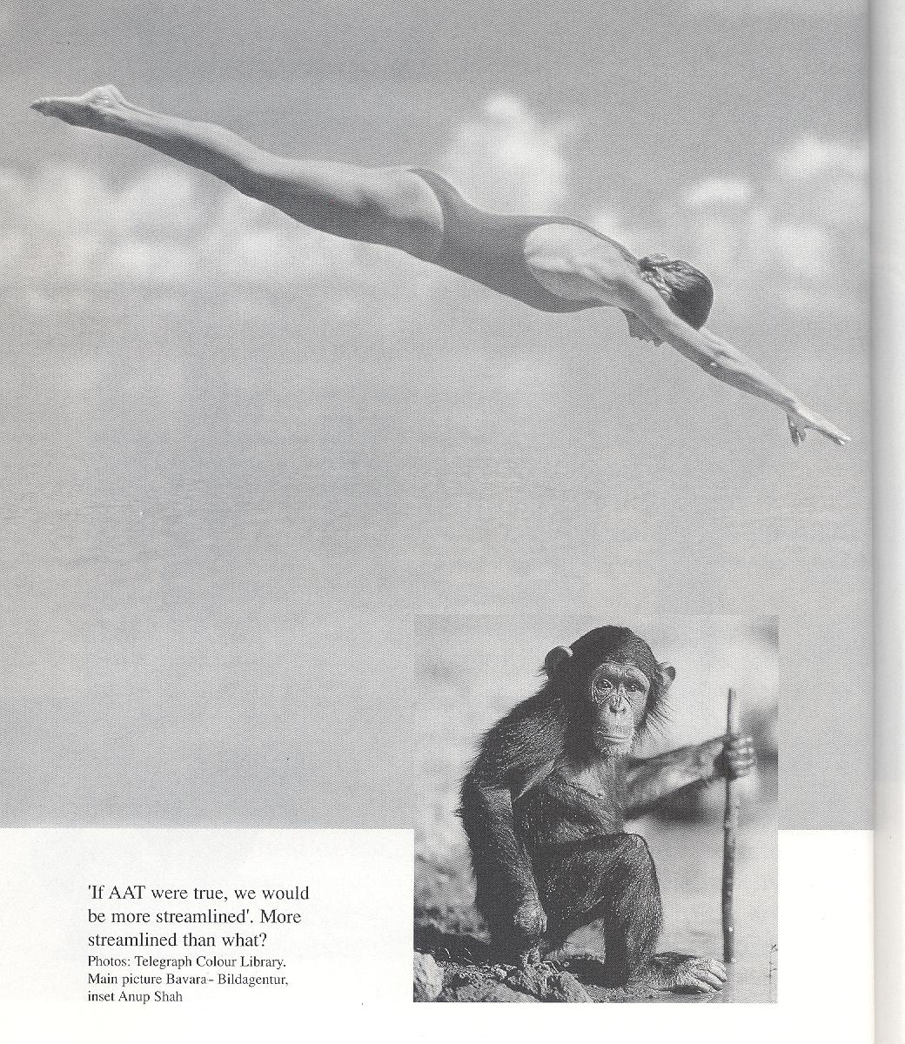
2. Only fully upright (orthograde) bipedal animals:
Head-spine-legs in 1 line
Morgan E. 1997. The Aquatic Ape Hypothesis. Souvenir

Slide 18
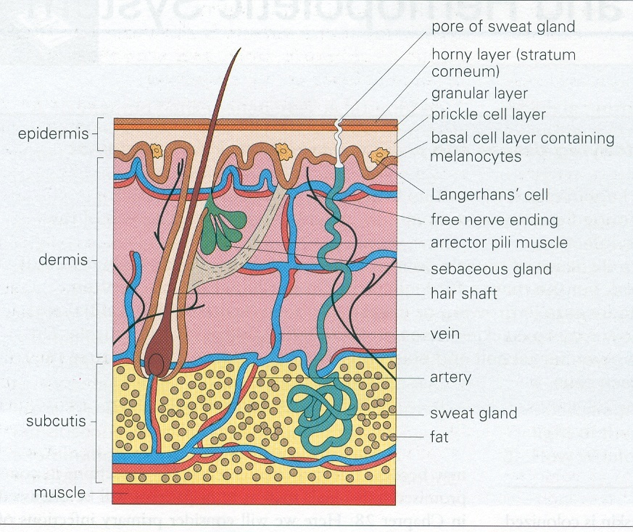
3. Skin: hairless – subcutaneous fat deposits/layers –
eccrine glands/sweat
Subcutaneous fat layer
Subcutaneous fat:
Not in primates
Also in aquatic mammals: insulation in water - buoyancy
Not very compatible for an open plain running past: weight – poor heat removal
Sweating all over the body
Not incompatible with a more aquatic past:
excess salt excretion glands in marine animals
Not very compatible with open plain running past:
excess loss of water and salts: dehydration.

Slide 19
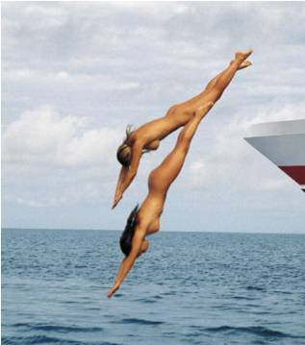
3. Skin: hairless – subcutaneous fat deposits/layers –
eccrine glands/sweat
Hairlessness: Fur insulates by trapping air
→ Wet fur looses its insulation capacities
Nakedness increases streamline in water
Not incompatible with more aquatic past
Several sea mammals still have fur:
→ contradicts nakedness for swimming?
possible explanation:
mostly arctic species
with ancestors from Artiodactyla/Carnivora,
whereas we stem from tropical ancestors
belonging to another order (Primates)

Slide 20
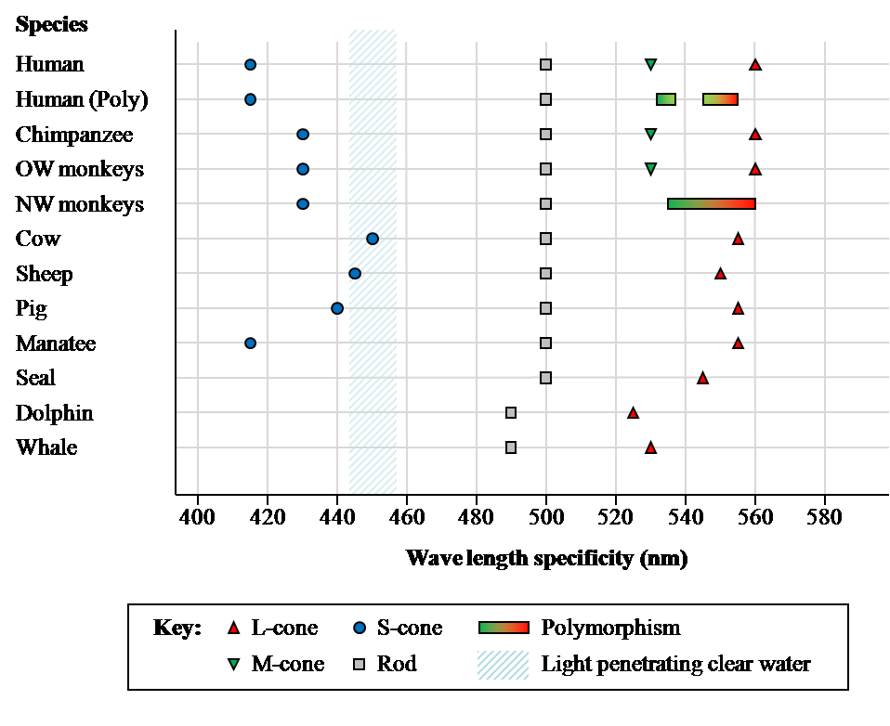
4. Reduced colour vision: matches best that of a shallow water diver
Species S Rod M L
(Di)
Chak BCW. 2013. Human aquatic color vision. Chapter 11 in eBook

Slide 21
5. Olfaction: strongly reduced – photic sneeze – external nose
Olfactory capacities of
Aquatic mammals (whales: olfactory bulb almost absent)
< Homo
< ½ of Pan, Gorilla
< other primates, tree dwellers, flying animals
< most land animals
Our very reduced sense of smell is
Not incompatible with a more aquatic past
Rather incompatible with open plain running past

Slide 22
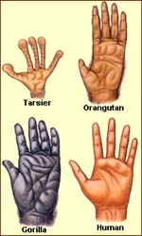
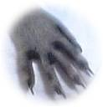
6. Manual dexterity & tactility + tool use
Raccoon
(Dutch: wash bear)
See video of macaque monkeys: diving and ‘fingering’ the bottom:
http://www.youtube.com/watch?v=9ObDgBLFo9w
Not incompatible with more aquatic past:
Manual dexterity in raccoons, sea otters
Tool use in many water-related behaviours: sea otter, capuchin monkey

Slide 23
7. Water and salt household: we waste water and salt
We produce unconcentrated urine: unlike terrestrial/savannah mammals
Species | millosmol/l | Niche
Beaver | 550 | Sweet water
Pig | 1100 | Marshes
Human | 1400 | ?
Dolphin | 1700 | Sea water
Cat | 3200 | Land
Cangooroo Rat | 4600 | Desert
2. We sweat twice as much as camels, 5 times as much as horses (per surface of skin)
Most land mammals do not sweat at all.
3. Land animals can drink large amounts of water at once
Humans need to drink often, but can take in only small amounts at the time

Slide 24
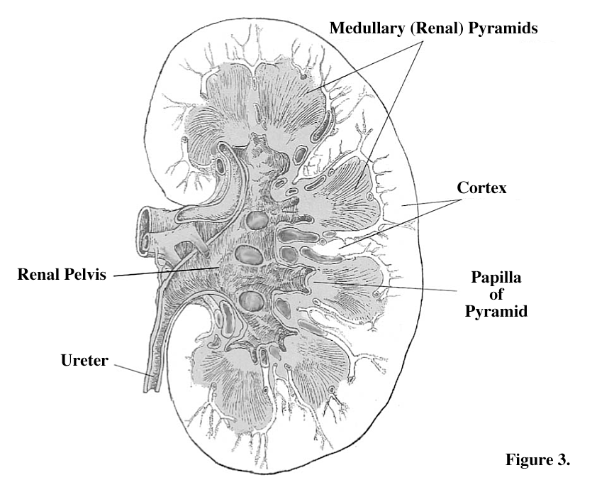
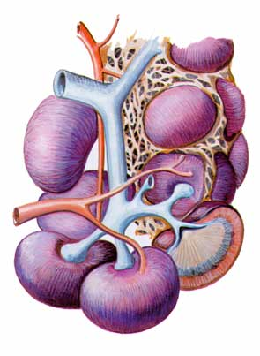
7. Water and salt household: we waste water and salt
We have multipyramidal kidneys, more like manatees than like apes
apes: unipyramidal kidneys
humans: 8-18 medullary pyramids
camels/manatees: 6-11 medullary pyramids
whales, dolphins: renculi: separate kidneys/hundreds of pyramids
Marcel F. Williams:
"I argue that evolution of renal medullary pyramids in mammals
is an adaptive response to diets with exceptionally high salt contents and
that the existence of multiple renal medullary pyramids in humans
was the result of specialized coastal marine adaptations in the human evolutionary past.“
Not incompatible with a more aquatic past
Apes
Camel/Manatee
Human
Dolphin
Williams MF. 2011. Marine adaptations in human kidneys. Chapter 8 in eBook.

Slide 25
7. Water and salt household: we waste water and salt
Sweating, crying and spitting
Sweating:
Our all-over-body-sweating may initially have served for removal of salt:
Salt content of sweat increases when eating more salt.
Secondary function (at land - after returning to land): cooling
Land mammals cool by panting,
which we can no longer do: as most aquatic mammals cannot.
Crying/dripping noses:
We are the only species with emotional tears: no explanation thus far.
Spitting:
We are the only species (except camelidae) that spits!!
We spit especially during exercise, and when salty sensation in mouth.
[Camels: drink brink water, eat halophytes: spitting is removal of salt?]
unconcentrated urination + sweating all over + spitting + crying = wasting water and salt.
Not incompatible with a more aquatic past
Very uncompatible with open plain running
Sweating for cooling: very uncompatible with open plain running
Notes:
Spitting is aggressive: idea came up in Honolulu at 01:27, October 26th 2012.
Adriaens. 2007.De uitgesproken aanwezigheid van zweetklieren zou dan het insulatieprobleem (ten gevolge van hypodermis (onderhuidse vetlaag) voor insulatie in water) kunnen opvangen als deze mensachtigen zich uit het water bevonden (en dus via zweten het lichaam koel konden houden).
Salt is recuperated in external channels of our eccrine glands, by inverted! CFTR channels. CFTR mutations, rendering the CFTR channel inactive, are frequent: homozygotes have cystic fibrosis or mucoviscidosis, with very salty sweat. Adaptation after returining to land?

Slide 26
8. Sexuality & Reproduction
Female humans are extremely special primates/mammals:
Low vaginal pH (pH = 4.5): unlike other mammals (pH = 6-7)
Hymen: not in chimps
Permanent labiae majores: not in chimps
Permanent breasts: not in any other mammal
Concealed ovulation: not in primates
Absence of placentophagy: unlike terrestrial mammals, absent in aquatics
Face-to-face mating: only in (semi-)aquatics and bonobo
Waterbirth?
Possible relation to aquatic past?
Absence of placentophagy: not incompatible with more aquatic past
Permanent breasts: very uncompatible with open plain running past
Odent M. 2011. Obstetrical implications of the Aquatic Ape Hypothesis. Chapter 9 in eBook.
Odent M. 2013. Pregnancy and neonates. This conference.

Slide 27
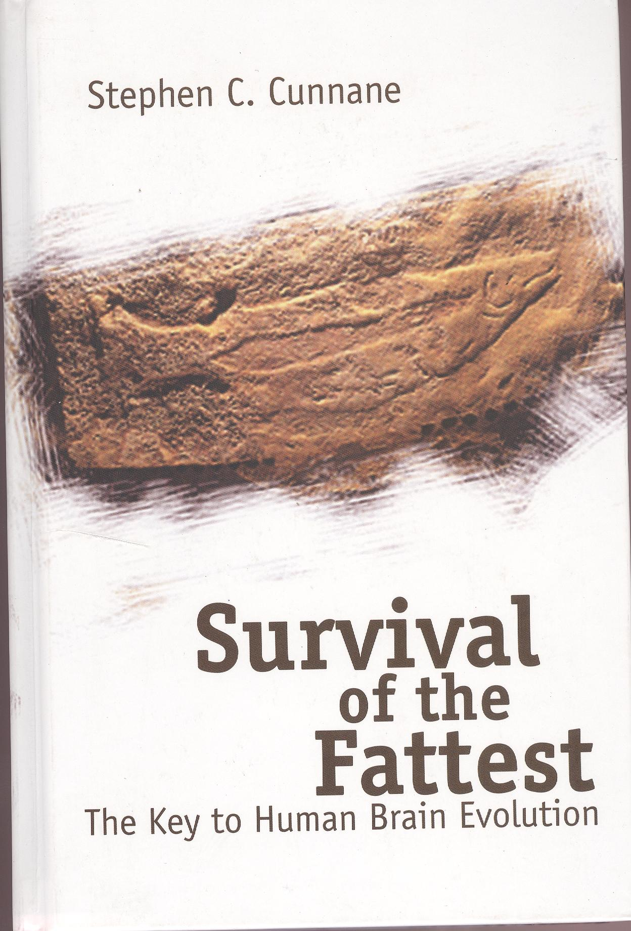
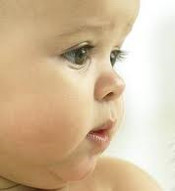
9. Large brains
Cunnane: Our neonates are extremely fat: essential for brain development
Fat neonates - Large brains - Need for ω3 fatty acids and iodine
Cunnane SC. 2005. Survival of the fattest. World Scientific, New Jersey
Cunnane SC. 2013. Survival of the fattest. This conference

Slide 28
9. Large brains
Major sources of omega 3 long chain fatty acids: seafood
Food source | Fat percentage | Arachidonic acid (AA) Omega 6 | Docosohexaonic acid (DHA) Omega 3
Game lean, < 4% fat
Wart hog |  | 8.5 | 0.6
African buffalo |  | 7 | 0.4
Zebra |  | 3.0 | 0.23
Antelope |  | 8 | 0.4
Kangaroo |  | 7.7 | 0.9
Kangaroo liver, 4% fat | 4 | 6.9 | 1.3
Sea birds
Penguin liver |  | 8.6 | 11.2
Emperor penguin egg yolk, 30-40% fat |  | 1.7 | 5.5
Emperor penguin, maternal blubber |  | 0.4 | 8.0
Temperate shell fish
Mussel (Mytilus spp.) | 1-3 | 2-4 | 6-14
Surf clam (Spisula spp.) | 1-3 | 4 | 11-12
Quahog clam^{d}, -1°C | 3 | 1.6 | 13.1
Fish
Sand smelt | 3.8 | 4.3 | 24.8
Whiting | 2.7 | 3.5 | 40.8
Australian barramundi | 0.3 | 14.5 | 16.2
Indian halibut | 1.7 | 6.3 | 10.4
Broadhurst CL, Crawford M. 2011. Chapter 2 in eBook. Compiled from Tables 1 and 2
Broadhurst CL. 2013. Exploitation of environmental resources. This conference.
Crawford M. 2013. Nutrition and development of the brain. This conference.

Slide 29
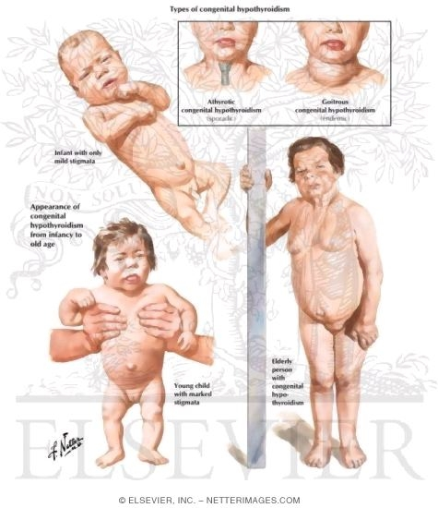
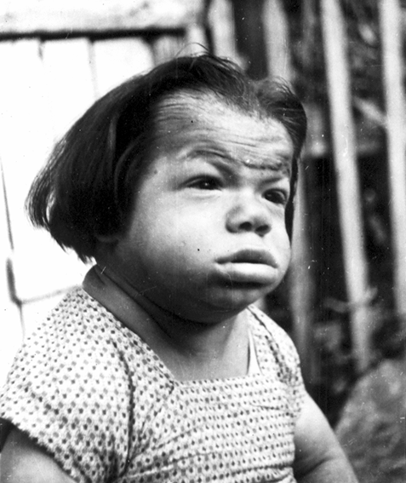
9. Large brains
Iodine
Are we now typically terrestrial?
we are still very dependent on omega3 LCFA and IODINE for normal brain development
Lack of iodine → cretinism. This is unexpected for a terrestrial species!
What are the sources of iodine?
Weight of food (grams) needed to meet daily iodine requirement
+ sea salt!: iodine rich

Slide 30
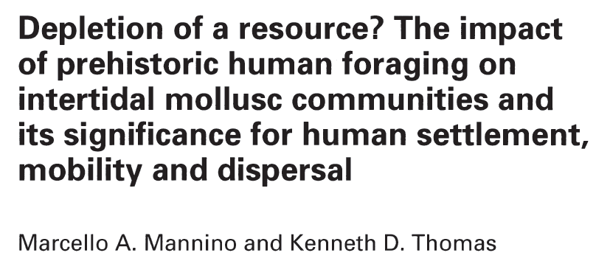
9. Large brains
Fossil evidence for large scale consumption of shell fish
Munro S. 2010. Molluscs as ecological indicators in palaeoanthropological contexts.
PhD Thesis: Australian National University. Canberra, Australia.
Munro S. 2013. The palaeoecology of human evolution. This conference.

Slide 31
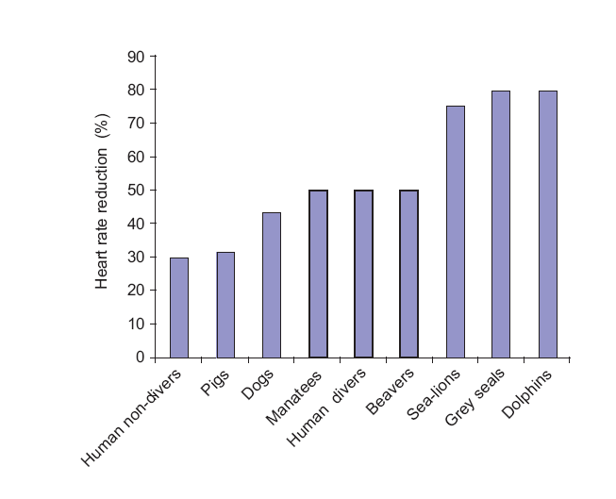
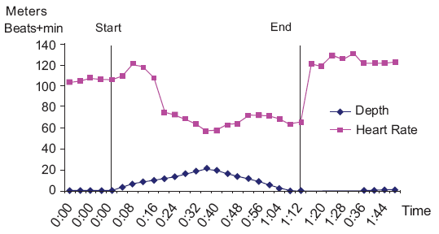
10. Cardiopulmonary system: Voluntary breath control/Diving reflex
1. Diving reflex
When our forehead touches water
+ sufficient temperature difference (= not necessarily cold water)
Heart rate reduction.
Of course, when we swim or dive as well.
/
(min:sec)
Schagatay E. 2011. Human breath-hold diving ability suggests a selective pressure for diving
during human evolution Chapter 7 in eBook.
Schagatay E. 2013. Human breath-hold diving ability. This conference.

Slide 32
10. Cardiopulmonary system: Voluntary breath control/Diving reflex
2. Autonomous (nose) & voluntary (mouth) breathing
Hominids (chimp, gorilla), terrestrial: autonomous breathing
Seals, semi-aquatics: both autonomous and voluntary breathing
Humans: both autonomous and voluntary breathing
Dolphins, whales, aquatic: only voluntary breathing
Aquatic explanation for voluntary breathing?
holding breath under water
breathing extra deep before diving
breathing faster after dive
Not incompatible with a more aquatic past
Not explained by an open plain running past
Verhaegen M. 1997. In den beginne was het water.
Schagatay E. 2011. Human breath-hold diving ability suggests a selective pressure for diving
during human evolution Chapter 7 in eBook.

Slide 33
10. Cardiopulmonary system: Voluntary breath control/Diving reflex
3. Only humans among primates have external countercurrent venes
→ Heating of the blood flowing back to the heart: heat exchange systems
→ [Cause of varices]
Also in water birds (gulls) and in flippers of some seals:
Odd!
Not incompatible with a more aquatic past
Not explained by a running over open plains past
Verhaegen M. 1997. In den beginne was het water.

Slide 34
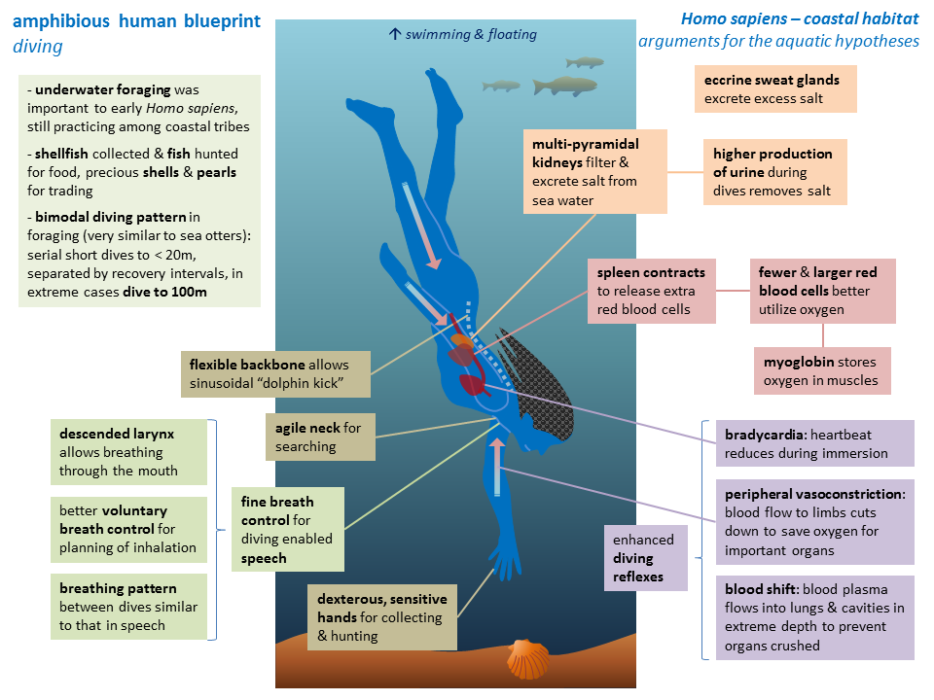
Conclusion
Our species is characterized by a long list of unique,
and frequently very unusual characteristics among (terrestrial) mammals
Most are not incompatible with a more aquatic past
and many are also found in extant (semi-) aquatic animals/mammals
Several are very incompatible with a past as a long distance runner over open plains
There are many more odd features …
that are not incompatible with a more aquatic past:
Closing of nostrils with philtrum in upper lip, fitting the nose septum
Spleen contraction: extra RBCs during dive
Sinuses
Ear exostoses
Paddle like feet
Webbed digits
Pachyosteosclerosis in archaic Homo
See Poster of Bert Chan Wang Chak

Slide 35
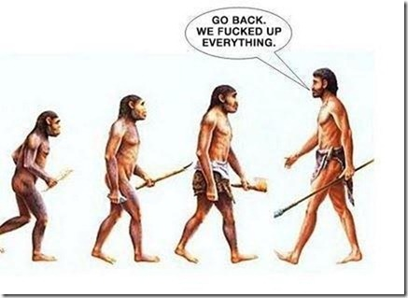

Slide 36
Was Man more aquatic in the past?
Slides available at:
http://users.ugent.be/~mvaneech/Index.html
Mario Vaneechoutte
Marc Verhaegen
The people along the sand
All turn and look one way
They turn their back to the land
They look at the sea all day
Robert Frost
Quoted by Elaine Morgan. 1997. AAH

